Slide 1
SAND WITH HIGH SILICA CONTENT
From
Myanmar

Slide 2
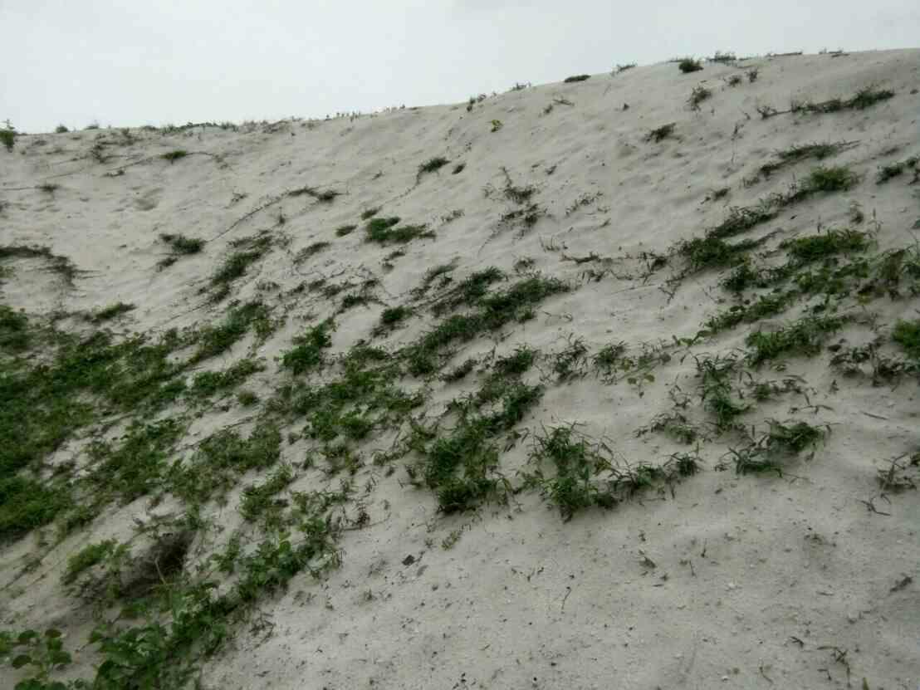
Sand with high silica content from Myanmar

Slide 3
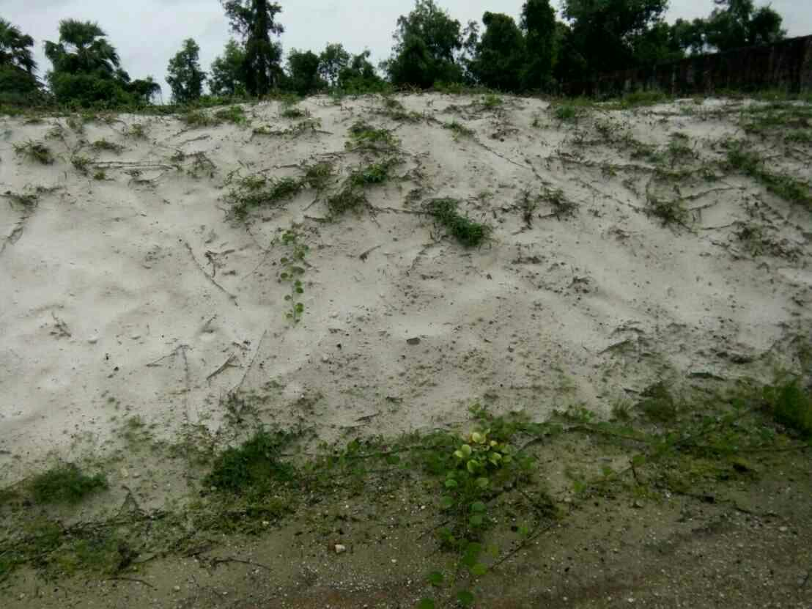
Sand with high silica content from Myanmar

Slide 4
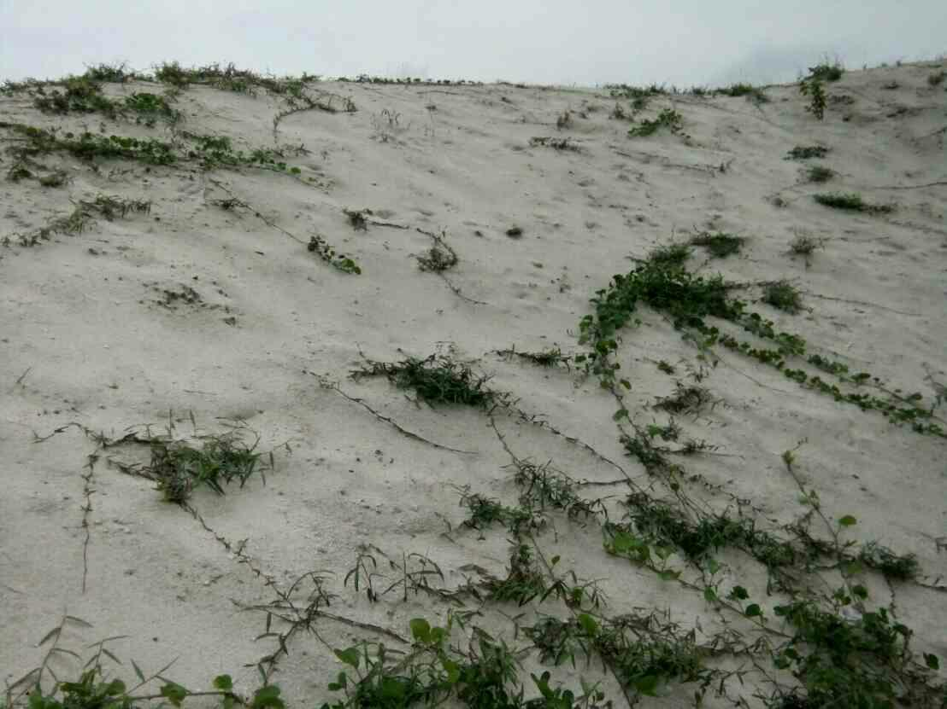
Sand with high silica content from Myanmar

Slide 5
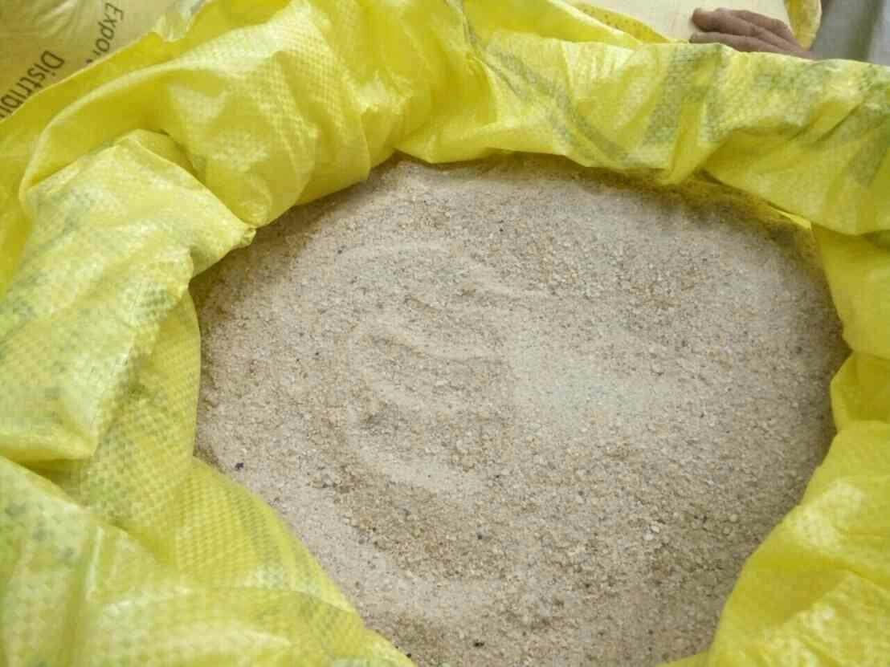
Sand with high silica content from Myanmar

Slide 6
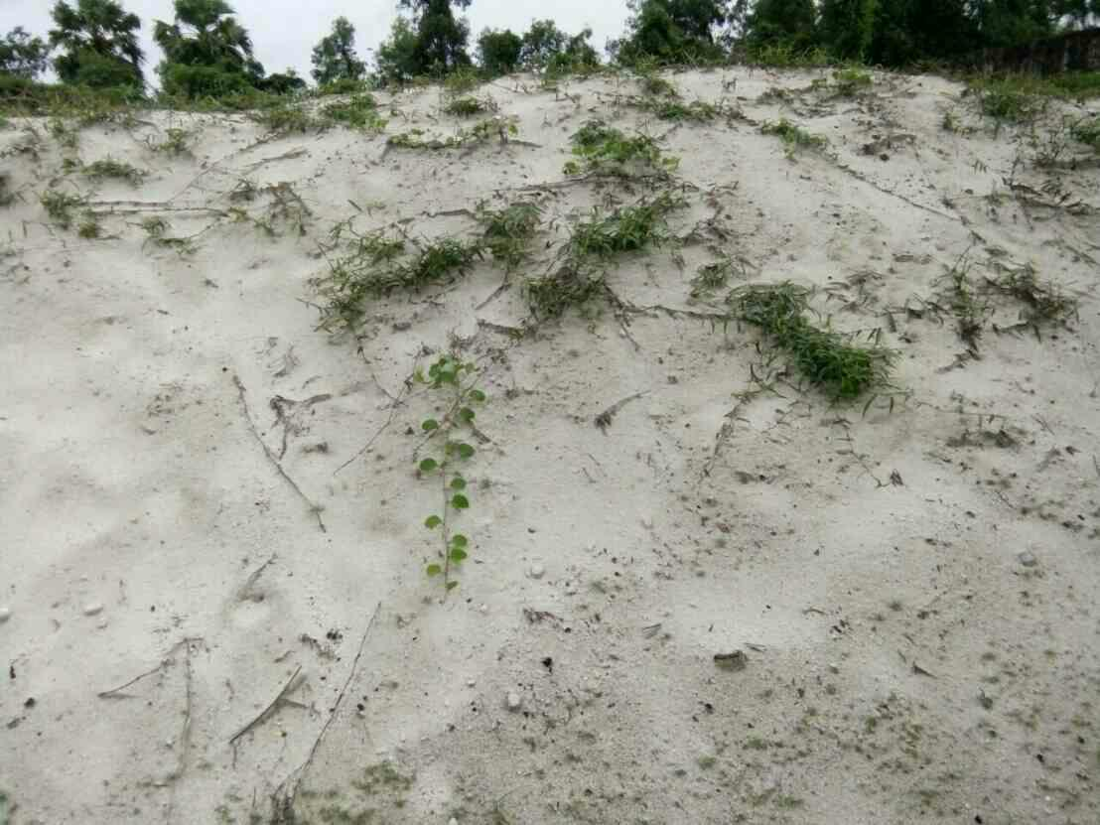
Sand with high silica content from Myanmar

Slide 7
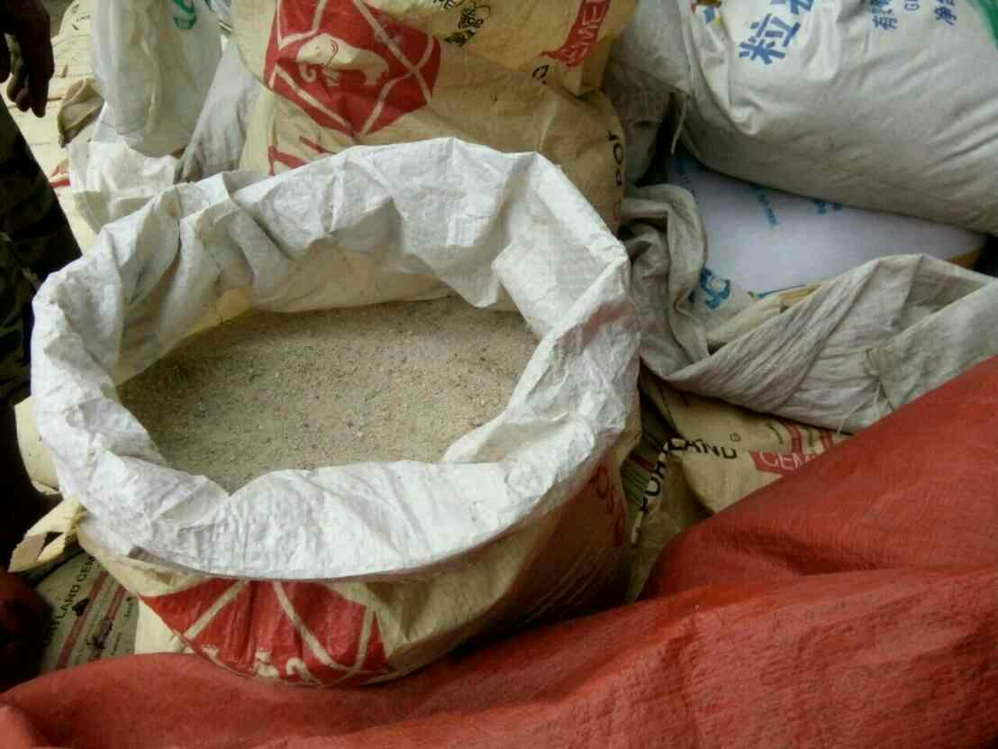
Sand with high silica content from Myanmar

Slide 8
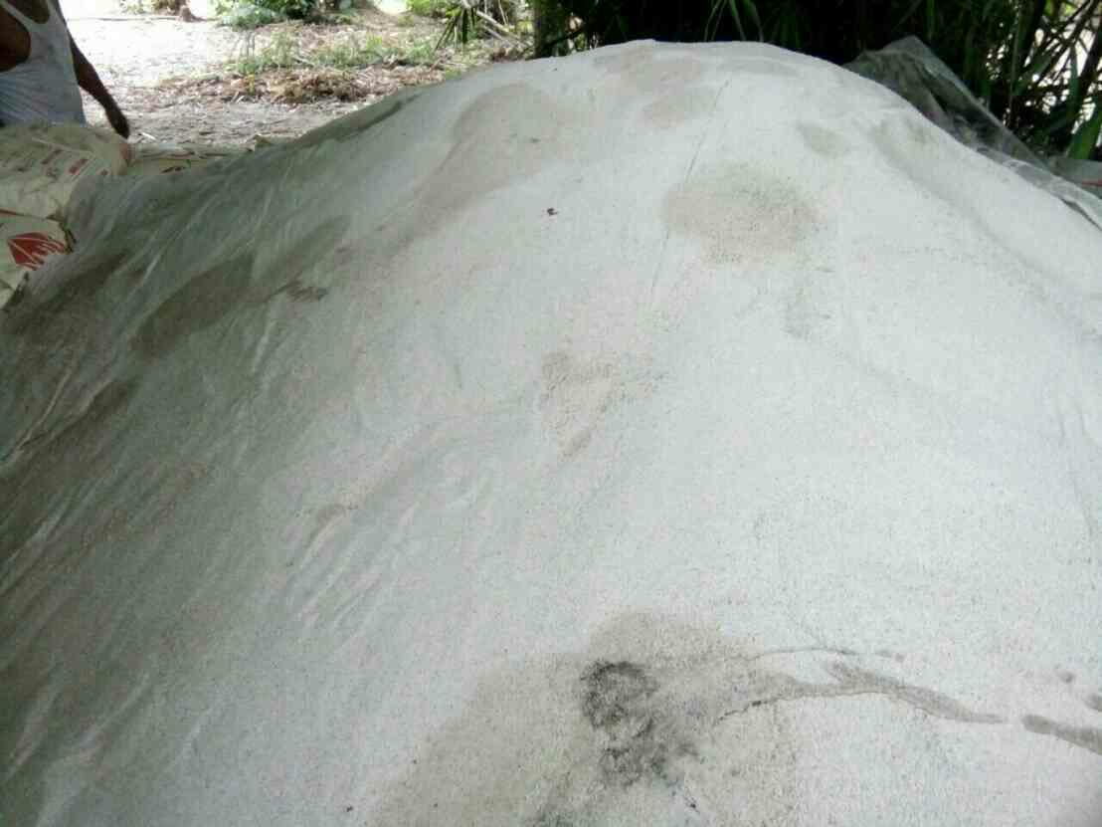
Sand with high silica content from Myanmar

Slide 9
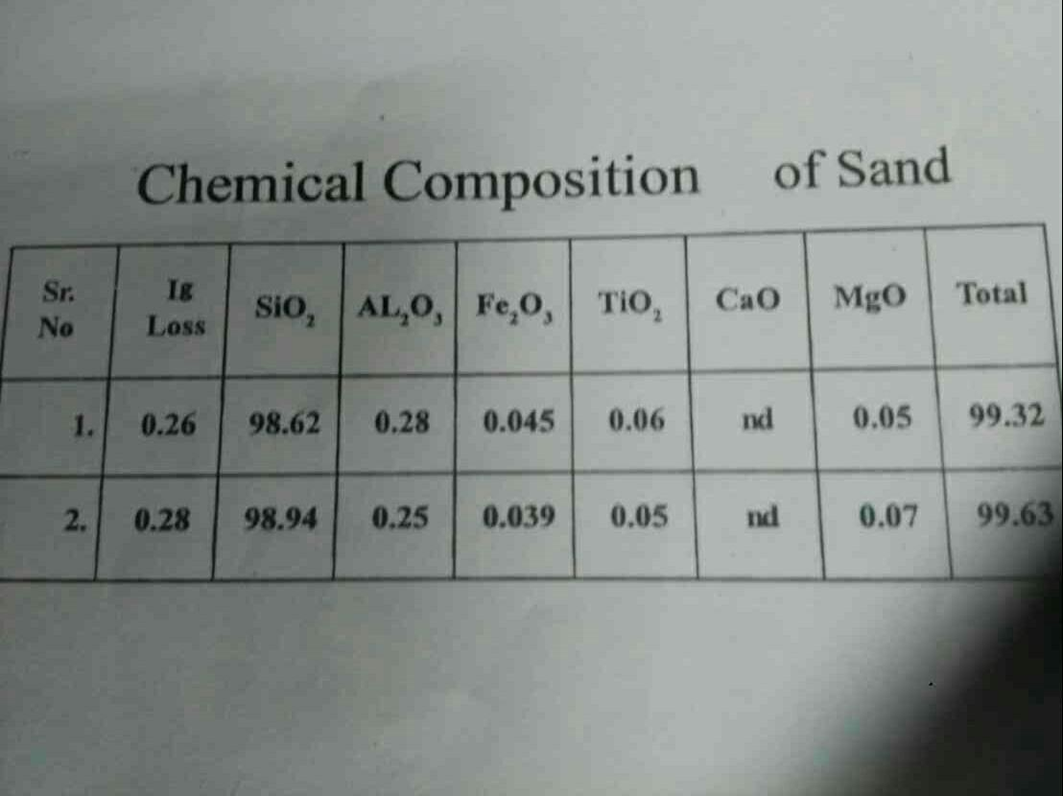
Sand with high silica content from Myanmar

Slide 10
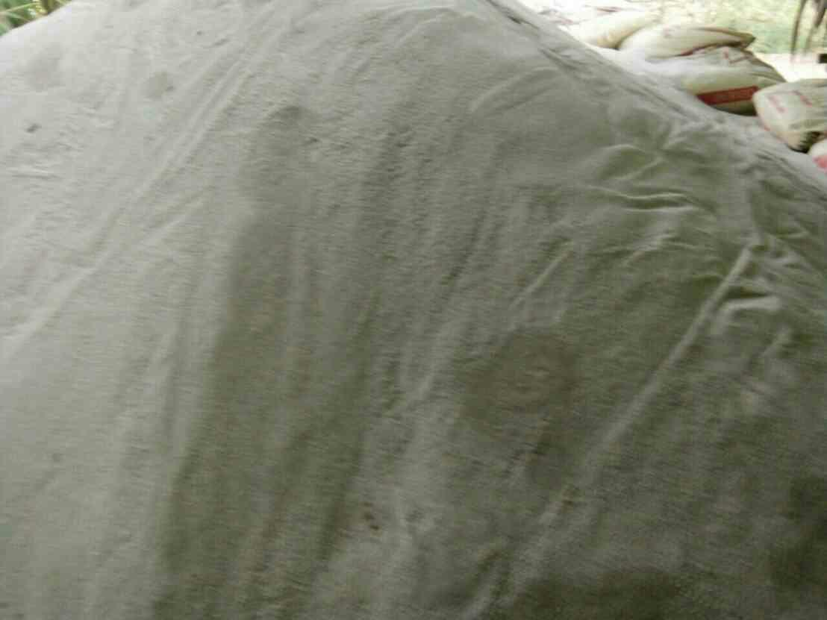
Sand with high silica content from Myanmar

Slide 11
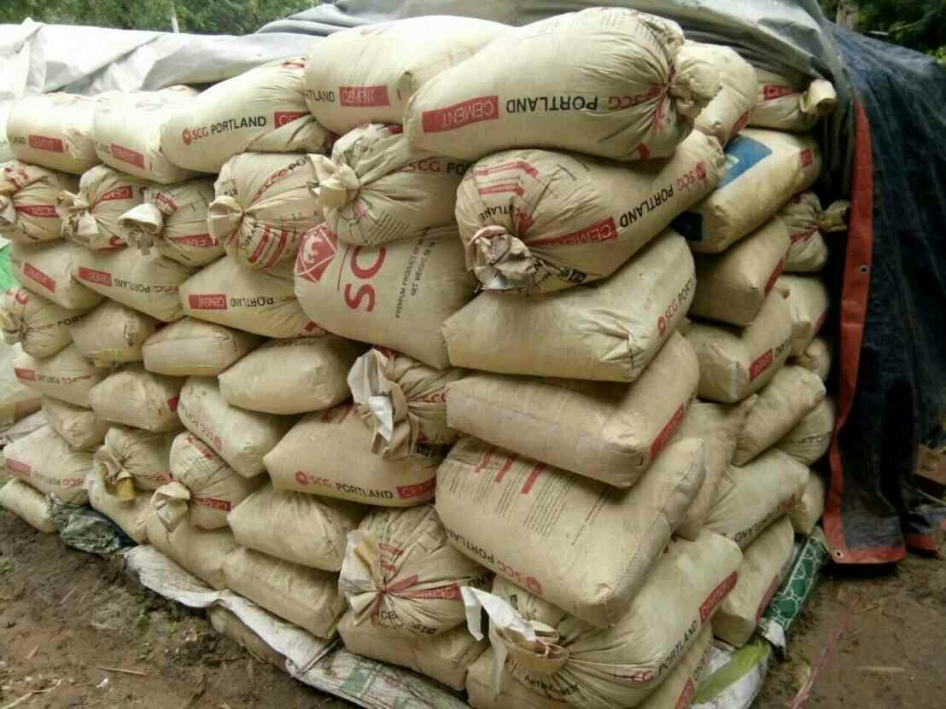
Sand with high silica content from Myanmar

Slide 12
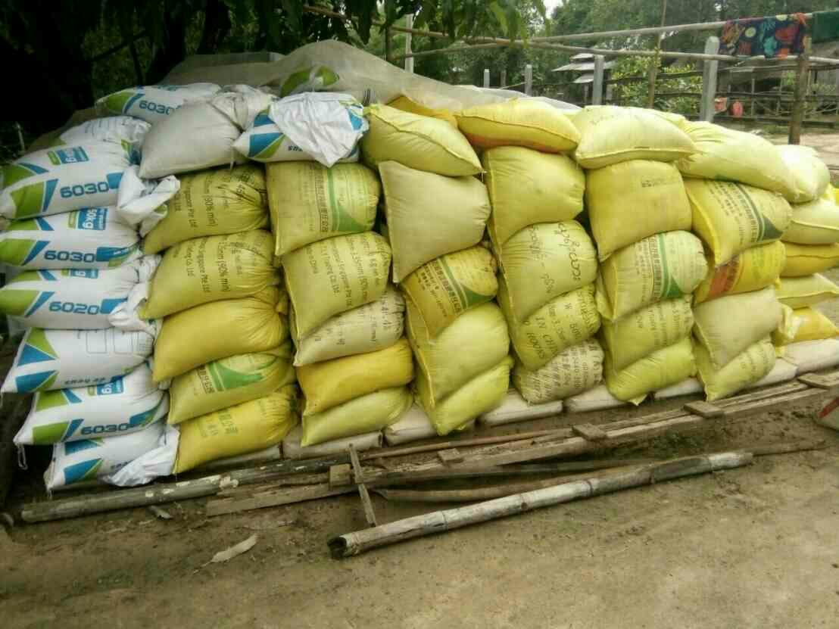
Sand with high silica content from Myanmar

Slide 13
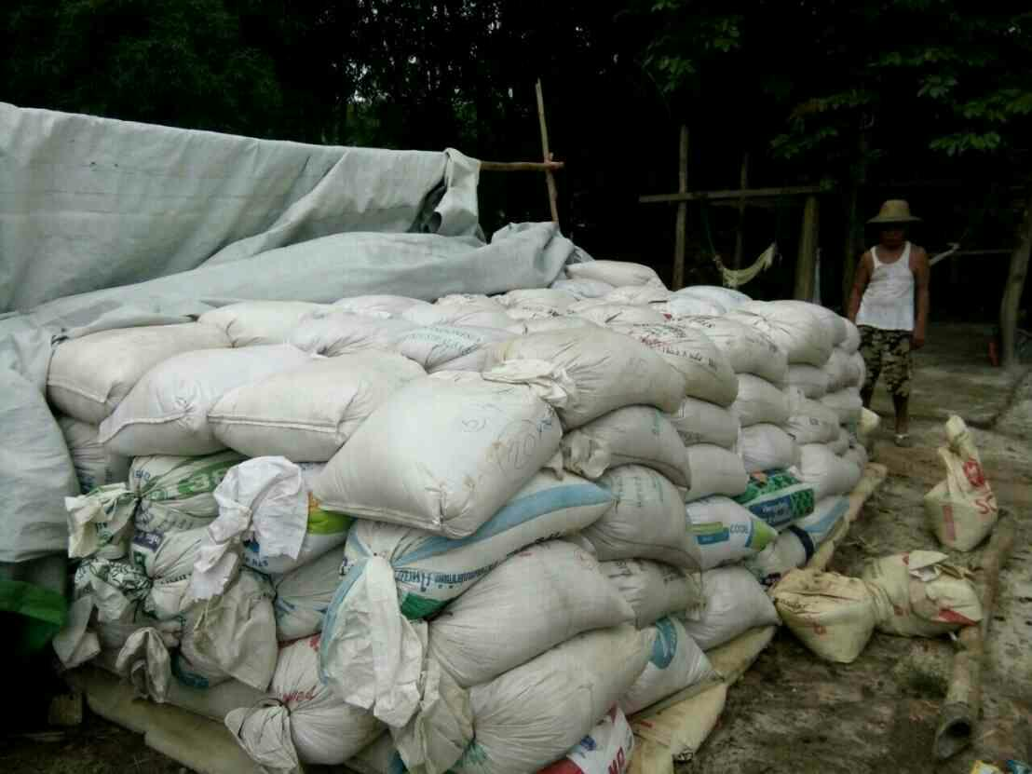
Sand with high silica content from Myanmar

Slide 14
Sand with high silica content from Myanmar

