Slide 1
MILK POWDER & MILK TABLETS
Made in thailand

Slide 2
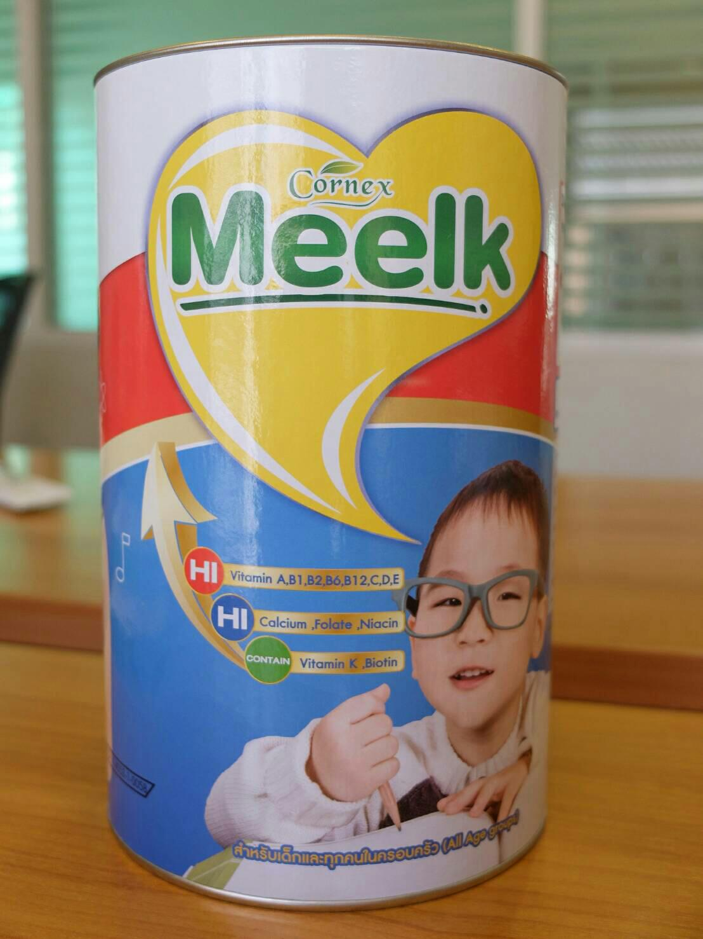
Milk powder
There are 900 grams in one tin can.
There are 9 tin cans in one shipping paper carton
There are 650 cartons in one full container load.
Total 5,850 cans in one container.

Slide 3
Price
$ 5.95 /can where $ 1 = 35 thai baht)
the price is Fob bangkok port
term of payment is Transferable l/c
voulme discount is POSSIBLE
own brand is POSSIBLE.

Slide 4
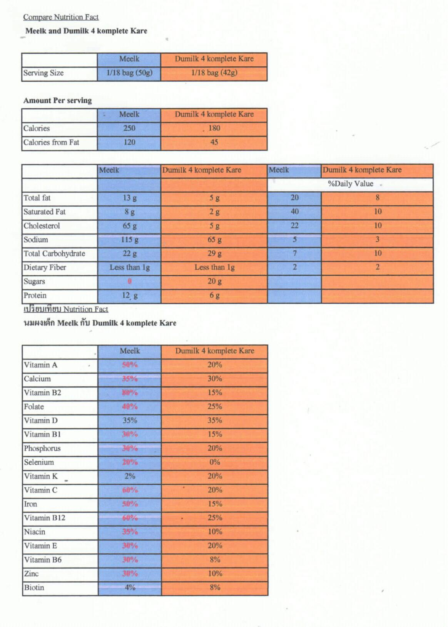
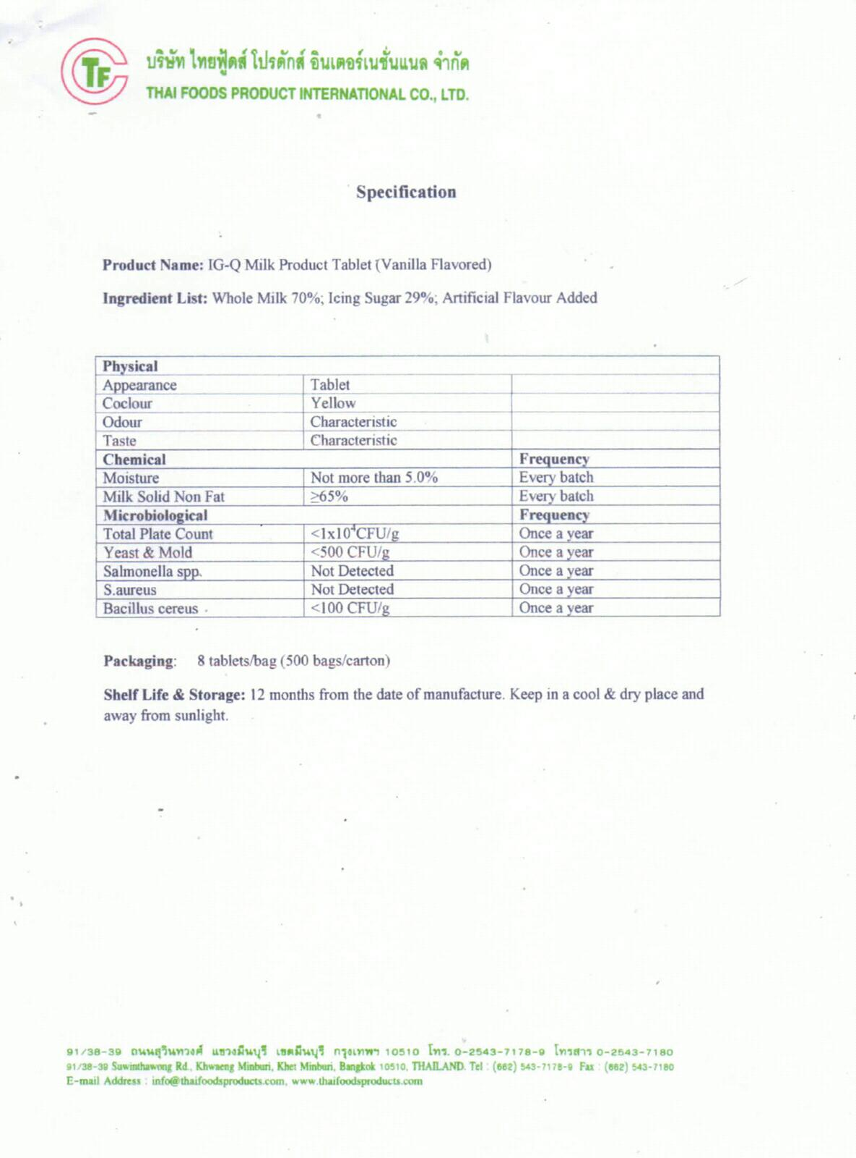
Specification

Slide 5
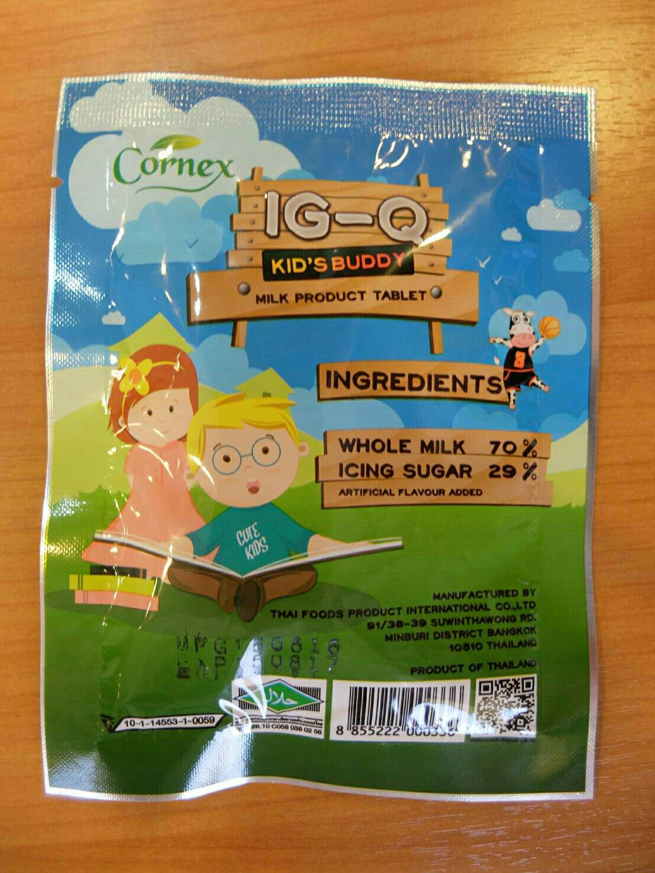
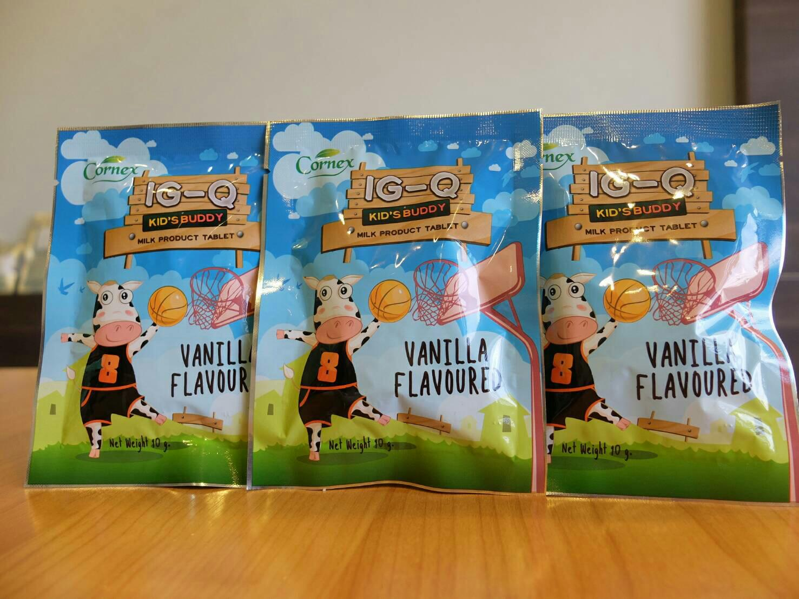
Milk tablets

Slide 6
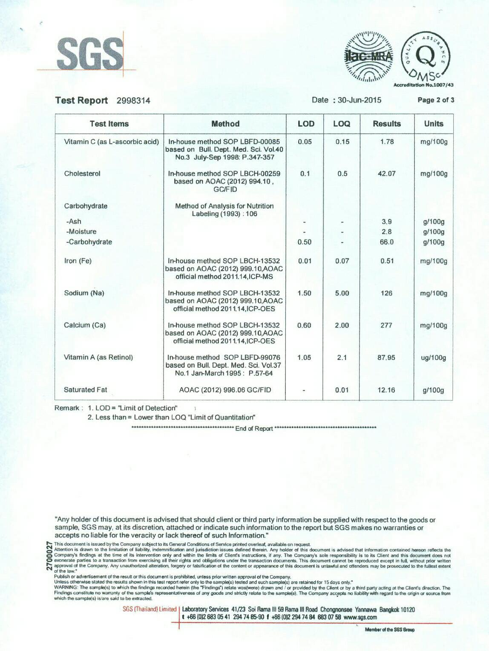
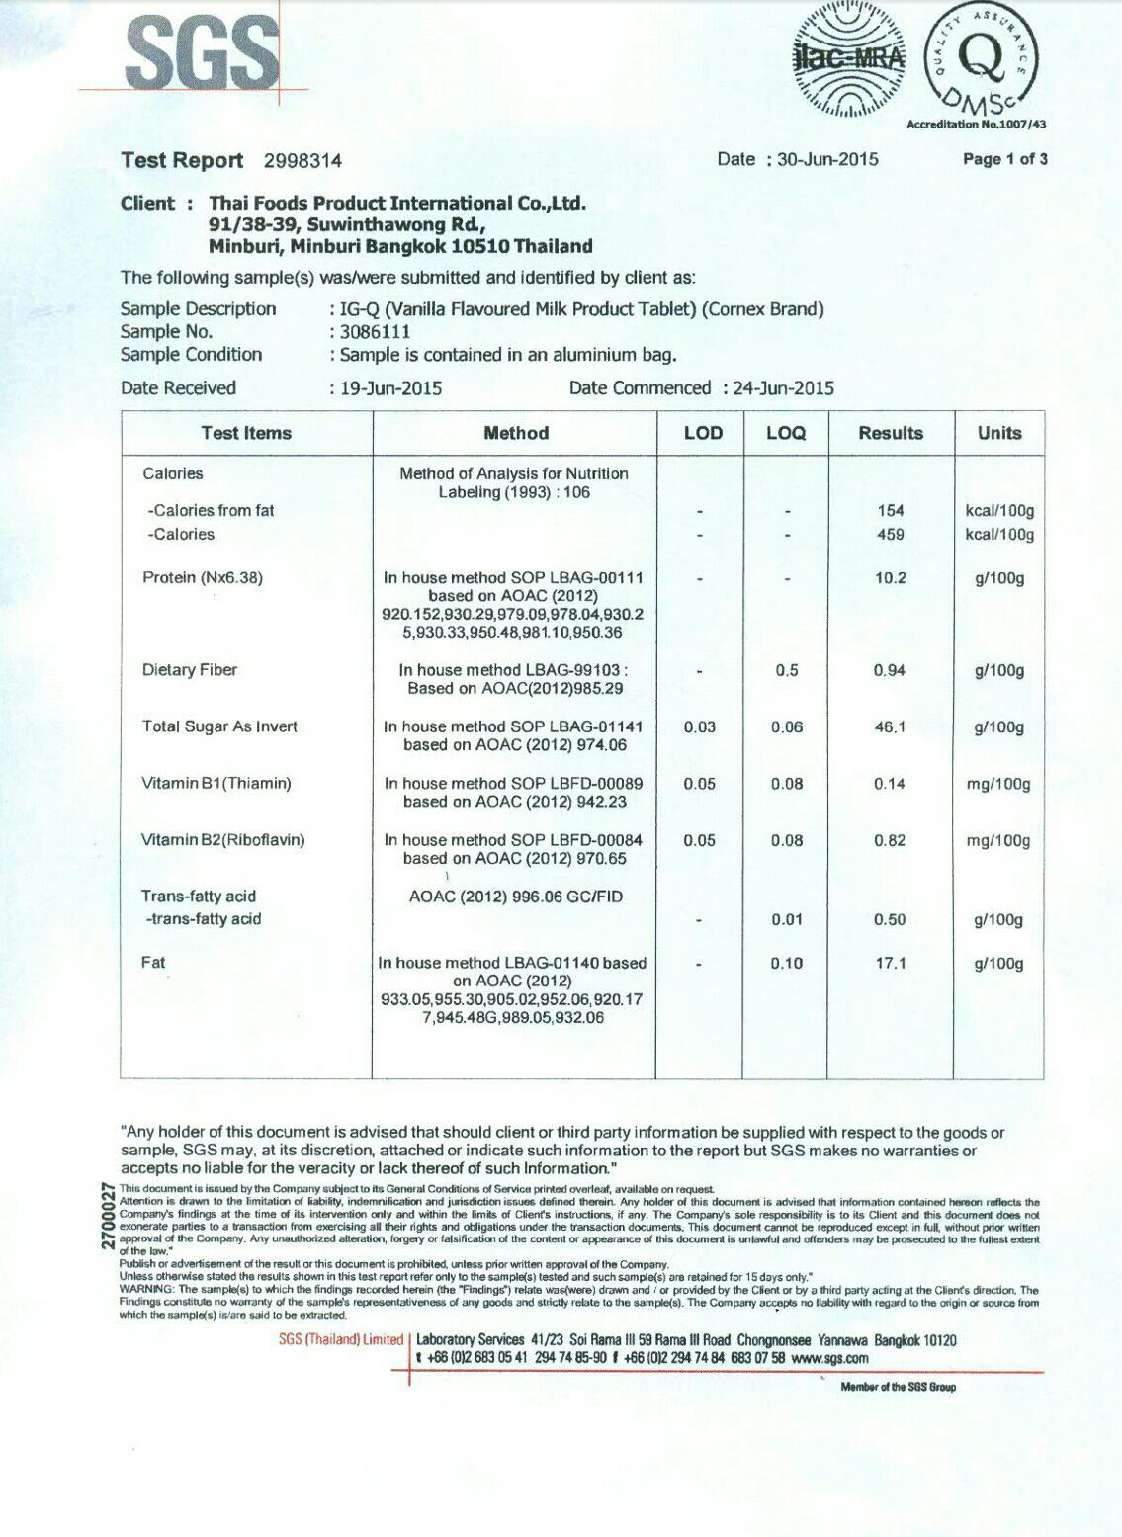
Specification

Slide 7
Price
Available in vanila and chocolate flavours
There are 20 grams in one pack
the cost is $0.27 where $ 1 = Thai baht 35)
term of payment TRANSFERABLE l/c
own brand and volume discount are negotiable

