Slide 1


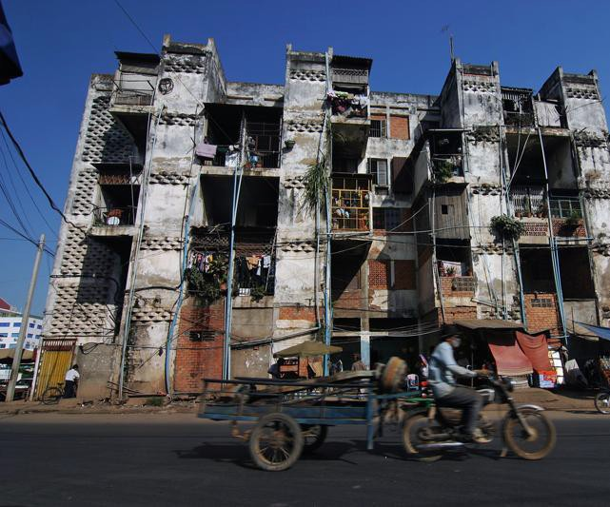


Slide 2

_{T}he explosive appreciation in housing prices from the mid 2000s to now created
significant wealth for people fortunate enough to own their own home.
In many markets, double-digit appreciation year after year created home equity that homeowners tapped to pay off other debt, remodel their homes, take vacations, and buy new cars. By around 2017, housing price appreciation had slowed to more traditional rates, but home prices remained high in t h e P h n o m P e n h markets. Over the same period, incomes were more or less stagnant, taking medium-price housing out of the range of medium-income households.
Several other factors combined to create what could be described as an affordable housing crisis in many areas on Phnom Penh. First, resources for the support of affordable housing became more limited with the continuing decentralization housing programs to the city limits. Secondly, many affordable housing units were lost to preferred uses (the conversion of subsidized developments to market-rate housing and condominiums ), the conversion of affordable rental developments to condominiums, and demolition. The growing local community opposition to any new development has also played a role in that it tends to focus particularly on multifamily housing, which can be more affordable than single-family housing, and on affordable housing developments with public subsidies.
The convergence of these trends has limited the housing options of many people with low and moderate incomes. Many are forced to pay a larger and larger share of their income for housing; to crowd into shared apartments, townhouses, or single- family homes; or to find housing in distant suburbs located far from their jobs.
Some are forced to combine all three options—to pay a lot to live in a crowded house in exurbia and creating massive peek hour traffic jams some forced to travel in backs of open trucks and over crowed vans and old buses.
It doesn’t have to be this way.
Communities can support the development of housing for people and families at a variety of income levels. And they should, in fact, because doing so makes sense from an economic development perspective. The availability of decent housing that is close to work and affordable for the jobholders upon which the proper functioning of the local economy depends is essential to the community’s economic health.
All communities need teachers, firefighters, police officers, municipal employees, health care workers, contractors, landscapers, and retail salespersons, to list just a few essential service workers. Unfortunately, many communities fail to ensure that such workers have safe, affordable housing opportunities within a reasonable distance from their work. The residents of many of these communities not only passively accept this reality, but also actively oppose proposals to provide such housing

Slide 3
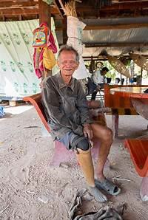

The opposition to local development of affordable housing may not serve the self-interest they believe they are protecting.
It is not only a community’s essential service workers who stand in need of afford- able housing. The market for affordable housing is diverse and does not correspond with many people’s outdated stereotypes about who lives in affordable housing. People in all stages of the life cycle need such housing. The adult children of community residents who are just starting out in their careers need affordable housing options. The parents of residents, who may be on a fixed income, might need low- maintenance, affordable housing. Disabled people, including war veterans who suffered injuries that have affected their ability to work, need and deserve safe and affordable housing
.

Slide 4
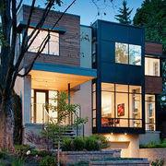
The Principles for Developing Affordable Housing seek to help those who wish to develop housing for low- and moderate-income households understand what it takes to make affordable housing projects happen. It also seeks to help policy makers and community leaders understand the principles behind the production of affordable housing. It is hoped that this understanding will lead to the creation of effective affordable housing policies and programs and to the fostering of a climate that is more supportive of the development of affordable housing.
Professionals with diverse and deep experience in the field of affordable housing participated in the identification of the principles outlined here for this unique parcel of 99 hectares of land now available to us at an affordable price.
This overview we hope, succinctly summarizes the knowledge and experience of the person who created it. We further hope that it will encourage financial interest from investors in the purchase of the property ideally situated for this purpose and the development of more affordable housing as part of localities’ efforts to achieve balanced, healthy, and sustainable communities.
Strong and creative leadership is necessary to successfully engage the public and surmount obstacles encountered in the course of developing affordable housing. People leading the effort to develop affordable housing will see the problem, dream of something better, and exhibit the passion and persistence needed to overcome barriers and achieve results. And they must inspire elected officials and community advocates to help lead the effort.
While leadership is essential for many endeavors, it is particularly important for developing affordable housing because of the length and complexity of the development process. It needs to address two great challenges: defining the problem and creating solutions. Affordable housing leaders must make the case for the importance of affordable housing to a community and they must also create and articulate a compelling vision for solutions to the lack of affordable housing.
Affordable housing efforts may get lost among competing needs in a community, particularly when resources are limited. Affordable housing needs the attention n and funding it deserves from local investors /bank.
Be inspired by past proof we do not have to reinvent the wheel

Slide 5

The I. Donald Terner Prize
Don Terner was an inspirational and inno- vative leader within the affordable hous- ing industry. As one of the founders of BRIDGE Housing Corporation, Don set out to prove that entrepreneurial builders can make a difference by succeeding where others had failed.
The success of BRIDGE stands as an enduring symbol of how one person’s vision can change the world.
Ten years after Don’s untimely death in a plane crash while on a humanitarian mission in Bosnia, the University of California at Berkeley’s Center for Community Innovation inaugurated the Terner Prize for Innovation and Leadership in Affordable Housing to honor his vision.
The 2006 recipient was 8NW8, a project in Portland, Oregon, that was developed by Central City Concern and designed by SERA Architects, both of Portland. For more information on the Terner Prize see http://iurd.ced.berkeley. edu/cci/ternerprize/index.html.
Don Terner with South African leader
Nelson Mandela.

Slide 6
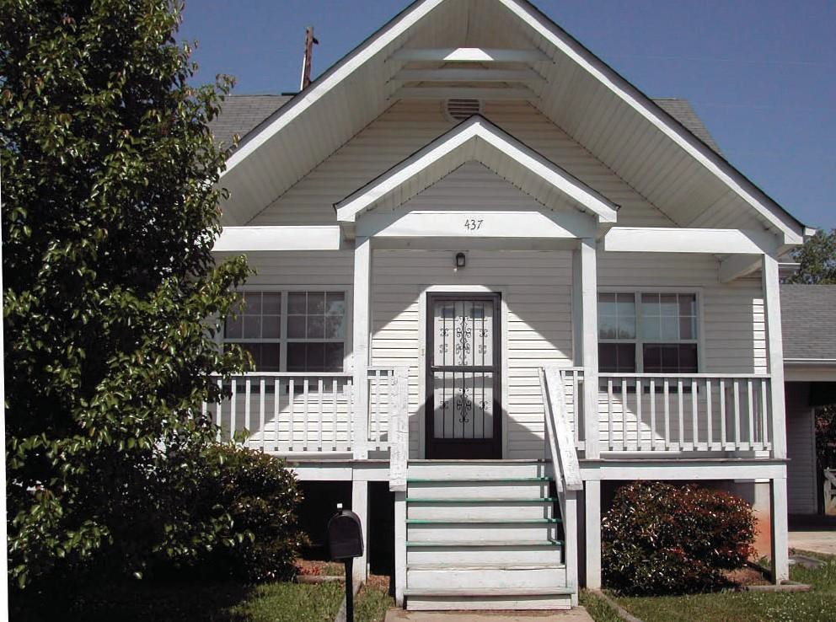
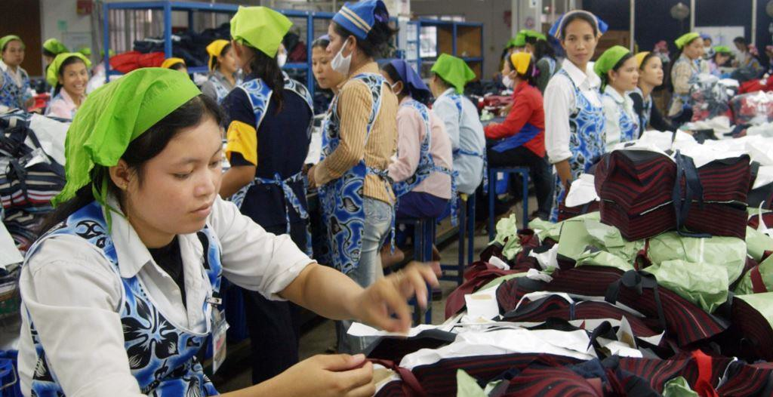
Orchard Village in Chattanooga, Tennessee, provides affordable for-sale housing to very low- to moderate-income families and seniors. The community received a ULI Award for Excellence. Proving low cost housing doesn’t need to be ugly nor create ghettos
Much of the public resistance to affordable housing stems from misperceptions about who will live in it. Often the ugliest negative stereotypes that are invoked by opponents need to be combated by telling the truth about the makeup of the market for affordable housing. This market comprises a broad spectrum of individuals and families that may include elderly couples on a fixed income, working families, and singles starting out in careers. Even the children or the parents of people living in the community may need affordable housing.
Having a variety of housing opportunities makes a community dynamic, lively, and, most importantly, sustainable. A mix of housing opportunities that accommodates a demographically diverse population helps to create a sustainable community, a com- munity with income and age diversity.

Slide 7
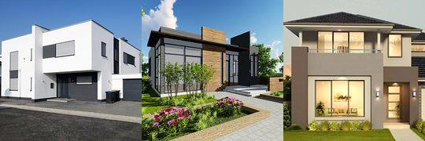
Housing that is affordable to working families and close to their places of employ- ment is a critical component of a region’s economic health. Workers who must com- mute long distances because they cannot find affordable housing close to their jobs spend an excessive amount of time on the roadways that could be spent at work, and are thereby less productive and more frustrated.
While one great challenge for affordable housing leaders is making the case for affordable housing in general, the other is creating and supporting more specific solutions. It may not be difficult to reach a consensus on the finding that housing affordability is a major problem; but a consensus on how to solve the problem may prove to be more difficult. A unique opportunity is at hand to purchase almost 100 hectares of affordable property ideally situated for the low income workers working in the immediate area .

Slide 8
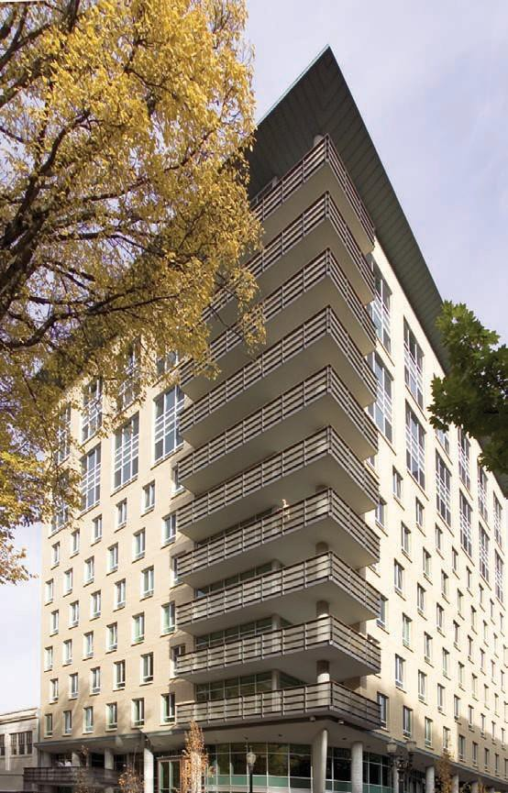
Oftentimes, opponents of an affordable housing development will underestimate the value that diversity and affordability can bring to a community while they overestimate the negative impacts of the proposed housing.
What they want is higher property values, secure neighborhoods, or less traffic congestion— which may not follow from the course of action, or inaction, they propose. To keep building middle class and high end condominiums ids already proving unviable as a high percentage remain unoccupied.
In fact, a community’s accomplishment of a coherent vision of diversity and affordability could produce a better outcome on property values, security, and traffic than would the rejection of the vision.
To effectively challenge opponents directly and in a principled way, that is, based on a vision of a balanced, sustainable com- munity, affordable housing developers and investors must align themselves with leaders in the community who can provide support at critical times. While, on one level, affordable housing leaders are fighting for the construction of affordable homes, ultimately they are arguing for larger concepts and ideas relating to fairness and equity. Leadership informed by principles of community will inspire community advocates to act and to lead. The broader community support and trust that can be engendered by principled leadership is crucial to the success of affordable housing development.
2007 Terner Prize winner.

Slide 9
Build Community Support and investors Trust
Two key developer qualities— dedication to quality and open communication— facilitate collaboration and consensus as well as understanding and trust.
Building community support and trust begins with clear and open communication with everyone from the highest elected officials to the neighbors of the proposed development. A fair and open planning and design process allows all interested parties to be heard, and builds a foundation of partnership and shared goals in the community before decisions are made and implemented.
Developers and the investors can also foster support and trust by a demonstrated long-term commitment to excellence, value, and good design, as well as dedication to active management and maintenance.
Full, direct, and proactive communication in partnership with local government must be part of the process from the beginning. One of the first steps is to explain the benefits of—or establish the need for—affordable housing. Residents of a community may have a general sense that the lack of affordable housing is a problem, but they often do not fully grasp the connection between a community’s affordable housing and its economic health. Affordable housing leaders need to quantify the problem and present the possible economic repercussions of inaction. They should point out that affordable housing allows communities to attract and retain essential workers such as teachers, police officers, firefighters, and service workers; and that the relationship between jobs and housing also affects traffic congestion. Workers who are forced to travel long distances to find affordable housing not only spend disproportionately on transportation, but also contribute to regional traffic congestion. Pushing affordable housing farther and farther from employment centers only worsens traffic congestion.
Government and the business community can help in this process of education, con- firming the need for affordable housing and the economic impact of losing workers who cannot afford to live in the community. Developers can then connect the need to a housing product that working families can afford.

Slide 10
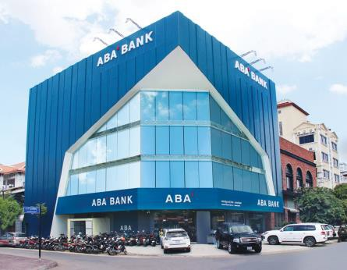
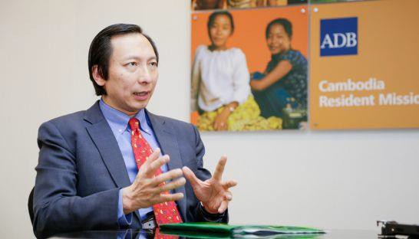
The communication and community feedback process for earning community support and trust can make use of a combination of traditional and innovative techniques, such as:
Internet sites that show images of proposed design ret to own program in conjunction with banks such as ABA and l oca l g a r me n t m a nu f ac t u re r s t h a t h i r e t h e m aj o ri ty o f t h e w o r ks i n th e im m ed ia t e v ici ni ty announce the dates and show houses and h old events related to the project;
.
Rules for building community support and investor trust include the following:
Nurture partnerships involving the private sector, government, investors and the broader community.
Establish a process that allows investors ideas to be heard, thereby informing and reinforcing decisions that guide housing decisions.
Ensure that all investors remain fully informed of progress.
Be proactive about informing the p o t e n t i a l community.
Make only promises that can be kept.
Create fantastic common areas for families

Slide 11
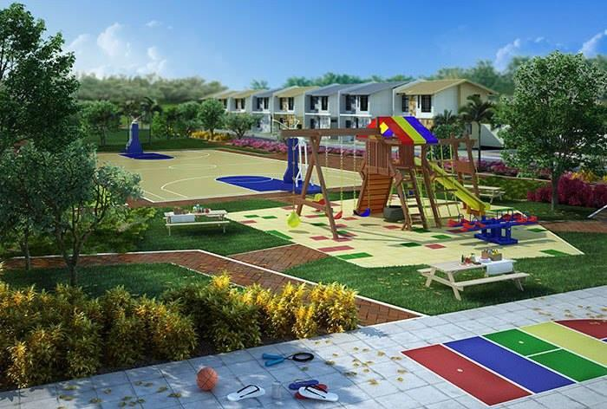

Slide 12
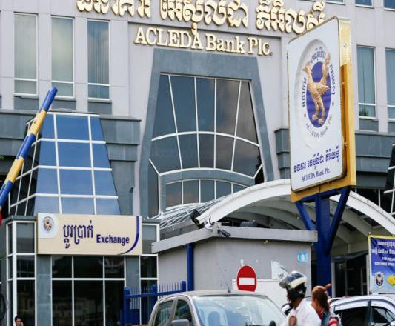
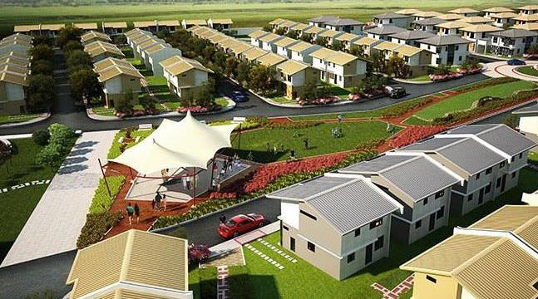
Financing options for affordable housing are an alphabet soup of loans, grants, and various other programs containing numerous qualifications and restrictions. Developing affordable housing requires in-depth knowledge of these options as well as the ability to stitch a number of them together seamlessly to create a development proposal that pencils out financially. Knowing the myriad funding sources and how to put them together to make a deal work is the art of affordable housing.
LIHTC low-income housing rent to own should attract numerous financing and incentive programs as well, including housing trust funds starting with banks such as Asian Development bank. While affordable housing projects generally need various funding sources, the expected commitments and reporting obligations of the programs vary, further adding to the complexity of developing affordable housing. Knowing these programs and their parameters is the first step in establishing long- term financial success.
Affordable housing developers are often constrained on sev- eral levels by both lending and program requirements. Lenders require covenants that ensure timely payments, establish reserves, and main- tain various metrics (such as loan-to-value ratio and debt service coverage ratio). Fur- ther, sale and rental rates as well as a host of maintenance and public service issues are restricted or mandated by pro- gram requirements.
Because of the many con- straints on affordable housing, underwriting is done with a careful eye toward established operating cost percentages derived from comparable nearby properties.

Slide 13
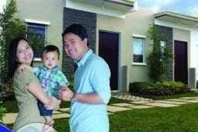
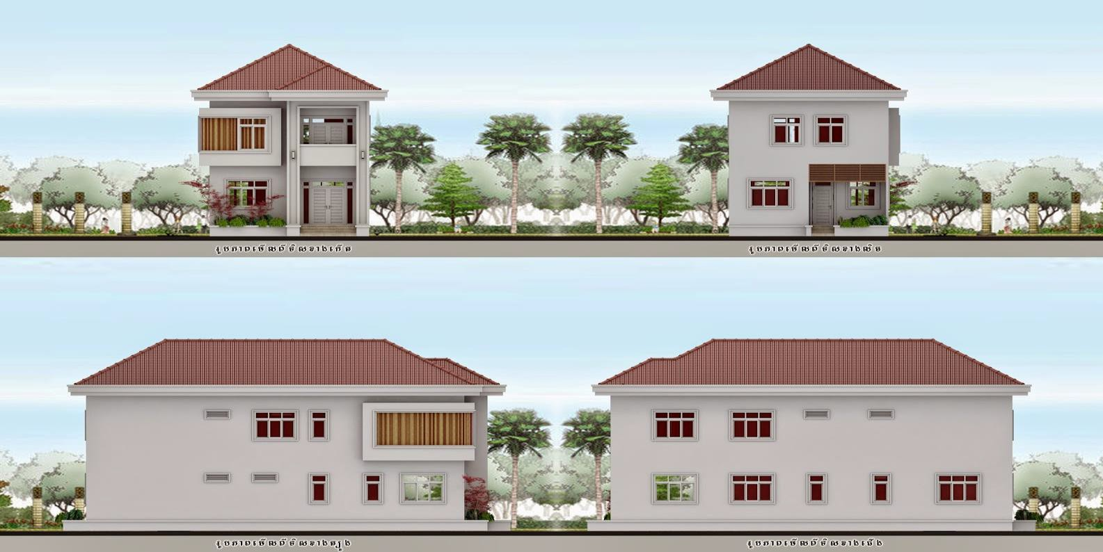
The Low-Income Housing Tax Credit
We should approach the Cambodia Government for a A low-income housing tax credit (LIHTC) this could represent a major source of funding for much of the affordable housing that is being planned.
general idea of how LIHTC program works.
Tax credits could be awarded for qualified costs for a period of ten years. Developers typically “sell” the tax credits by entering into limited part- nerships with an investor. Almost all investors in the tax credits are corpora- tions, because current tax law makes these credits less valuable to individual taxpayers. Through the syndication process the tax credits are “converted” to equity for the developer at a rate of 85 to 95 cents on the dollar (discount- ing future dollars). The investor gets tax shelter while the developer gets much- needed equity to finance the construc- tion of the affordable units.
All applications must meet one of two criteria: either 20 per- cent of the units must be reserved for households making less than 50 percent of the area median gross income, or at least 40 percent of the units must be reserved for households making less than 60 percent of the area median gross income. Typically large corporations such as the likes of SMART , TIGER BEER , ABA Bank, ANGKOR
etc etc
The LIHTC program is administered at the Government level with a fixed allocation from the government
Affordable housing development requires a long-term perspective and must take into account future hikes in property taxes, insurance, which could spike operating costs and lead to negative cash flow. Understanding a project’s long-term prospects requires an inherent understanding of factors that will increase long- term financing risk.
While piecing together financing is crucial, leveraging additional public incentives is often required to make affordable housing projects financially feasible. Developers can work with local agencies to obtain additional incentives for the development of affordable housing development, including land grants, tax abatements, lower fees for permits, water connections, and sewer hookups, and an expedited permit and entitlement process, to name just a few.
This project is a complex endeavor with layers of financial, political, and

Slide 14
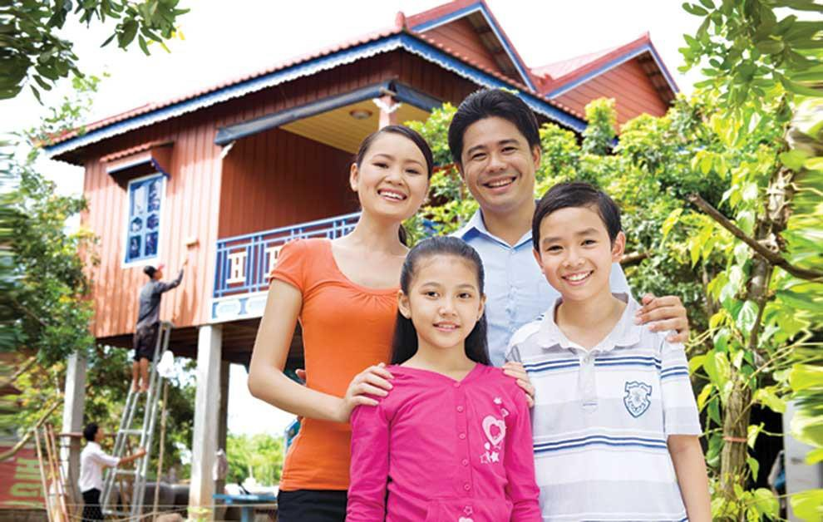
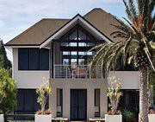
regulatory requirements. Understanding affordable housing loans, grants, and other programs and their requirements is the foundation for a successful project . Mastering the art of affordable housing can be difficult and challenging, but ultimately rewarding on several levels.

Slide 15
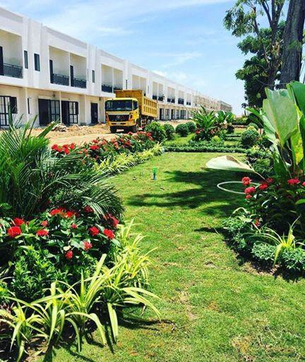
We Know our Market and Customers
_{A}s we will be affordable housing developers we should
have a thorough and deep knowledge of the market in which we intend to develop. We should have a clear understanding of who their customers are and what they want and need.
Knowledge of the market should encompass the political, social, and cultural facets of the community as well as the underlying market fundamentals. As affordable housing developers we should know most elected officials and community leaders, as well as competing market-rate and affordable developers. With this knowledge and a solid understanding of basic real estate principles, they should be able to fairly assess the needs of the community and how their proposal addresses those needs. Establishing and maintaining good relationships and trust goes a long way toward avoiding misunderstandings and surprises down the road.
In-depth knowledge of the community allows us as the developers to anticipate community concerns and proactively address them. Knowing the political situation can tell us as the developers on whom we can (and cannot) count for support. It also can direct us to incentives that can make the deal financially feasible. Finding a champion in city hall for a project can make the entitlement process significantly easier.
If, as is often the case, the developer finds that the needs of potential tenants, elected officials, and neighbors are not aligned, it needs to formulate a vision that takes into account the varying viewpoints and sell this vision to the larger group
of stakeholders. In some communities, public authorities will have already identified demand for workforce housing, housing for the homeless, or mixed-income communi-
ties, and thus clarified the community’s objectives for housing. Aligning the commu-
nity’s housing needs with political and financial realities allows developers to achieve projects that are both sustainable and responsive to the market’s unique characteristics.

Slide 16
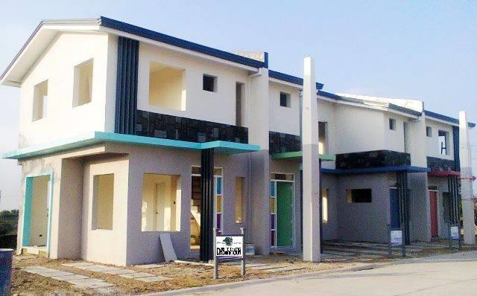
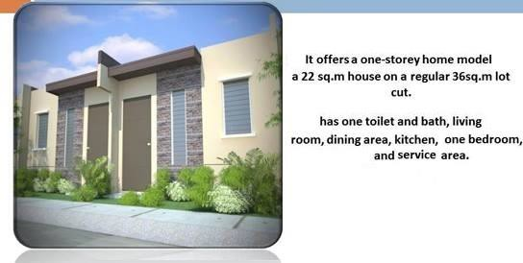
In most metropolitan areas, the demand for low-income housing far exceeds supply. Most new low- income housing communities lease up quickly and maintain waiting lists. For these developments, piecing together the necessary financing and navigating the entitlement process can be far more important than proving demand, which is often a given. Projects that involve the inclusion of market-rate or workforce

Slide 17

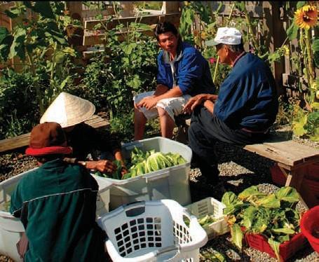
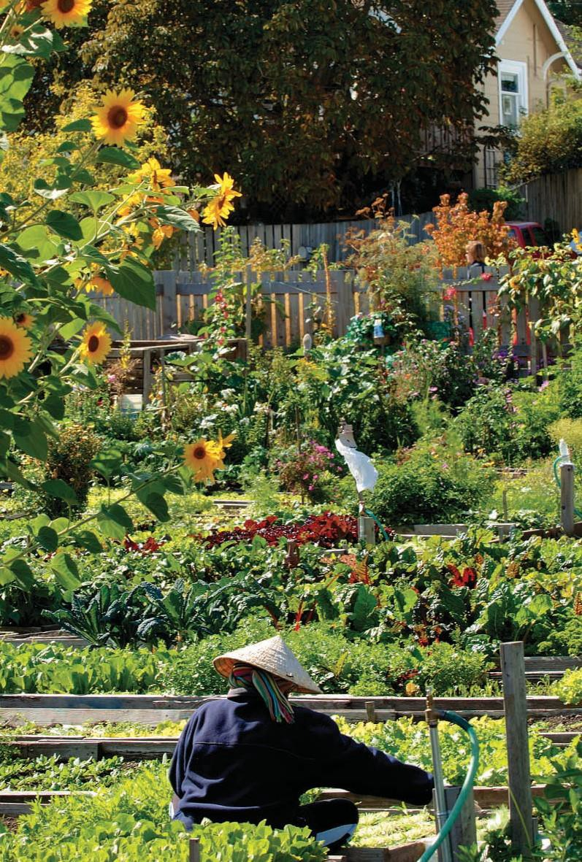
A community garden can be an important amenity for the resi- dents of affordable housing, allowing them to connect with nature and enjoy fresh and healthy produce. At lease a hectare must be put aside for this
A market study is needed and will help verify and quantify demand and allows for greater leverage in underwriting the development and gaining public support. Combining local and national data, a market study reveals trends that may affect the project and what the market can support. A market study can also become a selling point in convincing public officials and the community at large of the need for a proposed project.
Local brokers, property managers, hous- ing agency officials, or consultancies can help developers understand the market. They should be asked to identify similar projects and to provide their take on why those projects succeeded or failed to gain approval and community support. Developers should simultaneously seek to understand the concerns of nearby busi- nesses and homeowners in relation to
the proposed project.

Slide 18
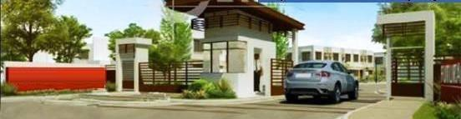
Components of a Successful Market Study
Preparing a market study can be a chal- lenging process with sometimes uncertain value, but following a logical process will produce good information for making investment decisions and influencing the community. The developer often must obtain the assistance of an independent professional who is well versed in analyz- ing residential markets and experienced in the local market. Increasingly, affordable housing projects involve a mix of uses, which may require researching the market for nonresidential uses, such as retail or office, as well.
Key physical and political/social features of the area (including natural boundaries, access, city/county boundaries, school districts) should be described. Market area demographics relating to the project’s target market (specific income qualifications, specific age groups, specific occupations) should be analyzed.
Recommended Development Program. The development program estimates the size of the project’s target market (households within income, occupational, or other qualifications; mix of market-rate and affordable housing), the market area’s capture of this target market, the pro- ject’s fair share of this capture, and the pace of sales or leasing (absorption). Mar- ket performance will depend on various elements of the program, including hous- ing characteristics (building types, number of units, unit sizes, unit amenities), sale prices or rents, and project design and amenities/services (parking, entrance and lobby, common areas, meeting and com- munity room, daycare and other social services, garden and green areas, gym, swimming pools playgrounds
Affordable Housing Demand. The overall demand for affordable housing in the market area needs to be assessed. This involves compiling information on house- holds (the number of current and forecast households, household sizes, income lev- els, mobility, demographic segments) and employment (total current and forecast jobs, employment by professions, wage levels, major employers).
Affordable Housing Supply. Estimating the supply of affordable housing requires looking at the number of residential units (including the share that are single-family, townhouse, or multifamily; and that are owner- or renter-occupied), the character- istics of housing (number of bedrooms, square footage), vacancy rates, seasonal occupancy, and residential building per- mits. Pricing is a key factor (the values
of owner-occupied units, mortgage pay- ments, rents, and utility payments). Other useful information can be provided by analysis of the performance of compara- ble and competitive projects in the market area, a survey of residential land prices, and opinions of local market experts.
A market study comprises a number of step-by-step analyses:
Preliminary Development Proposal. If there is a preliminary development pro- posal, its stakeholders (the developer, the financing sources) need to be identified and the proposed project (number of units, pricing, design, and target market) described.
Project’s Financial Performance. Financial performance hinges on development hard (land acquisition, site preparation, con- struction) and soft (architecture/engineer- ing, public fees, financing, legal) costs; sale and rent revenues, selling expenses, operating expenses (vacancies, utilities, maintenance, management, marketing), and developer profit. Note that while the issue of profitability is critical to the developers and financiers of a project, it is also increasingly of interest to commu- nity leaders and residents, who want to ensure that their support for a project is not out of proportion with the relation- ship between the community benefit and developer’s r
Site Characteristics. The location of the proposed project and the site’s existing conditions (access, visibility, topography, current uses, adjacent uses, infrastruc- ture) and regulatory situation (zoning, parking requirements, density and height limitations) need to be identified.
Ascertaining a project’s potential resid ents is an important part of the information gathering process, and knowing the
characteristics of prospective residents can help developers sell their project to community stakeholders.
After defining a market area, developers should collect information on the number of households, household size, average
age, income, ethnicity, mobility, and tenure preferences, as well as employment, including professions and wage levels.

Slide 19
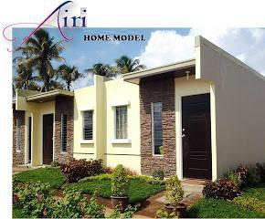
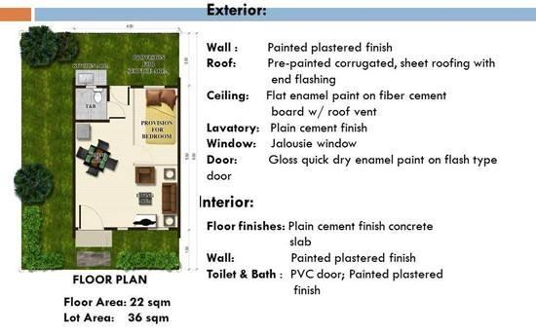
Some suggestions of ways for obtaining usable market information while also helping to set favorable local expectations for a proposed project include the following: frequent local eateries and nearby retail establishments, asking patrons and shop owners about the area and trends they see.
Walk similar developments, and meet with their developers, financiers, and man- agers. Take note of design and amenities, as well as maintenance and livability. Our understanding the living conditions of people in your market segment will help you establish a viable project. It may also provide a good sense of what community needs are currently not being met, which can be helpful in discus- sions with public officials and with the ultimate approval of the project.
While demand for affordable housing is likely to far outstrip supply, developers who examine selected comparable projects and the overall supply of affordable housing may be able to identify market gaps that allow them to increase total demand for the project, improve the potential for the inclusion of market-rate housing in the project, and accelerate the project’s absorption.

Slide 20
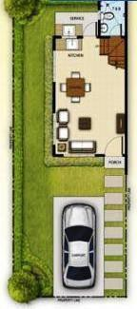
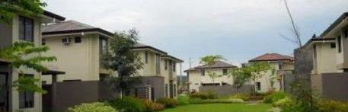
Selected Site for Opportunity and Choice
_{L}ow- and moderate-income families do not differ from other families in their
desire for housing with access to basic amenities and advantages. Accordingly,
developers should site affordable housing to maximize economic and social opportu- nities for its residents as well as to allow for quality-of-life amenities, including access to good schools, safe streets and parks, and public transportation options.
In the past, affordable housing projects typically have been relegated to the most disadvantaged neighborhoods in their municipalities. The large-scale public afford- able housing developments of the mid-20th century characteristically fostered con- centrations of poor (and black) families, which had devastating effects for both the public housing residents and adjacent neighborhoods. Isolating affordable housing in distressed neighborhoods with poor schools and substandard social services severely limits opportunities for upward mobility among residents and breeds a cul- ture of endemic poverty, hopelessness, and despair.
Affordable housing opportunities should be made available in a variety of markets and types of neighborhoods, not only in central-city neighborhoods. Rapid job growth in suburban locations has intensified the need for nearby affordable housing. Within cities, inner suburbs, and other built-up areas, affordable housing production should be an important component of infill and revitalization strategies.
While demand for affordable housing exists in older, redeveloping cities, it also exists in rural areas where wages may be significantly lower than in cities. In all markets, some community opposition to affordable housing proposals is likely to arise. See principle 2 for ideas on allaying the fears of neighbors.
Choices that influence housing decisions for most people include proximity to work, neighborhood amenities, quality of schools, and perceived safety. The choice factors for people in need of affordable housing are no different. Affordable housing should be
located near appropriate retail, daycare, high-quality schools, recreational opportu- nities, and office and commercial districts. Nearby shopping, schools, and
offices are not only ameniti es for residents, but they also offer employ- ment opportunities that do not entail long commutes.
A factor that may influence lower-income fam- ilies more than other families is proximity to transportation. Almost 40 percent of the income of households can be spent on transportation. Every effort should be made to minimize this expense by siting affordablehousingdevelopments close to public transportation.

Slide 21
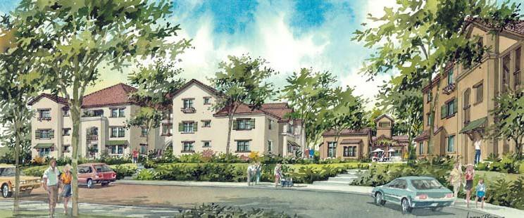
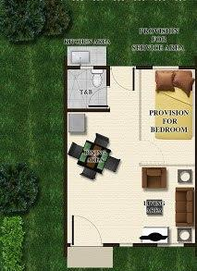
Another benefit of access to public transportation is that it allows the developer to allocate less space for parking, which makes more of the land available for housing and reduces the overall land cost per unit.
Low rise NOT high rise Lots and lots of Green
The reality, of course, is that affordable housing developers often cannot compete for land in many areas where affordable housing is needed without funding assistance in our case a highly desirable 99 hectare lot has been located . Furthermore, proposals to develop affordable housing in good neighbor- hoods are almost bound to engender
community opposition, which results in a lengthier entitlement process and legal entanglements that add expenses to pro formas that have very little room for such additional costs. Inclusionary zoning ordinances that call for the vol- untary or mandatory inclusion of “affordable” units in new housing devel- opments offer one entryway for afford- able housing in a number of communi-
ties where it is scarce. Where a share of new housing construction must be set aside for low- and moderate-income households, affordable housing developers can partner with market-rate developers to provide it.
Communities with a shortage of affordable housing can help affordable housing developers compete for sites in several other ways. Those with surplus schools or school land can rehabilitate or redevelop these properties for affordable housing. Local governments can provide the rezoning or variances that may be required for converting old buildings to affordable housing. Public land or property can be con- veyed to affordable housing developers under land grants or long-term leases. Com- munities can use their power of zoning to create value in land, which can be lever- aged to create affordable housing. And affordable housing can be incorporated into new public uses including libraries, public parking garages, and municipal buildings.
A number of communities sponsor affordable housing developments on remediated brownfields (contaminated properties). The cleanup costs on brownfields can be significant, and the financial risk associated with such properties often precludes them from being financially feasible for redevelopment of any kind. Bringing remediated brownfields back into productive use as affordable housing serves the public good on several fronts: it removes blight, creates property tax revenue, and provides much-needed affordable housing.

Slide 22
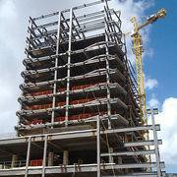
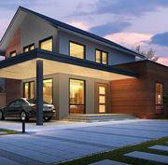
We will Strive for a Healthy, Balanced Community
_{D}iversity is the hallmark of a healthy and balanced community. A healthy com-
munity provides a variety of housing types appropriate for residents in all
stages of the life cycle; safe and affordable housing for people in all income groups; and housing opportunities close to jobs. The U.S. population is becoming increas- ingly diverse—less than a quarter of households are married with children—and American communities should reflect this diversity in their demographics.
The majority of U.S. communities have always lacked racial diversity, but many were much more economically diverse 75 years ago than they are today. In the early 20th century, a typical community blended an assortment of housing types and residents of disparate incomes and backgrounds. Residents of such a community did not con- sider it to be a “mixed-income community” or “social experiment,” but, rightly, to be simply their community. The fact that the richest residents lived within walking distance of some of the poorest was just a natural circumstance.
Today’s typical community is more economically segregated, a result chiefly of the migration of many upper- and middle-income households to homogenous housing devel- opments in the suburbs—made possible by the expanding interstate highway system— and the segregation and isolation of poorer families in high-density public housing con- centrated, as a matter of government policy, in the poorest urban neighborhoods.
Some communities have retained a variety of housing that is affordable and attrac- tive to families at different levels of income, and the effort to return to healthier and more balanced communities should begin with the preservation of existing bal- anced neighborhoods. Throughout the country, much of the existing affordable hous- ing is disappearing due to neighborhood changes, expiring uses, and market
pressures. Much of this disappearing stock is rental housing, which is the only housing choice for many low-income fami-
lies. Many communities that understand the connection
between a housing balance and economic health are taking steps to preserve the affordable rental stock that allows work- ing families to live near jobs that are vital to the healthy functioning of the community. In some communities, low- income housing tax credits are being used to update existing rental housing stock to preserve this vital housing option.
Neighborhood revitalization through public investment in new infrastructure or community services is a way of preserving balanced communities. In rapidly gentrifying communities, freezing or deferring the taxes of existing residents may help lower-income residents stay in place.

Slide 23
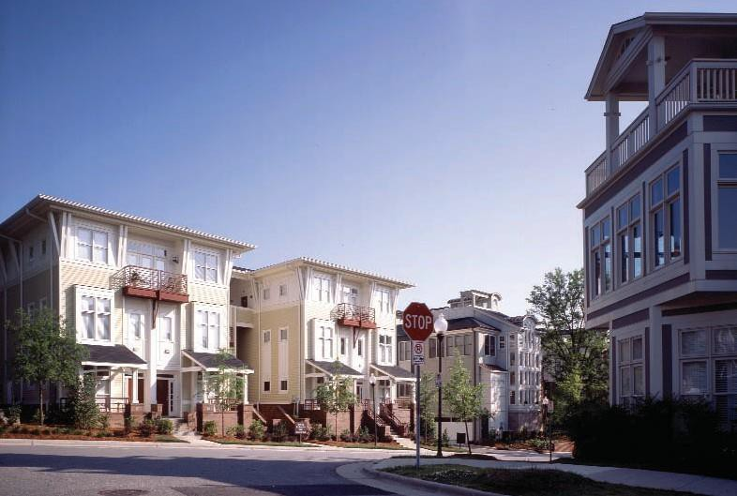
Example
First Ward Place
First Ward Place in Charlotte, North Carolina, is a successful HOPE VI mixed-income community that was developed by NationsBank Community Development Corporation (now Bank of America CDC) and the Charlotte Housing Authority. The redevelopment created 250 units of public housing, 50 units of workforce housing for families earning 80 percent or less
of the area median income, and 101 market-rate units of for- sale and rental housing.
Because of First Ward Place’s well-thought-out design and plan- ning, the community’s market-rate units have proven popular. One-third of the for-sale units are reserved for former public housing residents who have improved their financial situation
to the point of being able to afford market-rate housing. In order to buy and occupy these units, the purchasers must first attend and graduate from the Charlotte Housing Authority’s Homeown- ership seminars .
The exceptional design and planning of First Ward Place in Charlotte, North Carolina, led to quick sales for the market-rate units.
In neighborhoods with mixed affordable housing, the introduction of mixed-income communities can jump-start the process for bringing about diversity, affordability, and balance. Much of the affordable housing being constructed today aims to create balanced communities by providing a variety of housing at a variety of price points. People with rising incomes or growing families can move up without having to move out of the community. Seniors can downsize without leaving their family and friends. Adult children can stay in the neighborhood in which they grew up. Households can move from subsidized housing to a home of their own without having to relocate. The presence of long-term residents who stay active and vested in their community helps maintain a sense of community.
From the developer’s perspective, a mixed-income, mixed-product development miti- gates the development risk by appealing to a variety of potential customers. Market- rate units can help cross-subsidize the income-restricted units, making the develop- ment more financially feasible. The proper ratio of market-rate, workforce, and
low-income housing units in any one community is a matter of some debate, and the answer may vary based on the situation in the surrounding community. This
writer believes that at least 50 percent of the units in larger mixed-income com- munities should be market-rate housing to ensure community stability and provide
options for families to move up from subsidized or small units.

Slide 24
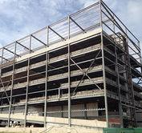
Use Design to Foster Community, Safety, and Pride
_{I}t is now widely accepted that much of the public housing built in the mid-20th
century was a massive failure—its configuration too isolating, its scale too dense,
its towers too tall, its residents too uniformly poor. Unfortunately, powerful negative images of failed high-rise, public housing developments and their associated social problems have been burned into the country’s collective consciousness, leaving a lin- gering negative perception of affordable housing. People are still less familiar with the attractive, lower-density, mixed-income communities where much of today’s affordable housing development is taking place; in these communities, most residents cannot tell the difference between the market-rate units and the affordable ones.
The lessons from past failures have not been lost on today’s affordable housing designers, many of whom are creating award-winning communities. Good design can foster a sense of community, pro- vide for the safety of residents, and ultimately cre- ate community pride. In fact, one of the great les- sons from public housing’s failed approach is to focus on building communities and neighborhoods, not projects and developments.
The resources for the development of affordable housing are typically limited, which demands creativity from developers and design professionals.
.
They put significant effort into value-engineering interior and exterior spaces to cre- ate the most value for the least cost. This may mean reassessing how spaces are used and challenging traditional thinking regarding design and density. The follow- ing design guidelines can help designers and developers create high-quality afford- able housing and great communities:
Create curb appeal. Does this look like a place in which you would like to live?
Attractive housing fosters resident pride.
Scale projects to respect the neighborhood. Some areas may support large multifamily structures. The proper scale will promote a healthy connection between the development and its surrounding neighborhood.
Foster a sense of ownership. Involve our target market in the design of the building, so that it reflects their needs and tastes.
Orient windows to put “eyes” on the street. Street watching can instill a sense of ownership in residents and it serves as a de facto neighborhood watch program— and thereby makes the neighborhood safer

Slide 25
Use public spaces to foster a sense of community among residents.
Provide adequate light and air circulation in the homes.
Recognize the context of the surrounding neighborhood, but do not rely solely on replication.
Consider the entry sequence. The character of the entry can be a defining ele- ment in the perceived quality of the building. The entry should be clear and iden- tifiable so that all site elements contribute a better whole. Entry points for resi- dents and visitors should be clearly defined.
Use the lobby to set the tone for the building. The lobby or reception space should be clearly defined, attractive, and well lighted.
Study pedestrian paths and address problems. Worn dirt paths, for example, pro- duce negative impressions.
Address issues of parking and auto circulation. Is there enough parking? Insuffi- cient parking causes stress to residents and neighbors. Parking should be located appropriately. For example, a parking field in front of a building on an otherwise residential street will not give the right impression.
Use lighting to enhance security. Good lighting helps to define and enhance a property at night. A well-lighted site is not only secure, but also attractive. Strong use of Solar
Make use of distinctive and clear signage wherever possible. Depending on how it is designed and placed, signage can go both ways—it can enhance or intrude on the design of a building.
Use good landscaping to both enhance security and define the property. Good landscaping provides shading exposure as well as cooling of the overall site, and thus contributes to the energy-efficiency of the building.
Use fencing carefully. Decorative fencing can be used to define the character of a property as well as enhance security. However, well-designed affordable housing
does not rely heavily on security fencing for safety.
Know where to cut costs and think long term. Drastically reducing room sizes or installing cheap equipment or finishes might not save money in the long term because of increased maintenance costs. Additionally, excessive cost-cutting may contradict the goal of increasing the inventory of high-quality affordable housing.

Slide 26
Empower the Residents
_{W}ell-planned affordable housing is a long-term investment and a key compo-
nent of a healthy community. As an affordable housing developer we need to pause amidst the busy development process to respect, relate, and respond to hat the prospective customers need, the ultimate residents of the housing we are developing. While a current project is temporarily our undertaking, remember that we are building permanent homes, relationships, connections, lifestyles, and community.
To cultivate a community, it is necessary to bring together multiple entities. Con- sulting, involving, and responding to the community, buyers, and residents are activities that build a sense of ownership (literally and otherwise) and create a sense of home, neighborhood, and community.
Community participation is key. Community members must be involved in initial project meetings and residents consulted on unit design, programs, and planning. Participatory activities will keep the energy high and provide residents with a mean- ingful role in project development. An inclusive, people-driven process will gain acceptance from the businesses, neighborhoods, and politicians affected by the proj- ect. Broad community support is essential to ensure the residents’ success.
As the affordable housing developer we should take stock of the neighborhood’s assets and respond to the community’s vision for the neighborhood. An assessment of the social, economic, and environmental factors in the community will help identify what is working and what is not, what is valued and what needs to be improved. It helps to ask potential community members where they envision themselves living in ten, 20, and 50 years. By listening to the community and responding to its vision, u s a s t h e the developer can create a development plan focused on common goals related to a healthy environment, a strong economy, and a high quality of life. Collective decision making increases pride and investment in the community, which, in turn, encourage high-quality maintenance and adherence to community rules and policies on the part of residents.
A socially and economically inclusive development can seamlessly integrate lower- income residents into the broader community. One rule of thumb is to design with- out gates and fences. New development should connect to the surrounding neigh- borhood by streets, parks, paths, and natural areas. It is important to make lower- income residents a part of mainstream society, both physically and emotionally.
As the developer we should seek to accommodate the housing preferences of all buyers and rent to own regardless of income. Like their more well-off counterparts, lower-income residents want amenities and possibly need it more so then the wealthier residents.

Slide 27
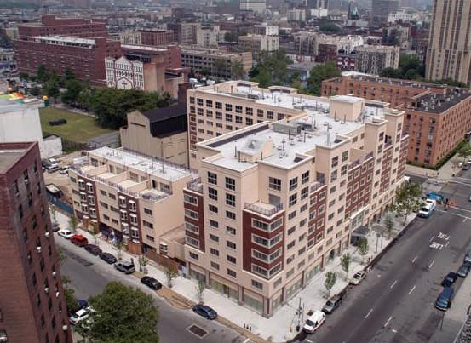
EXAMPLE
1400 on 5th
1400 on 5th is a new 128-unit, green condominium development in New York City’s Harlem neighborhood. The developer
reserved 85 units for households with incomes between
$52,000 and $103,000. These units were priced from $158,000 to $272,000. The remaining units sold to residents with incomes above $89,000.
Developed by 1400 on 5th LLC and financed by a mix of public and private funding, the development took shape through engaging and empowering the community that it would serve. Community surveys found that potential affordable-unit resi- dents wanted the same amenities as market-rate tenants. They were concerned about security in post-9/11 New York City. They were concerned about healthy-building issues, partly because asthma rates in Harlem are higher than in other parts of the city. And they were concerned that the new development spurring Harlem’s renaissance was not capturing and expressing the cul- tural history and importance of their community.
ing Harlem’s unique heritage were incorporated throughout the building. The Mfama-dan Adinkra symbol, which symbolizes a house in harmony with nature and with the community, is high- lighted throughout the building. 1400 on 5th respects Harlem’s past and addresses present and future community needs—all because the developer listened to the community, responded, and thereby empowered the residents.
The developer listened: 1400 on 5th includes a smart-security system, a 24-hour attended lobby, and a private parking garage. The development is LEED certified; it uses geothermal heat pumps and its air-ventilation system brings in fresh air to en- hance indoor air quality. West African design elements reflect-
Finally, our goal as the affordable housing developers must incorporate programs that encourage ownership, that facilitate transitions from rental to ownership and build wealth for low income workers . Various development banks and private initiatives provide financing, technical assistance, and educational resources to encourage affordable homeownership. We could consider partnering with lenders, and neighborhood residents to educate potential homebuyers on realistic homebuying goals. Some programs overseas as in Philippines even enable low-income families to contribute sweat equity to the building of their own home.

Slide 28
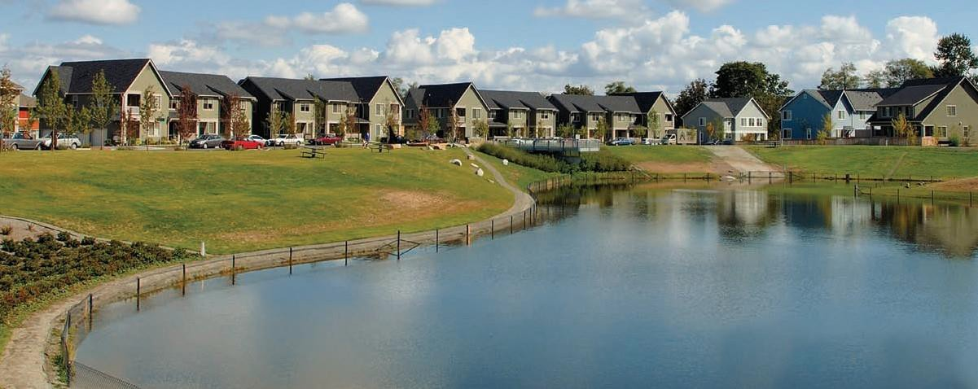
Orchestrate Sustainability
_{A}s we are affordable housing developers w e w a n t t o build for the long
term.
Affordable housing developments are required to remain affordable over the long term. Affordable housing developers must develop, finance, and manage for property longevity, which means integrating sustainability into all aspects of the project.
The period for which affordability requirements are in place is commonly known as the compliance period. While it is difficult to predict how the area around the proj- ect site will develop over the compliance period, it is a good idea to try to establish a terminal value that reflects the likely status of the property given its geography, assumed capital improvements, and likely demographics, while also taking into
High Point Neighborhood Redevelopment
The redevelopment of the High Point pub- lic housing project in Seattle, Washing- ton, involves 1,600 units on 120 acres. New infrastructure, buildings, and com- munity facilities, funded in part with grants, nurture pride, encourage resident interaction, and improve sustain- ability. The restoration of street and open- space connections with the surrounding community has integrated High Point con-
textually into its historic Seattle neigh- borhood. The former public housing project has been reborn as a safe, acces- sible, mixed-income, multigenerational community.
The redevelopment includes a number of innovative features, including a 34-block natural drainage system to protect a salmon stream. Likewise tilapa or similar can be introduced to a fishing lake in Phnom

Slide 29
Building for sustainability offers the best chance of maintaining long-term value. Sustainable development is high-quality development, but it does not need to be
high-cost development. Through creative design and value-engineering, as developers we can create sustainable communities while maintaining affordability. Key qualities of sustainable affordable housing are that it promotes economic vitality, fosters environmental integrity, and encourages a sense of community today and for future
generations. More specifically, such housing should promote health, conserve energy use of solar wherever practical and natural resources, and provide easy access to jobs, schools, and services. It is best to take a holistic approach to sustainable affordable housing that focuses on people instead of buildings.
The incorporation of greener systems contributes to sustainability. Green affordable housing can reduce utility bills, create healthier living environments, and save non- renewable resources. Some green options—for example, the use of native plants in landscaping and the use of nontoxic (zero-VOC) paints—cost no more than standard options. Other green options—for example, using old paving material as backfill in trenches and minimizing the amount of grading—can actually save money. Some green options, such as energy-efficient cooling systems, can cost more initially but offer long-term savings in operating or maintenance costs. For lower- income residents, investment in high-quality and efficient cooling systems and solar hot water and other building systems is important to the degree that it achieves savings in maintenance and replacement costs and significantly lowers utility bills.
As affordable housing developers should think sustainability when specifying building materials. With projects that operate on tight budgets, affordable housing developers are generally careful to invest in nonstandard strategies only where they make economic sense. Green materials offer numerous benefits and opportunities for a project. The recycling of construction materials, which can often be reused for on- site public art projects, saves money. Specifying materials that result in durable sur- faces reduces maintenance fees for residents and managers. Affordable housing developers should think beyond meeting green-building standards to setting examples of sustainability. Sometimes the budget limitations
of affordable housing projects force creative solutions.
Sustainable development requires a flexible approach and long-term thinking. Sus- tainability is the glue that unites the financing, planning, zoning, designing, mar- keting, selling, and building of an affordable housing development. A sustainable development fosters a sense of community that benefits buyers over the long term. Developers need to look into the future: How will future investors benefit from today’s planning and design choices? How will the community change and adaptation

Slide 30
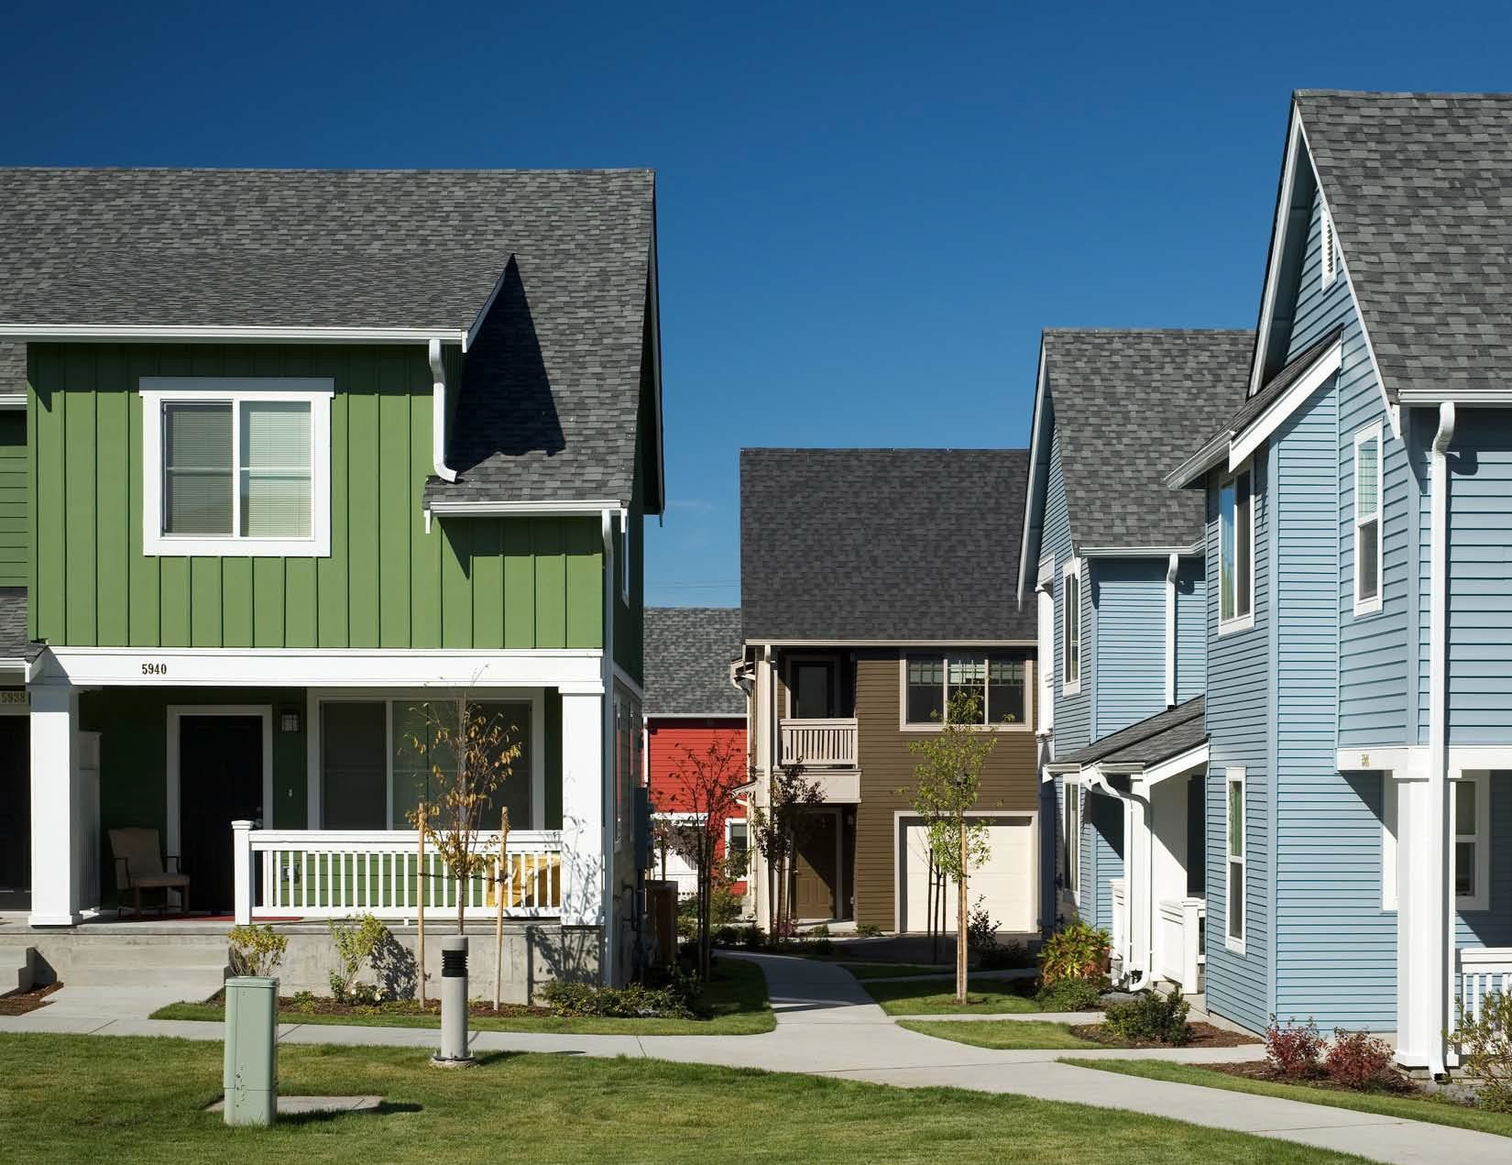
Planning for sustainability does not stop at buildout. As developers we need;
to put in place a strong strategy that addresses long-term operational issues,
including the following:
the protection of open space;
the funding and maintenance of key programs and amenities;
retention of green infrastructure;
responsible environmental management;
the mix of uses and incomes;
continued high standards of architecture;
the execution of maintenance plans for the building, the site, the community, and the infrastructure;
financing for long-term management and maintenance;
responses to disasters and replacement needs; and
the education of residents on the subject of maintaining and improving important sustainable features.

Slide 31

Housing Concepts

Slide 32
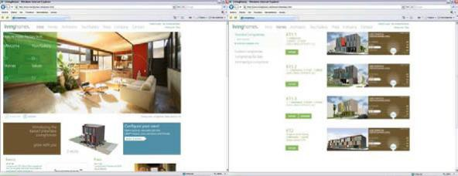
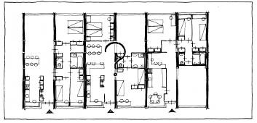
Customization derives from “to customize” or "to build, fit, or alter according to individual specifications". It could also have the meaning "to personalize" or "to make personal or individual" and "individualize" or "to adapt to the needs or
special circumstances of an individual". to customize a house means to design and build a place to live according to the specific needs or demands of those who will occupy it, or to alter an existing place to meet such needs or demands. To design and build customized dwellings in collective s o c i a l housing, it is necessary to apply the term "mass customization", which is the opposite of "mass production". To mass-produce a house means to build the same model many times in order for it to be useful to many people. However, to "mass customize" a house it is necessary to manufacture many components that can be combined in various ways. The combination of these components could be calculated and visualized with a computer program, and the results could be spread through interconnected computer networks. Thus each individual or the members of a family, with the help of a selected factory/ manufacturer of prefab housing (China), can choose the house in which they want to live, according to their requirements and within a collective environment. On the other hand, a "mass-produced" dwelling, which is part of collective housing, could also be adaptable or flexible so that it can be altered and therefore "customized" with special furniture or with moving partitions.
Through the Asian dragon website, people can choose, within certain limitations, among several houses, and we can customize them by adding rooms and choosing materials and finishes.
We need to select several model hoimes and construct show houses on site for buyer / future residences to select from.

Slide 33
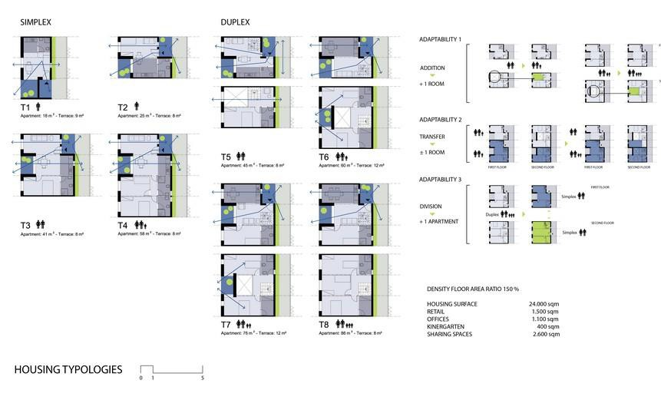
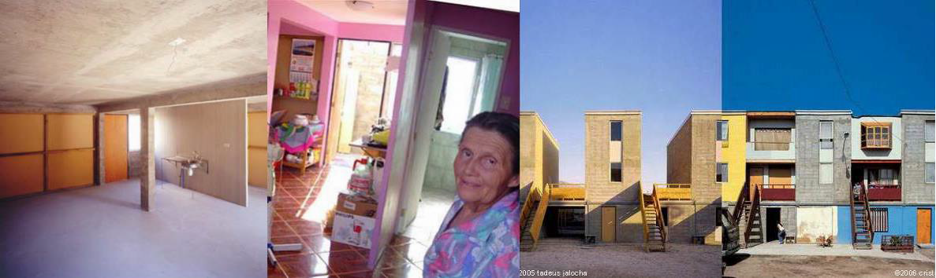
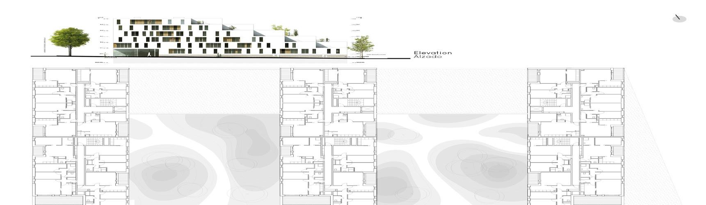
One way of making a project financially viable is to supply a percentage of the house in Unfinished state designed by t h e p r o j e c t m a n a g e r s
but inhabitants co uld conclude
the process, meaning they continue to build their homes. In this case the architects can design cores or half-finished houses, planting the seed and leaving certain guidelines. Thus a dwelling is not a finished product
In a house whose interior spaces have similar dimensions, any room can be adapted to become a bedroom, a lounge, a dining room, a study room or a playroom. Thus each space of the house could become a "living room". However, these spaces must possess certain qualities that help their inhabitants to "customize" them, providing them with new qualities. A house can be "customized" inside, outside or both. The inhabitants could alter its façade but also could continue building, whereby the house transforms but is part of a process.

Slide 34
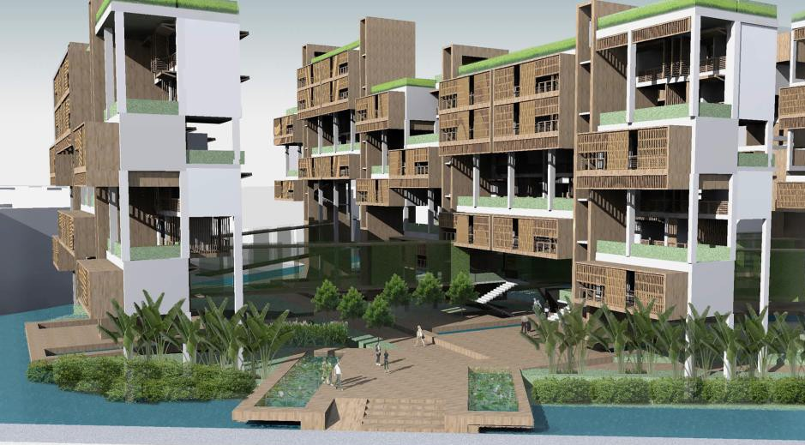
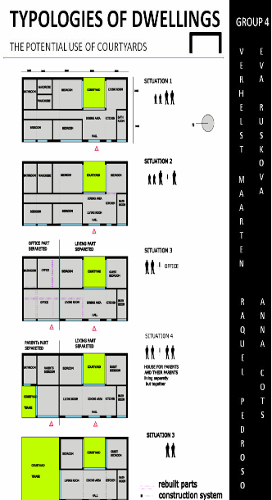
FLEXIBILITY AND VARIABILITY
Housing flexibility and housing variability can be defined as the design of dwelling structures with an understanding of the prospective development of the site as well as life and social scenarios, and with the possibility of making appropriate changes in the living environment.
Flexibility and variability enable one to change the living environment according to the new requirements in the course of their existence. It can be applied to urban and architectural design related to the actual and future needs of the people living there. In the urban context it applies mainly to the structure of amenities of a city and community in order to design specific areas for shops, services, offices, leisure and culture.
The variable, flexible structure of amenities of a community within a city offers an attractive mixture of different functions, which can be linked in a variety of ways with multifunctional, point-concentrated units, i.e. shopping malls, multipurpose complexes and greenery.
Public spaces play significant role and create a connecting framework for the combination of individual amenities. Public spaces may offer a number of variable, flexible elements that increase their attractiveness of use and may also change their functions.
The final outcome in the context of a variable, flexible urban structure improves the quality of housing through its relationship to such structures.
In the architectural context, the flexibility and variability provide specific conditions to create spaces that are designed to change their functional use. They are the spatial expression of the activities created by a rapidly changing way of life. Architects and planners must be able to translate the needs and resources of society into physical solutions; into the forms of buildings and landscapes that serve and express the ideals of the time.
Flexible adaptation of the living unit reflecting the changes in the family home.

Slide 35
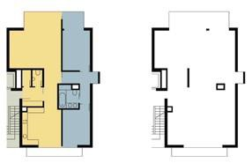
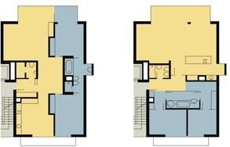
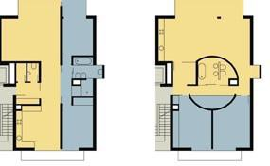
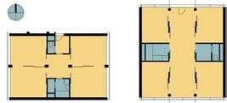
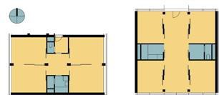
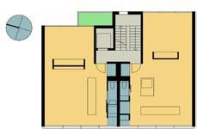
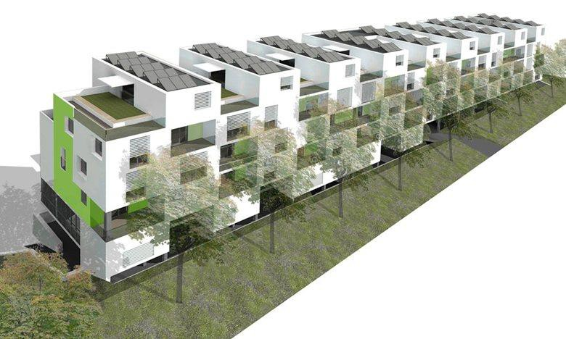
Examples of the variable layouts of the living area (student work) Examples of the flexible layouts of the living area |  | A variable apartment is a dwelling with a layout that allows for certain simple, inexpensive modifications without changing the total area of the apartment. A variable apartment allows the change of layout through inexpensive modifications to the overall building.
A Flexible apartment is a type of flat that allows the adaptation of its layout to current needs in a highly flexible but uncomplicated and effortless manner, without a change to the building itself, such as in the use of sliding walls and a variety of mobile furniture elements. The total area of the apartment remains unchanged. Such an apartment can be compared to a theater scene that can change very quickly. Mobile furniture elements are generally used for furnishing the day zone, which can eventually adapt to different situations. W plan extensive use of solar.

Slide 36
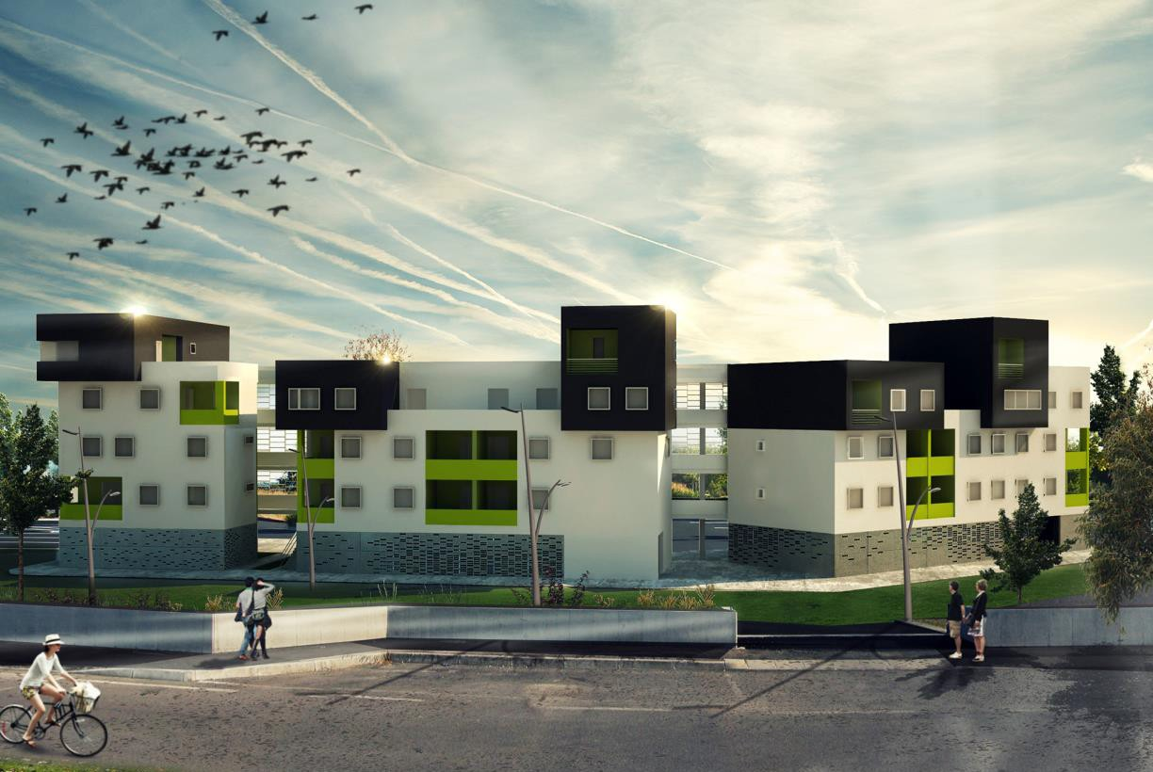
GATED COMMUNITIES
Gated communities comprise physical areas that are fenced or walled off from their surroundings. The entrances to these areas are usually prohibited or controlled by means of gates or similar physical obstacles.
Gated communities are by nature separate and enclosed areas, being isolated from the broader urban environment and enclosed through physical barriers. Besides the main purpose, which enables a specific lifestyle of a group within the enclosed area or to protect the residents from possible intruders, gated communities reflect an urban entity that is physically
-- often socially and economically -- differentiated from the surrounding urban environment.
Gated communities are categorized into three types: lifestyle communities, elite communities and security zone communities.
Living in a gated community has undoubtedly become more and more popular as the years have passed. Those who opt for gates point out the reduced crime and traffic, as well as a safer environment for children and the prestige of living somewhere that is exclusive. However, not everyone likes being sealed off from the world.
Gated communities seek to seclude themselves from the outside world, and city status codifies that as self-imposed retreat. Gating makes private what is essentially public.
In the case of crime prevention, gating is not the only way. One of the effective forms of situational crime prevention involves the community taking action to protect itself, which has been defined as “neighborhood watch”. The main idea of the “Defensible Space” theory w h ic h w i l l b e introduced is not only about fences and gates but also about allocating environments under the responsibility of the people living there.

Slide 37






Sheshsad Dastgah, a residential complex in Mashhad. The complex covers 12 hectares and provides essential facilities for residents. The residents have been encouraged to be involved with the enhancement of their security; the role of designers can be considered as dividing the shared space for the people of each block and encouraging the residents’ “ownership” of their environment and a sense of responsibility for the surrounding area. This phenomenon could be considered a form of “neighborhood watch”.
These images show Newman’s effort to give people the opportunity to take control of their space, providing an outdoor environment in which to live that enhances their self- image, evokes pride and allows them to improve -to define their space by themselves- so that their identity is reinforced. He subdivided all the public
grounds between individual families.

Slide 39


HOUSING AMENITIES AND
UTILITIES
The level of the housing quality stems from the fulfilment of the basic and superior living standards within the dwelling unit, as well as the amount of complementary services, housing utilities and amenities, including health, education, shopping, working, recreation, etc. The satisfaction of all human needs and desires represents a very wide range of factors, which must be taken into account and consequently incorporated in any design of living environment. The creation of mixed areas with the optimal proportion of residential units, amenities, working and public spaces facilitates the design of convenient, pleasant spaces for the largest possible spectrum of users and dwellers. Design of the residential areas must be considered as a multifunctional unit consisting of mutually interconnected architectural elements that constitute the cultural and social milieu. They must cover all standard needs of the individual and community expressive of its way of life. Hence the terms “housing amenities” and “utilities” represent a very important part of architectural and urban planning design. In the architectural context it implies the items of everyday usage, which increase the standard of living. Housing utilities are all the things that are necessary in order to live. Water, electricity, heating, air conditioning, kitchen equipment, furniture, balconies, terraces, garage, parking lots, etc., are what most people consider utilities when looking for a place to live. Some items can be considered as „luxury“ because they aren‘t necessary for living, such as cable TV, satellite, the Internet and telephone. They influence the quality of housing.
In the urban context it applies mainly for the structure of amenities of a city and the community in order to design specific areas for shops, services, offices, leisure, health and education facilities and culture. It also includes the quality of design of semi-private and public spaces.
When it comes to home features, prospective dwellers consider ample garage space, walk-in closets, open-plan design, walk-in shower, master bathroom with dual vanities and separate tub and shower, energy- efficient systems, including solar hot water, appliances, and airconditioning.
Considered is the locality within the city, the proximity to community amenities such as mass transit, major highways, employment corridors, schools, walking/biking paths, playgrounds, sports and swimming pool.
Housing amenities and utilities on the architectural scale

Slide 40


“Housing spatial quality” deals with the creation of the complete, compact, functional and attractive central public spaces can be comparable with the attractiveness of historical central areas of existing cities.
Optimal integration of the local sources and neighborhood connections contributes to the design
quality of a housing environment that is rich and
stimulating. Thus the level, standard and spatial quality of the designed
housing amenities and
utilities refer to the overall housing standards and creation of the attractive network of public spaces within the residential units.

Slide 41

IMPACT OF ICT ON THE
HUMAN PSYCHE
Innovations such as the World Wide Web and related technologies, including virtual social networks, have emerged and dramatically expanded over the past 20 years. Consequently, as new machines become part of our lives, we become more dependent to them. Therefore, a daily living pattern within housing is affected by these virtual activities.
Our mental map, describing the place in which we live, is therefore modified by these newly encountered inputs, such as virtual communities and teleconferencing, internet TV and so on. Studies on this topic are aimed at determining the increased use of new virtual technologies at home and understanding the extent to which they change our behavior.
Considering this point, it is crucial to define these modified habits and behaviors and to examine how they can affect our housing environments. The results of this research are carried out from original qualitative field work. A hundred questionnaires were carried out and analyses with SPSS software. The target of this study consisted of university students in EMU (see Figure 2-5).
Three main parts were investigated in this study: the first one concerns recent human needs; the second is related to user’s behavior in conscious and subconscious levels, as shown in mental maps; and the third is to understand how to create answers for user needs and psychology with respect to their housing environment with this deep relationship.
In the current technology we have faced brand-new inventions and experiments that could directly affect the higher levels of our needs. We might not have an appropriate house, but we have a Facebook page and e-mail that provide us with a virtual settlement. This new digital era has an impact on our habits and behaviors with negative and positive aspects. Although the negatives were more obvious, the positives might be more effective due to the high rate of affordances of human beings. Thus the research concerning the effects of these virtual communication technologies on our housing environments has become an unavoidable issue.
Two main parts are to be discussed in relation to human nature: human needs and the mental map for housing spaces. The possibility of presence within the house is centered on TVs and computers. It leads the users to be more alone with their virtual devices. Consequently, this phenomenon changes the mental map in the human mind about one’s housing environment and affects his/her living pattern.
Figure 1, possibility of presence under the effects of virtual activities.

Slide 42


Based on the study of student accommodations in EMU, this habit was one that should be measured. In this questionnaire the author attempted to understand the character of these technologies in young people’s minds.
Figure 2. Time Spent with a Computer in the House
Figure 3. Watching TV or Chatting with Family
As a result, it can be perceived that the majority of this group spend more than two hours in front of their PCs each day. They eat their food in front of the PC and TV. They prefer to stay in their rooms, and most of them sit and watch TV in their living rooms instead of chatting and looking at each other.
Figure 4. Eating in front
Figure 5. Location for Laptop or PC
of the Computer
Figure 6. Physical Activity versus Human Satisfaction (By the Author)
It is recommended to design for the purpose of balancing the real and the virtual. The creation of useful, simple ways to encourage physical activities in home makes the housing seem “alive.” However, it is difficult to force people to do these things in their houses; instead, we must convince them to change their habits slowly through means of slight changes in our designs. For example, Dr. Lim, of UCL, suggested placing an area for plant-growing in interiors as a supplementary food and as a natural object, thus helping to dispose of the dominance of the virtual.
References
Iranmanesh, A. (2010). The Role of ICT on home spaces among EMU Students. Unpublished Term paper for the Graduate class ‘ARCH 567: Informal Studies on Housing I’ supervised by Dr. B. Ozmen Mayer, EMU, Cyprus.
Jung, C.G. (1995) Memories, Dreams, Reflections. (original v.: Erinnerungen Träume Gedanken, 1962, Rascher, Switzerland) London: Harper Collins.
Maslow, A.H. (1971). The Farther Reaches of Human Nature. New York: Viking Press.
Olson, G.M., Olson, J.S. (2003). Human-Computer Interaction: Psychological Aspects of the Human Use of Computing. Annual Review of Psychology, vol.54, pp. 491-516.
Weil, M.M., Rosen, L.D. (1994). The "Psychology" of Technology. Behavioral Healthcare Tomorrow, no.3, pp.37-39.

Slide 43

MIXED URBAN FUNCTIONS AS
FACTORS OF PROXIMITY
Urban functional diversity is generally regarded as a condition for the reduction of social distance by reducing spatial distance. The mix of functions is thus seen as a tool for managing flows and relationships between spaces. The connection to urban planning and housing diversity is obvious. Everyone recognizes the problems caused by mono- functional spaces, which are land-locked and poorly accessible, resulting from "zoning" areas for housing, industry or commercial use. The spatial dimension of urban development is the right scale where we can adequately address and manage these flows and connections between places. Reflection on the urban mix is a very topical issue. Urban mono- functionality consumes more space in urban development; it poses new constraints through economic, financial, regulatory and environmental (land) pressures, thus motivating the production of smaller, more diverse housing units. The small residential "neighborhood" with 10 to 15 flats replaces the minimalist linear structures and towers of the large social housing districts from the 1970s. Interfaces, such as public spaces, being combinations of places with additional complementary functions, are important in a sustainable vision of dynamic urban life. Urban renewal projects more frequently tend to exceed the mono-functional character of existing urban fabric, causing many of the difficulties in the life of a district or neighborhood. The industrial suburbs of the nineteenth century saw the emergence of new, original forms of housing (lofts) or services. Residential functions were thus combined with economic activities, public equipment and utilities. The new proximity also permits the partitioning of higher level functionality (businesses platforms, daycare, medical Centre, sports center, night spot/s,
coffee shops for telecommuting, etc.)
ten percent of the investment in urban renewal w i l l go to the introduction of the functional mix.

Slide 44

The assurance of public access to diversified places and activities is more efficient than trying to restore order in the disturbed mono-functional city through simple social intermixing

Slide 45




MIXED-USE HOUSING
Mixed-Use Housing Development, also been known as “Compact Development”, is not just a design/planning pattern that involves a multi-storey building whose ground floor is made up of commercial units and other floors having residential facilities; instead, it is a development that encompasses three or more significant revenue-producing and related land uses whose closeness of proximity shortens trips, lessens dependence on automobiles and encourages alternative modes of transportation such as walking, cycling and public transportation.
Mixed-use development offers numerous benefits to its inhabitants. However, the most frequently stated benefits of this development pattern are sustainability and compliance with housing needs. Mixed-use may be developed at three scales, namely mixed-use buildings, mixed-use parcels/sites and mixed-use walkable/transit areas.
Because housing is a very sensitive component of any town or city, the concept of mixed use seeks to rediscover the vitality and attractiveness of town centers; recognize the role of partnership in promoting affordable housing; and tackle the economic, environmental, social and political problems of providing livable communities in contemporary cities.
Beside all the advantages of mixed-use housing, the existence of a series of barriers, which are believed to prevent or inhibit the delivery of mixed-use development, remain a recurrent subject of discussion in the debate concerning mixed-use development. Barriers to mixed-use development have been seen differently by knowledgeable minds in this field of study, either as mere perceptions or reality.
The adoption of mixed- use patterns can promote community living and improved access to services, as well as safety through the around-the-clock presence of people in the concept of 24-hour living.
This pattern of housing development creates a variety of housing choices while reducing land wastage and automobile dependency.
Typical examples of livable communities
Communities developed using a single-use approach are often characterized by restricted movement.
High automobile dependency: consequence of segregating related land uses.

Slide 46




Initiatives required in order to promote the realization of mixed- use communities include promoting an area-based approach, comprehensive reviews of new development plans, revitalization of single-use areas, preservation of existing mixed-use development, and post- occupancy evaluation.
Planning Proposal for a Mixed-Used Community
Attention has been drawn to the crucial role housing plays in driving the delivery of mixed-use schemes. It contributes a qualitative benefit to a mix of uses, since its active period is not limited to workdays.
http://www.tjpdc.org/housing/mi xeduse.asp.
- Newman, P., Kenworthy, G.
(1999). Cities
and Overcoming
Today, mixed use incorporates lessons from the past
Sustainability:
with the needs and awareness of contemporary development. Generally, solutions to overcome the
automobile dependence. Chicago: Island Press.
barriers that prevent the building of affordable mixed- use communities should be based on the critical dimensions of affordability, land use, public private partnership, transit-oriented development, diversity and inclusion as well as education.
Transition between mixed use of the past and contemporary development
References
Cleveland/Planning Commission (2010). City of Cleveland Ohio. Retrieved 17 October 2010, from http://planning.city.cleveland.oh.us/cwp/glossary/images/site_p lan.jpg.
Defining Mixed-use Development (2003). Design center for American Urban Landscape, University of Minnesota. Retrieved 8 November 2010, http://www.designcenter.umn.edu.
Glaeser, E.L., Gyourko, J. (2002). The Impact of Zoning on Housing Affordability. Harvard: Harvard Institute of Economic Research Working Papers, no.1948. Retrieved October 15, 2010,
http//www.economics.harvard.edu/pub/hier/2002/hier1948.pdf.

Slide 47


Christopher Alexander, in his books “A Pattern Language” and ‘The Timeless Way of Building,” proposed a system to observe and identify patterns of behaviour of individuals, and thereby discern the relationship of these patterns with the qualities of the spaces they inhabit.
The system allows the architect to create new spaces with new qualities; the shapes and sizes of the spaces that are built; the placement of the elements will depend on factors such as the actions performed on them, the number of people using them or the amount of time that these people would use them.
Participatory Process of Christopher Alexander in Mexicali
The inhabitants learned how to identify a pattern language that would help them to build their commu- nity.
Conversely, the architect Ralph Erskine observed and established dialogues with the inhabitants of the communities in which he worked. Its participatory process was to work with the inhabitants in the community, moving his offices there. In this way the inhabitants could also watch the development of the project and express their points of view.
References
Blundell, J.P. (2005). Architecture and Participation, english translation of Il pubblico dell'architettura (1971), Parametro, no.5. London: Spon Press.
Cross, N. (1972). Design Participation. London: Academy Editions.
Hague, C. (2005). Place identity, participation and planning. New York: Routledge.
Sadler, S., Hugher, J. (2000). Non-plan: essays on freedom participation and change in modern architecture and urbanism. Oxford: Architectural Press.

Slide 48


SOCIAL MIX
The social mix becomes a main theme in the new tastes for new neighborhoods. Planners have for many years endeavored to encourage neighborhoods, specifically those in Asia containing the appropriate social mix of residents along with a variety of public policies, to achieve diversity among their residents.
The image of the ”livable n e i g h b o r h o o d ” has thus become a key factor. The post- industrial cities have a growing interest in marketing themselves as being built on a foundation of neighborhoods and therefore being capable of harmoniously supporting a blend of incomes, cultures and lifestyles.
Due to the concentration of poverty in specific areas, certain disadvantages have emerged. Rising crime rates, high levels of unemployment, the anti-social behavior of youth within unimproved areas of cities, and the individual’s inability to move out of poverty were problems. Thus the social mix was suggested as a means of raising the standards of lower classes by nurturing a spirit of emulation as well as encouraging diversity and standards, along with the aesthetic design of social housing. Because poor housing conditions can lead to poor physical and mental health, these would be influenced by this issue. Great numbers of people face barriers to their full potential because of where they come from or who they are. The relationship between life opportunities and housing should be well documented, given that one's health is impacted by where he or she lives. The mitigation of these problems needs a new approach; one that does not place vast swathes of the population into pigeon holes but treats them as individuals. This reflects our modern society, particularly in developed countries where social diversity has become a sign of neighborhood vitality. The social mix, or diversity, can be defined in a number of ways, including household type, income, culture and education.
Le Fauvelles Social Housing in France, 2007. Groupe 3F and the Courbevoie Town Council launched a competition for the last remaining plot in the urban development.
With a view to adapting their spaces them to collective living, residents can change the placement of bedrooms and living areas as their family grows, depending on the lifestyle and hobbies of family members.
This project utilizes various external features, such as front lawns, courtyards and terraces, to encourage mutual trust among neighbors.
Le Fauvelles Social Housing in France, 2007

Slide 49


Social housing in Hamburg, Germany, with a new spatial formation within its structural divisions
References
- Arthurson, K. (2005). Residents’ Perspectives about Social Mix. Paper presented at the 2nd State of the Australian Cities Conference, The Sustainability and Vulnerability of Urban Australia, 30 November-2 December, Brisbane.
Arthurson, K. (2008). Urban Regeneration, scale and balancing social mix. Proceedings Development Social Inclusion and Place Based Disadvantage Workshop, 13 June. Melbourne: The Brotherhood of St Laurence.
Atkinson, R. (c.2004). Occasional Paper 1: Neighborhoods’ and the Impacts of Social Mix: Crime, Tenure Diversification and Assisted Mobility. Housing and Community Research Unit/ ESRC Centre for Neighborhoods Research. School of Sociology, University of Tasmania.
Atkinson, R. (2008). Housing Polices, Social Mix and Community Outcome. AHURI Final Report, no.122.
Darcy, M. (2010). Deconcentration, Social Mix and Poverty. Paper presented at the Shelter NSW Conference, Estates in the Balance. Sydney, 17 June.
Galster, G. (2009). Neighborhood Social Mix Theory, Evidence and Implications for Policy and Planning. Paper presented at the International Workshop at Technion University, Planning for / with People, Israel.
Johnston, C. (2002). Housing Policy and Social Mix. Sydney: Shelter NSW.
Lees, L. (2008). Gentrification and Social Mixing: Towards an Inclusive Urban Renaissance?. Urban Studies, vo.45, no.12, pp. 2449-2470.
Talen, E. (2010). The Context of Diversity: A Study of Six Chicago Neighborhoods. Urban Studies, vo.47, no.3, pp.486-513.
Sarkissian, W., Forsyth, A., Heine, W. (1990). Residential Social Mix: the Debate Continues. Australian Planner, March.
http://www.architizer.com
http://www.architoko.co.uk
http://www.architectural.com

Slide 50




Architecture and urban planning are part of the physical manifestations of a society, being expressive of its values and resources. A city, as a complex system comprising a multitude of elements, is thus generated in the course of a city development. The phenomenon of architecture and urban planning should reflect social diversity in providing living environment forms that are socially generated.
Social housing diversity and housing availability are significant factors in the phenomenon of city formation; they introduce a very wide scope of problems connected with the social and economic aspects of life.
The understanding and implementation of social differences in the planning of living environments helps to fulfil the various desires of humankind in the process of constructing dwelling forms, thereby contributing to the examination of these forms for various social groups.
Social diversity and availability are basic parameters of the scenario of social quality in the scope of effective housing, taking into account the different social profiles of the dwellers.
The aim of this project is to implement effective housing concepts that reflect differentiated social conditions of the future users and consider the fulfilment of their requirements.
The basic aim of housing availability for different social groups is to determine the most appropriate input conditions, which essentially influence the quality of a living environment.
Socially diverse housing in Vienna; an apartment complex Tokiostrasse, Artec Architecten; emphasis on the design of private outdoor spaces; a principle according to Cité verticale (Casablanca, Morocco, 1952, architects George Candilis and Shadrach Woods). In: ARCH, a magazine on architecture and other culture. May 2010, Borovičková, Z.: Terraced house Tokiostrasse, Vienna, p. 40, published by Eurostav Slovakia www.archnet.sk
The better the country and/or society regulates its social housing policy, the better the overall parameters of the quality of housing will be.
Disproportion between the lack of affordable housing and a surplus of expensive luxury apartments is a characteristic feature of many eastern European capitals (e.g., Prague, Bratislava and Moscow.
This handicap can be changed and improved through the effective scenarios of social housing.

Slide 51



Affordable social housing, Záhorská Bystrica, Slovakia Architects: Šmondrk, Norbert - Studio KFA; constructed in 2010
In: ARCH, a magazine on architecture and other culture. October 2010, Gürtler, I. Záhorská
Residence, p. 28, published by Eurostav Slovakia www.archnet.sk
Minergo, a low-energy residential complex, Bratislava, Slovakia, Architects: Hantabal Architects; constructed in 2011.
In: ARCH, a magazine on architecture and other culture. 04/2011.
Bystrická, A.: Low-energy residential complex, p.24, published by Eurostav Slovakia,
www.archnet.sk.
Minergo, Photo: J.Hantabal, ARCH 04/2011
References
Gotz, B. (2010). Abstract City-Urbanes Hausen. Berlin: Universität der Kunste Berlin.
Kieran, S., Timberlake, J. (2004). Refabricating architecture. New York: Mcgraw Hill

Slide 52





The most important aspect in light of the current trends is the optimal structure of various functions necessary for the
Negative examples of suburban zones.
quality of life in a given environment.
One of the key problems today is the relationship and proximity of housing and work.
Scheme of the volumetric concepts incorporating living and work.
of the family houses
-+
Positive solution of the suburban housing (preliminary architects: Fečík)
study, Bratislava-
Rusovce;
The emerging problems of today should be seen as negative examples of suburban zoning. A response to the problems of suburban development is the attention devoted to high-quality
processing of territorial plans, use of the sites that have lost their original function and the
revitalisation of existing estates. The architect’s role is to develop future housing schemes that will find appropriate solutions of the broad scope of problems connected with the suburban housing.
References
Bacová, A. (2009). Suburban process of Bratislava. Bratislava,FASTU. Retrieved 17 October 2011, from http://fastu-oikodomos.blogspot.com/
Hayden, D. (2004). A field guide to sprawl. New York: W.W.Norton & Company.
Hnilička, P.(2005). Sídelní kaše. Otázky k suburbání výstavbě kolonií rodinných domků.
Praha: ERA group.
Suburban housing. Wikipedia. Retrieved 17 October 2011. http://en.wikipedia.org/wiki/Suburb

Slide 53
SYSTEM
Housing can never be seen in isolation. It is always part of a larger ensemble: a settlement, a neighborhood and the built environment. Considered as an object, a house is always in relationship with other elements: houses and buildings, the surrounding spaces and the landscape. In order to address housing planning and design, we cannot lose sight of the fact that a house is always part of a greater assemblage of interrelated elements.
An organization of parts within a whole is usually understood as a structure. A system, on the other hand, is a structure with a functional purpose. A structure is a stable organization, while a system is a dynamic set of interactions. A systems- oriented approach to housing conveys not only an understanding of its structural condition but of the functional purpose of the system in which housing is embedded. For example, we can see housing as part of an ecosystem aimed at reducing energy consumption or as part of an industrialized system whose goal is to produce the maximum number of housing units at a minimal cost. The notion of a system is equally applicable to living beings, physical reality and abstract thinking. In fact, systems-oriented thinking blurs the separation between these realms, between the natural and the artificial, and between the physical and the abstract (von Bertalanffy, 1968).
A system is always dynamic, because it’s a conceptualization of the interactions between the parts that make the whole, and in turn between these and the environment. Accordingly, a systems-oriented approach applied to housing design and planning would pay attention to the dynamic relationship between the elements
-- physical and abstract -- which comfort housing and other elements of the built environment.

