Slide 1
Cost Effective Container House
Asian Dragon Philippines
Asian Dragon International Impex Incorporated
Suites 105/106/107/108 SIH Complex Alpha Bldg.
Subic Bay Freeport Zone, 2222. Philippines
SEC Registration # : CS201629062
Duty Free and Tax Exemption # : 2017 - 0630
Email : President.ceo@asiandragonintl.com.ph
Telephone : +63 (047) 251 3586
Asian Dragon International Cambodia
#7B Street 462 Sangkat, Tonle Bassak, Khan Chamkarmon, Phnom Penh 12301
0974 687734 (9am to 5pm) Monday to Friday
Http://www.asiandragonintl.com/

Slide 2
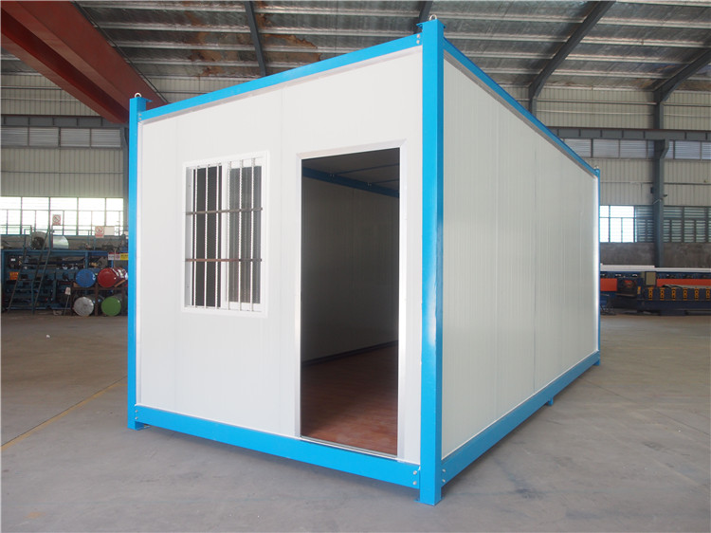
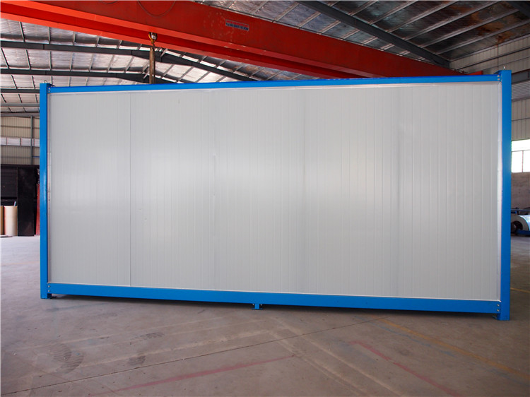
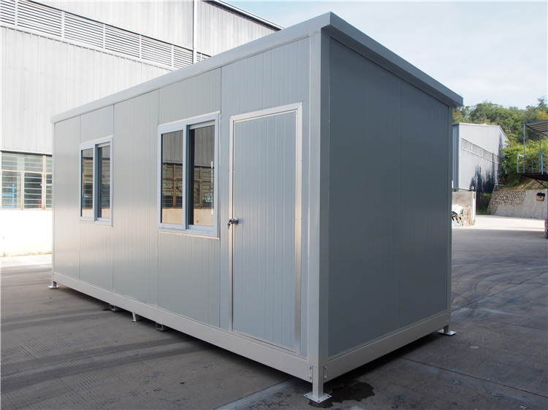
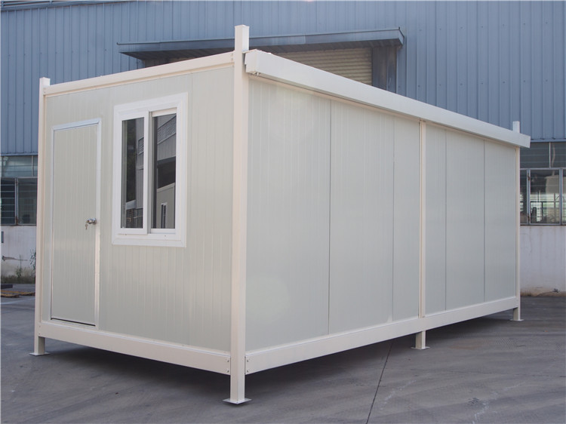
Outside Views

Slide 3
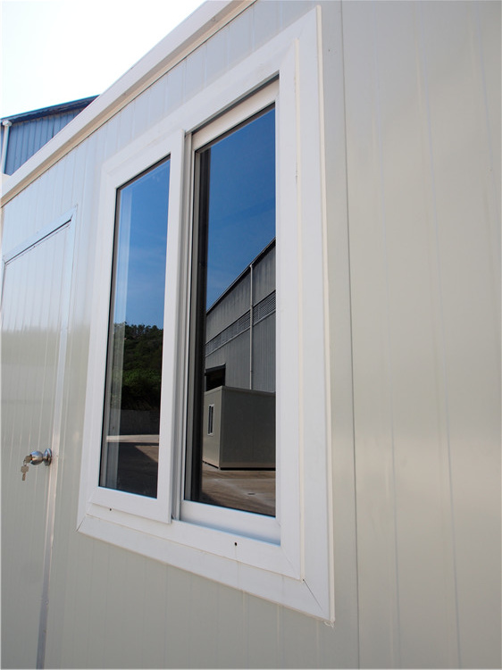
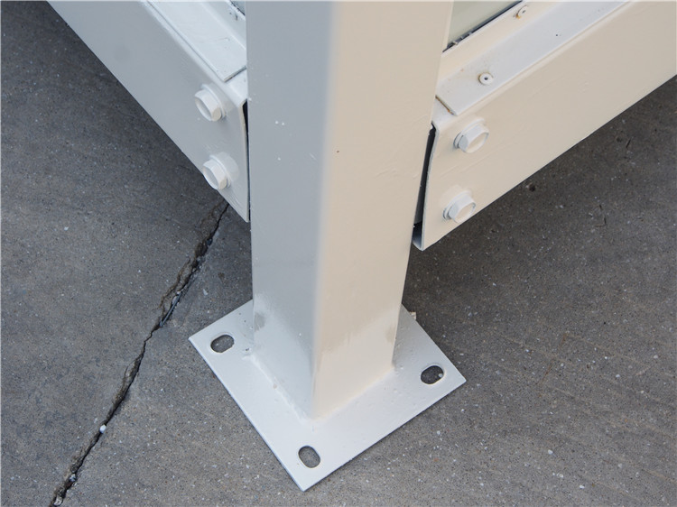
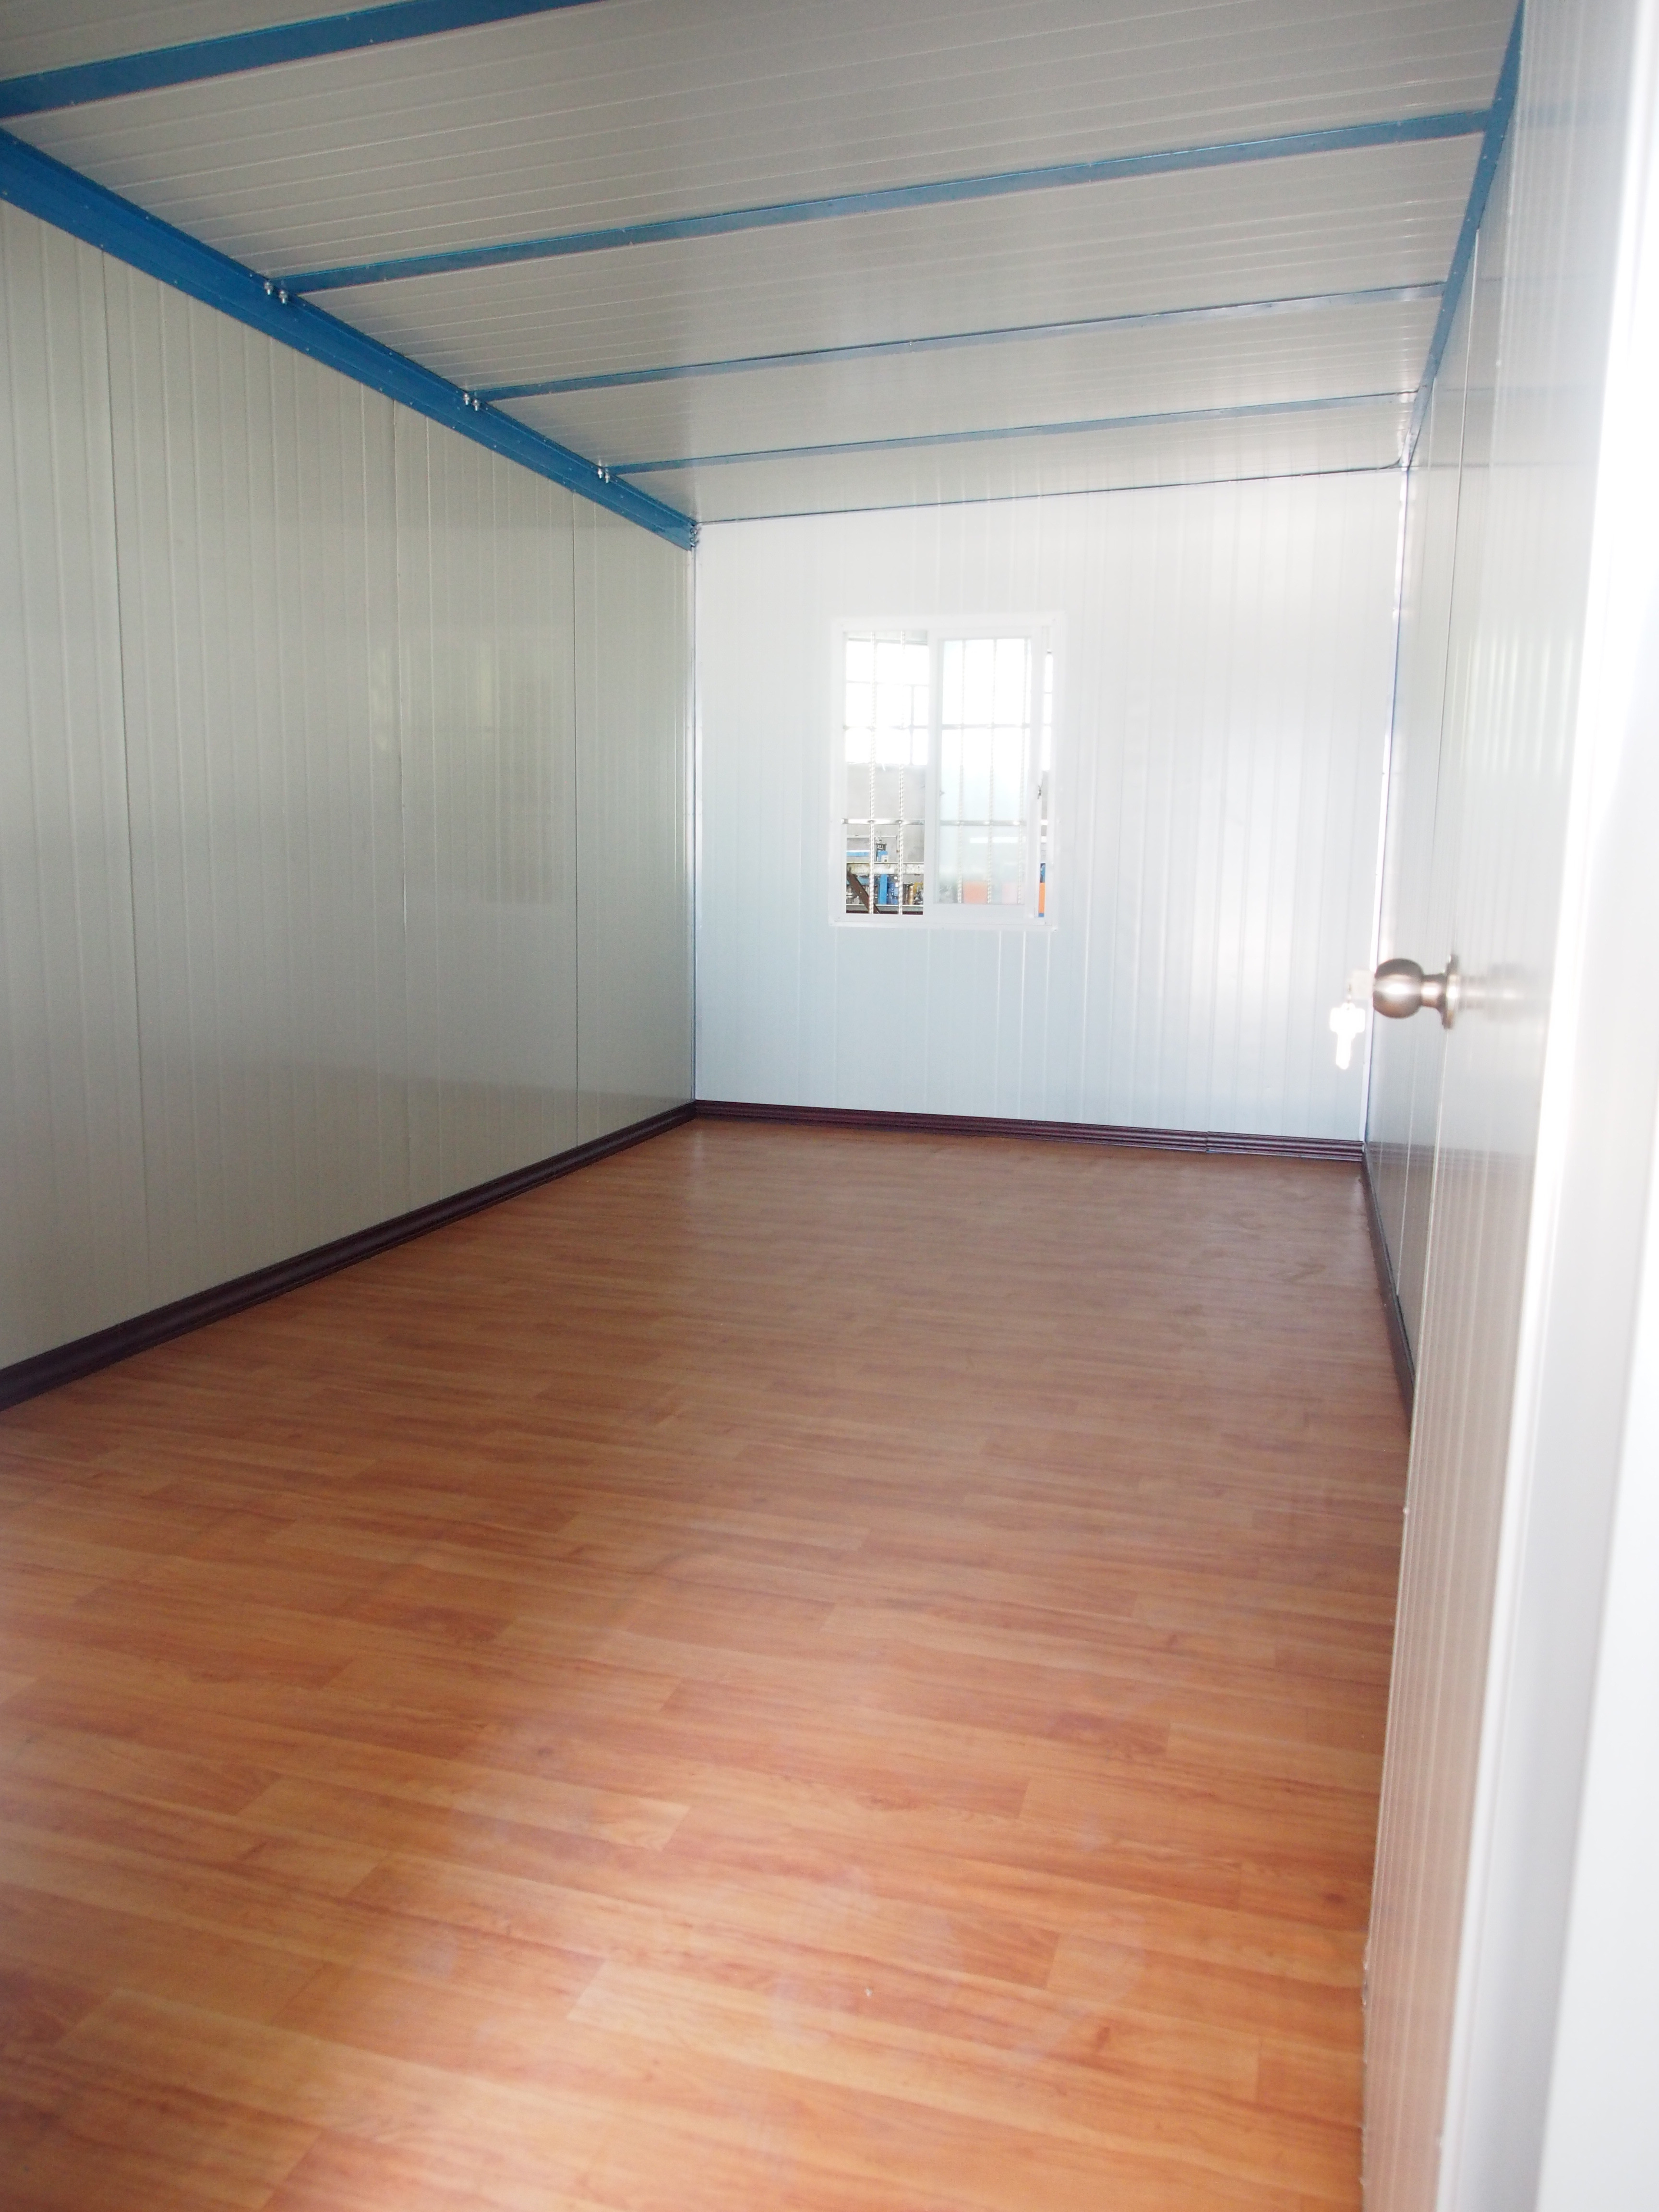
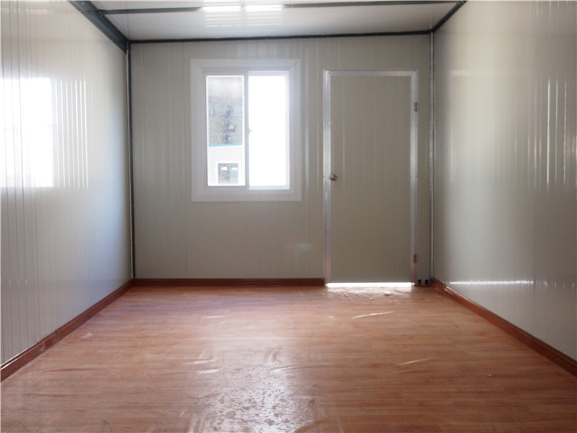
Detialed
Views

Slide 4
Size
20ft: 6050*2490*2950mm
Can be customized, to make it bigger or smaller.

Slide 5
Standard 20ft CHC
Item | CH-C
Name | Prefab Container House
Size | Sandard size:6050x2490*2950mm, and can be customsized
FOB Xiamen | USD 2,399.00/unit
MOQ | 14 units/40'HQ
Layout
Life span | 12-15 years
floor load | 1.5KN/㎡
roof load | 0.5KN/㎡
Layer | 2 floor is available

Slide 6
Standard 20ft CHC
Structure: | Column:80x80mm steel tube Top beam: 80x80mm steel tube Bottom beam: 140x80mm C section steel
Wall panel | 50mm EPS sandwich panel:0.26mm +10kg/m3, More optional
Roof | 50mm EPS corrugated sandwich panel
Floor | 16mm plywood, with 2mm vinly sheet and wooden floor trim
Window | UPVC sliding window, need to install at site. 4 pcs.
Door | SIP door, sandwich panel with Alu edge, ready in panel. 1 pc.
Electrical | None
Installation Speed | 1 unit/4 workers/day (for refer)
Tools | supplied by buyer
Load | 14 units/40'HQ

Slide 7
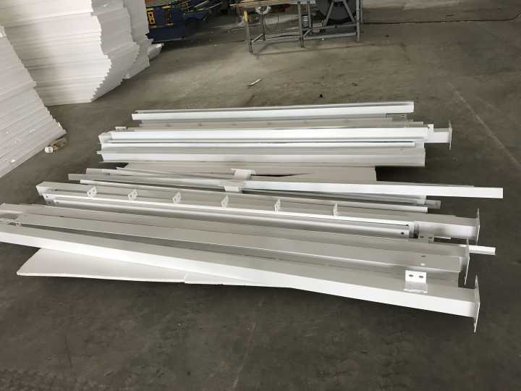
Details
Steel Structure:
corner column
Frame

Slide 8
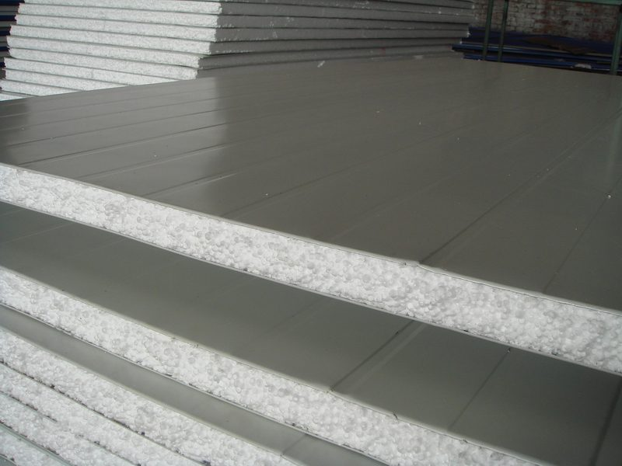
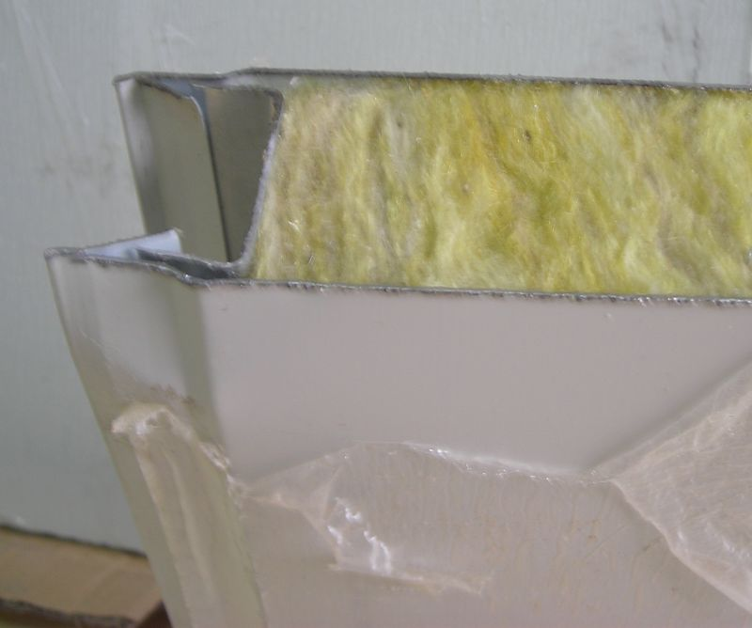
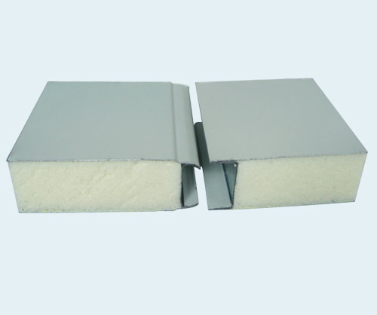
Wall:
50/75/100mm EPS/Glass wool/PU sandwich panel
EPS sandwich panel
Glass wool sandwich panel
PU sandwich panel

Slide 9
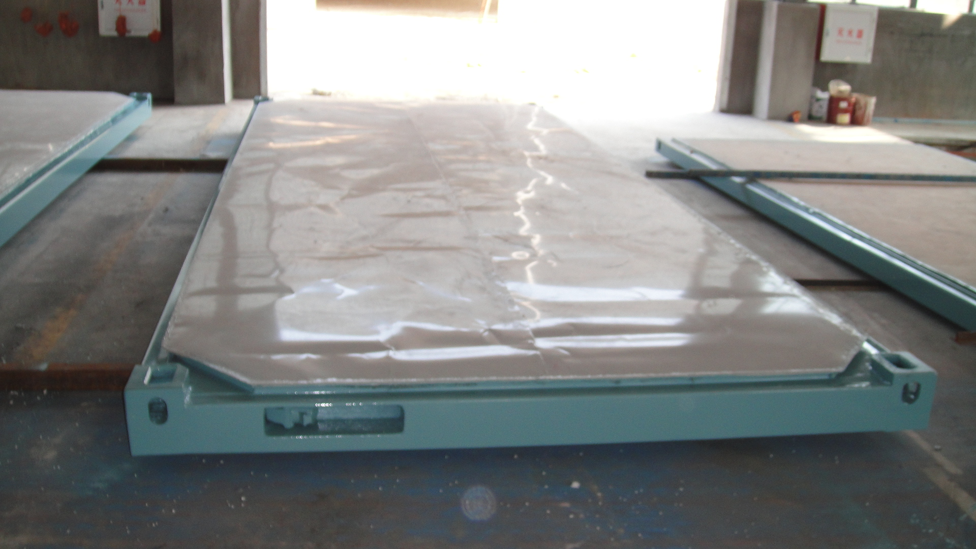
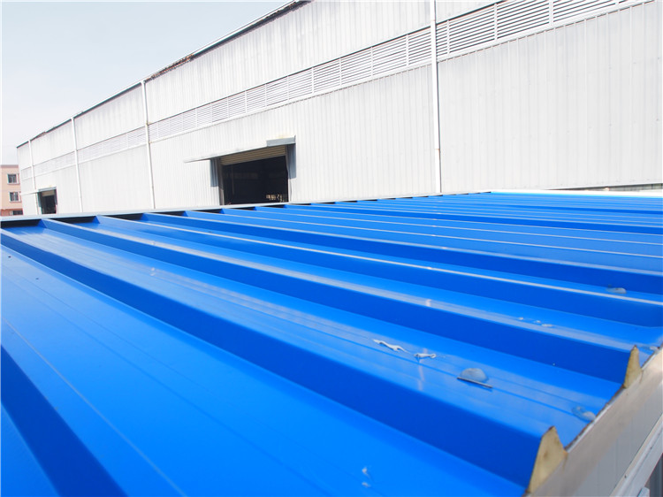
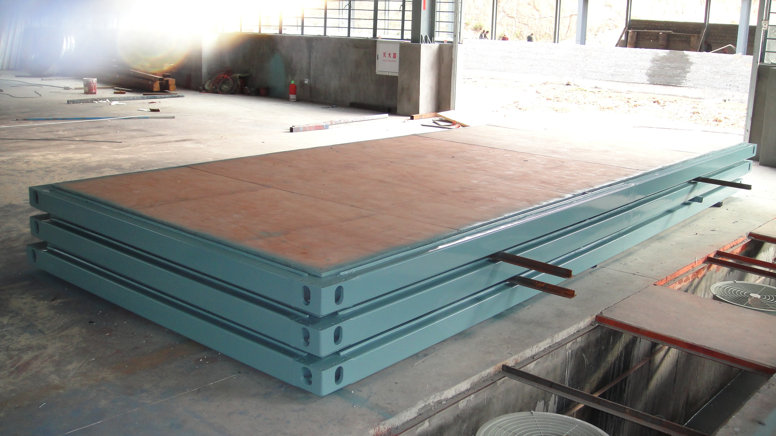
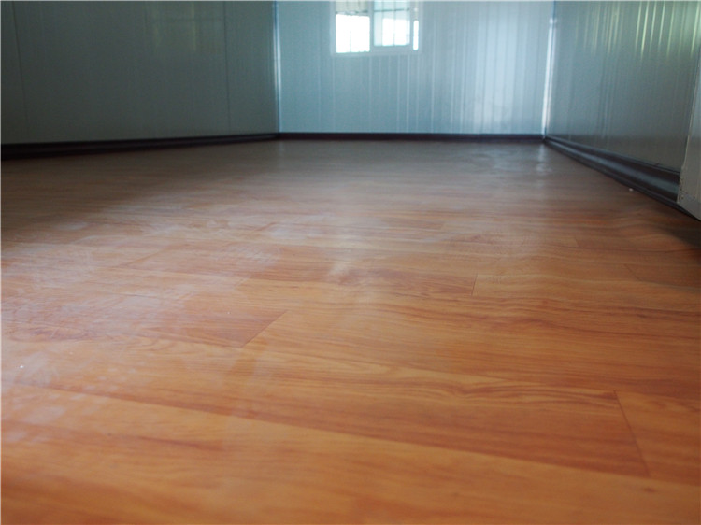
Roof &ceiling:
Flooring:
50mm sandwich panel
Plywood 木工板+ Vinyl sheet地板革

Slide 10
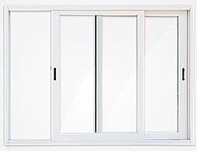
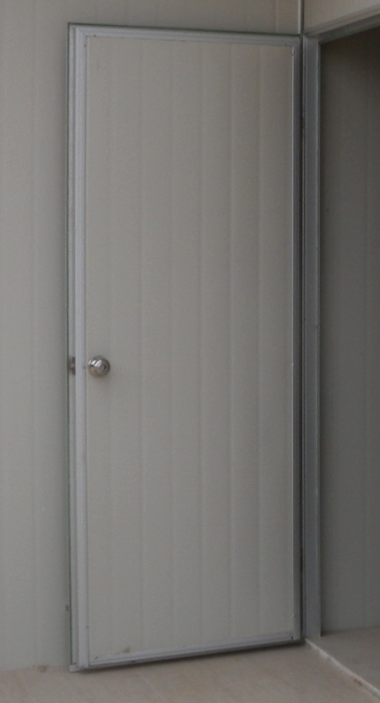
window:
door:
Aluminium sliding windows
SIP door

Slide 11
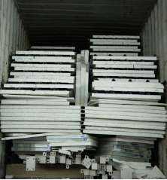
Loading:
packed speratly by structure,wallpanel, roof, panel, window, and door
Movement:
Can move wholely by forklift and crane.

Slide 12
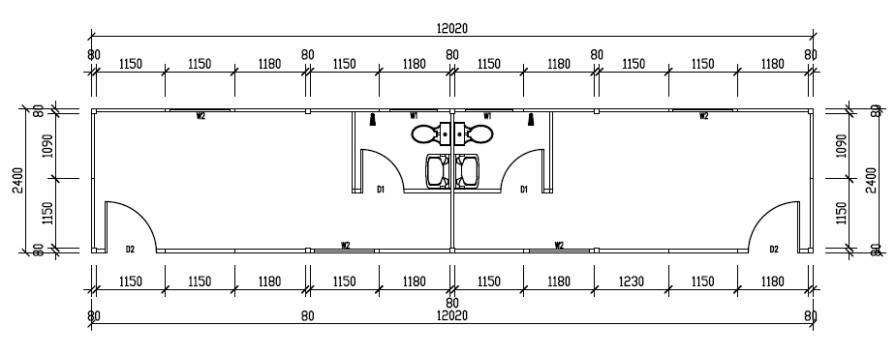
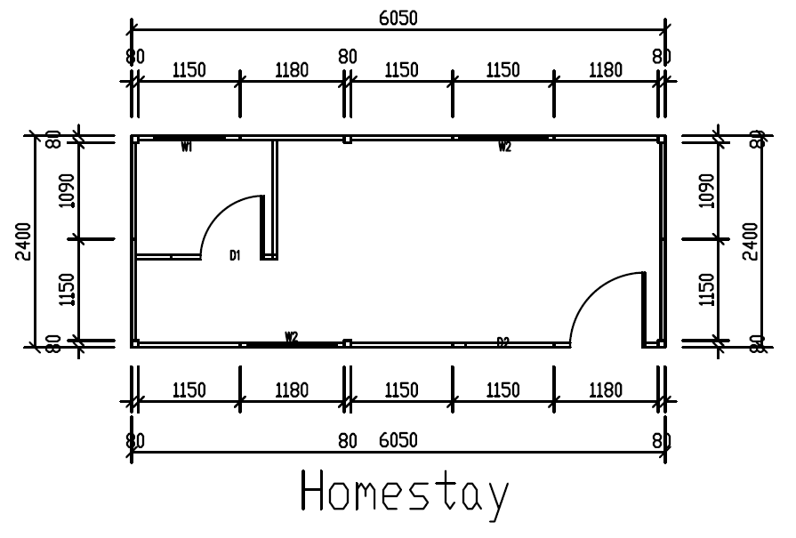
Other layouts for CHC

