Slide 1
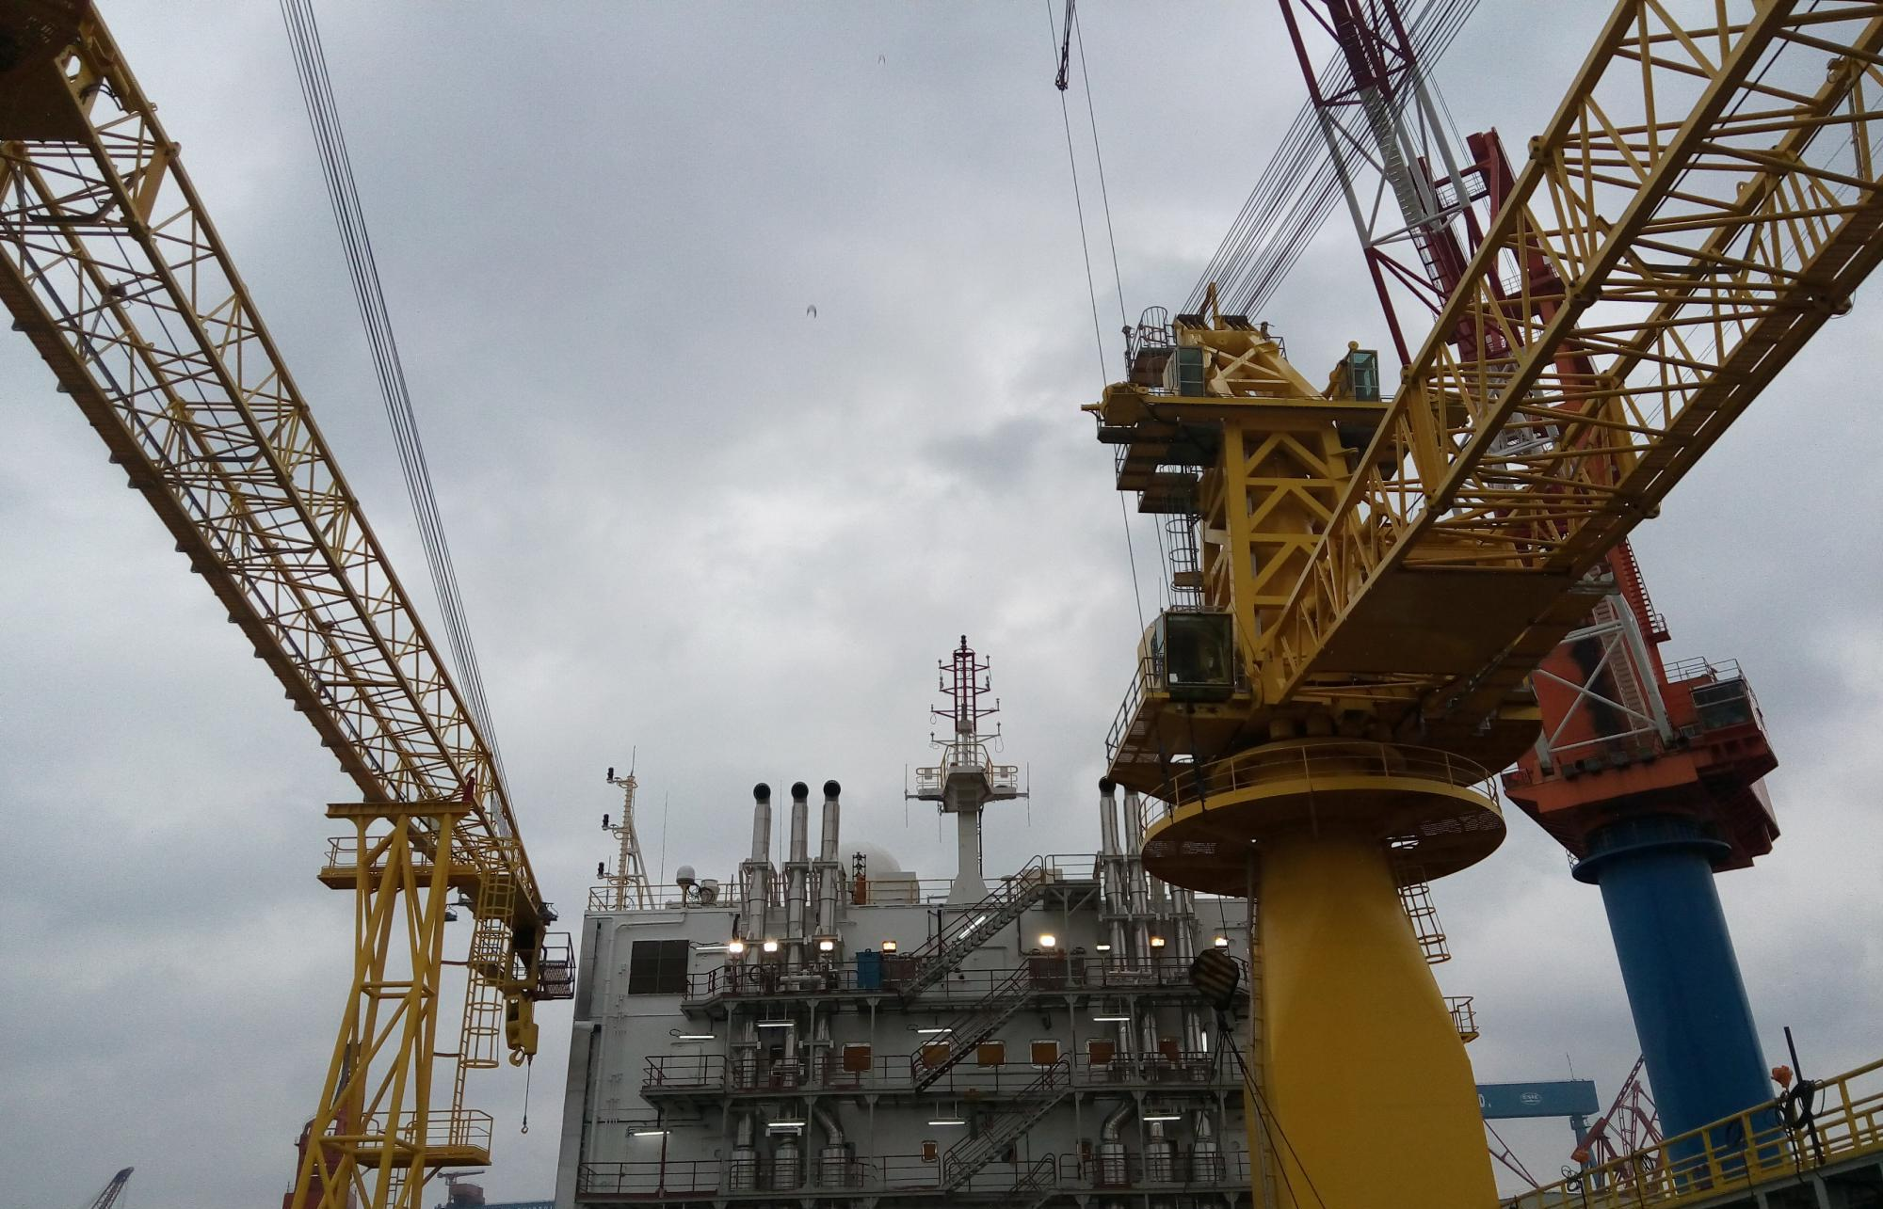
Heavy Tender Barge
HTB-1

Slide 2
Contents
1. Technical Specification
2. Completion Status
3. Property Right Status
4. Maintenance Condition
5. Current Situation

Slide 3
1. Technical Specification

Slide 4
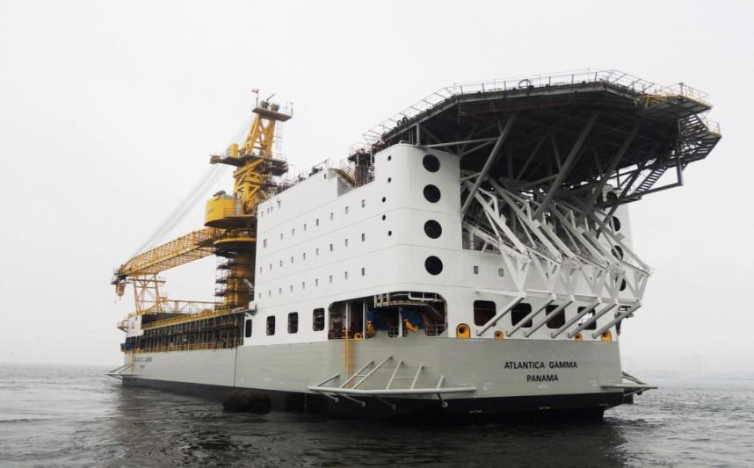
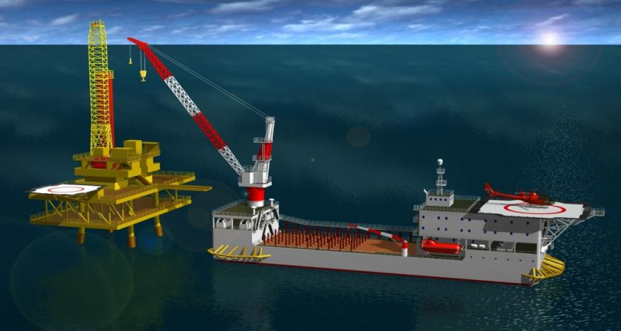
1.1 Technical Specification - Overview
The tender drilling barge is designed for efficient and safe drilling and work-over operations using a Mast Equipment Package (MEP) set upon fixed installations in water depths between 10 and 120 meter in primarily benign environments, such as those West of Africa and in South East Asia but shall be designed for unrestricted service.
The Vessel will transport, erect onto a fixed platform installation a MEP structure for use during drilling and work-over operations. The Vessel will have required facilities installed to provide the MEP with services such as electrical power, drilling mud, cement, compressed air, water, etc. in order to fulfill operations described in this specification.

Slide 5
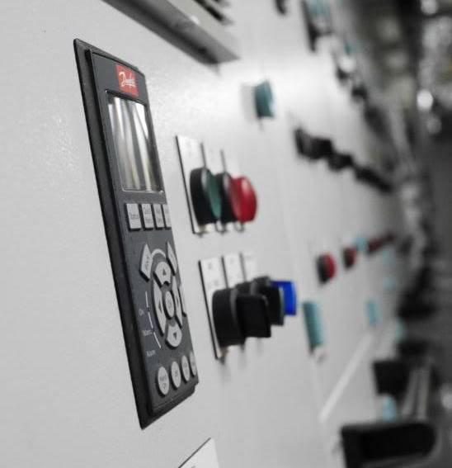
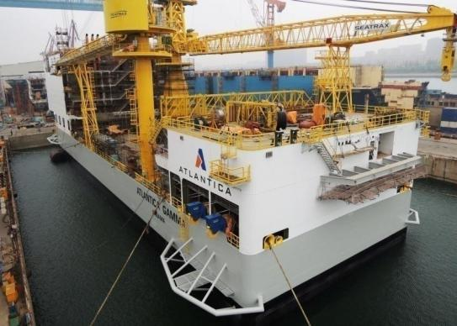
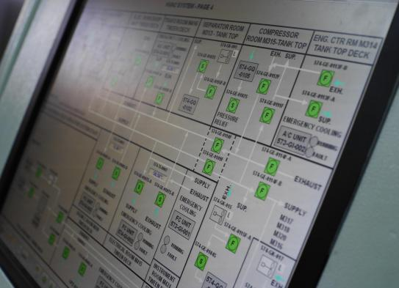
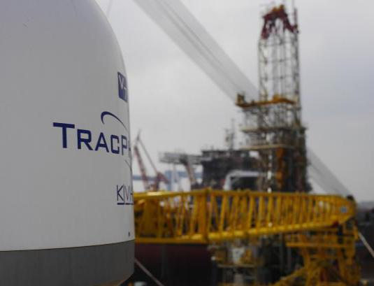
1.1 Technical Specification - Overview
Onboard the Vessel shall be arranged drilling support facilities such as bulk handling, storage and mixing, mud storage in tanks and pits, high pressure mud pump equipment, well cementing capacity, pipe and tubular storage and remote drilling control and monitoring system. Furthermore the Vessel will provide office facilities, accommodation for up to 140 persons, helicopter landing facilities and life boat rescue arrangement.
The Vessel will be moored with the fwd end towards the fixed installation. The Vessel is arranged with the main crane located aft of midship at port side. This will facilitate that the Vessel to be moored alongside the fixed installation (beam or stem heading the prevailing wind direction) during erection of the MEP onto the fixed installation deck. Before commencing the support of the drilling/work-over operations, the Vessel will be repositioned with the fwd end towards the fixed installation.

Slide 6
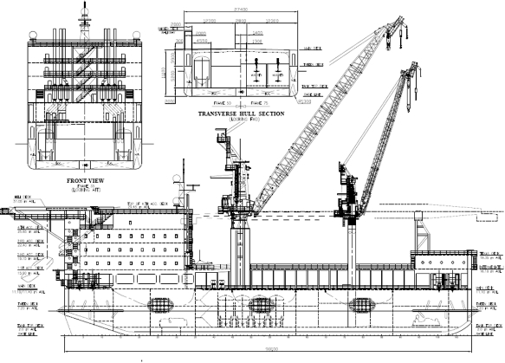
1.1 Technical Specification - Overview

Slide 7
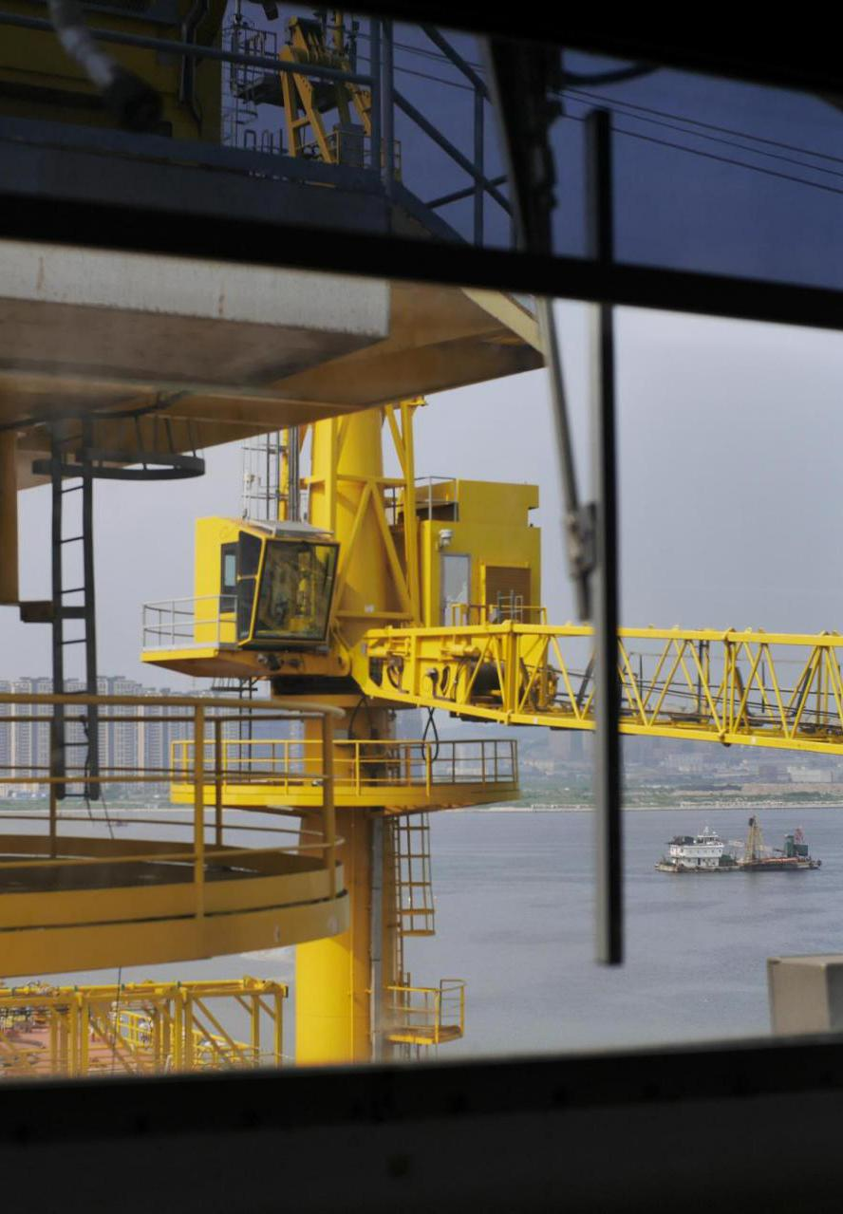
1.1 Technical Specification - Overview
Design: | BassTech A/S. Gothenburg, Sweden
Overall length: | 112.9 m
Overall breadth: | 35.8 m
Depth to main deck: | 11.1 m
Design draught: | 6.3 m
Operating water depth: | 10m~120m
Main deck area: | Pipe rack area 890 m2 Main deck general lay-down area 150 m2 Texas deck lay-down area 310 m2 Sack storage area 300 m2
Total Payload: | 6,000 mt at Design Draft (full load draft)
Classification: | ABS +A1, Barge, Drilling Tender, Circle P
Flag: | Panama
Hull: | Double Bottom & Side
Full load disp: | 15,880 MT
Quarters capacity | 140 Person,10 in 1 Bed Cabin,130 in 2 Bed Cabins
Helideck: | Max loads:12.8t
Mooring winches: | Four (4) Oil States DMW-250-108 , 300 HP (224kW)
Anchors: | 8 x 6 ton Stevepris MK6

Slide 8
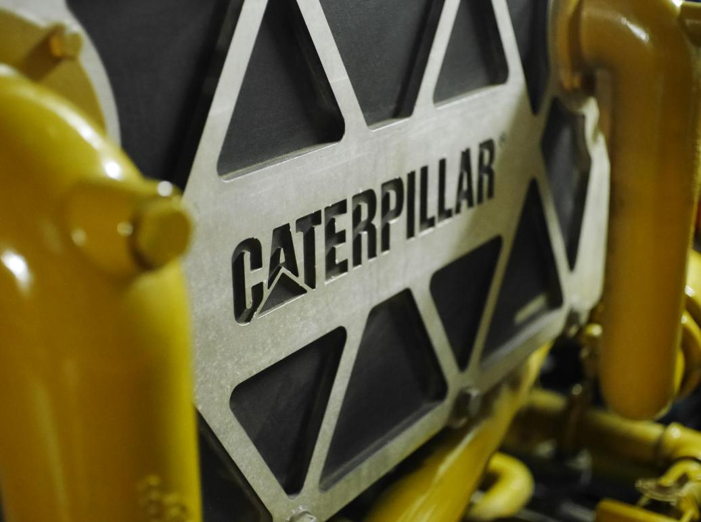
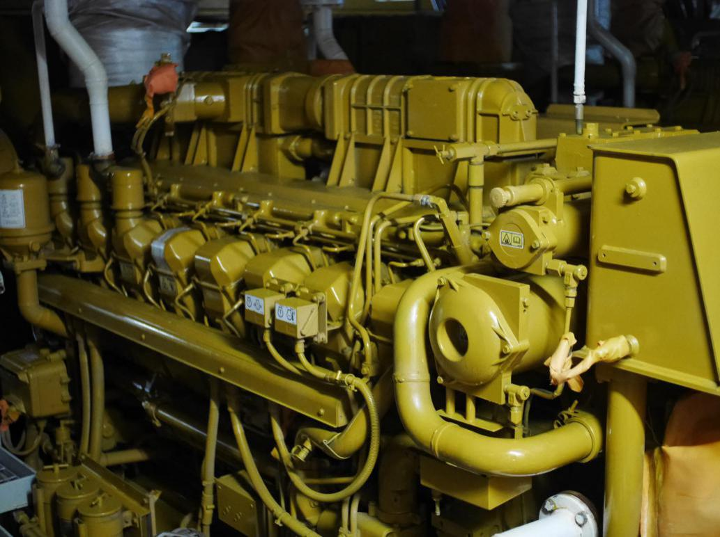
1.2 Technical Specification - Power System
Main engines: | 6 x Caterpillar 3516CHD 1603 Bkw
Main generator: | 6 x ABB AMG 0500LM06 LAP ,60Hz, 690v
Standby（Emergency） engine: | 1 x Caterpillar C32 994 Bkw
Standby（Emergency） generator: | 1 x ABB 60Hz, 480v

Slide 9
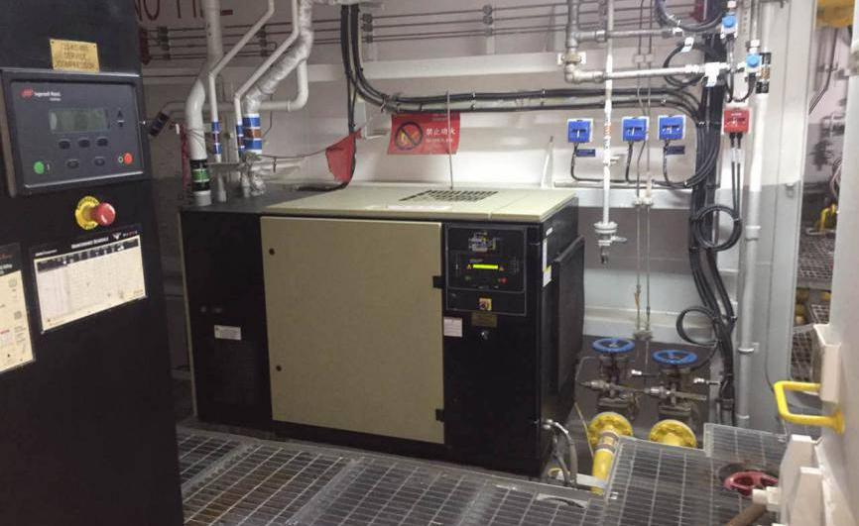
1.3 Technical Specification - Air Supply System
Air compressors | One VFD controlled service air compressor, Water cooled, screw type, oil injected, 400m³/h, 8.6Bar One Air cooled, screw type, including dryer harbor air compressor 100m³/h, 8.6Bar Two (One on/off and one VFD controlled) Water cooled, screw type, oil injected bulk air compressors, 3350m³/h, 11.5Bar Vendor by Ingersoll Rand
Air receivers | Three start air receivers each for 3.0m³,8.6 Bar Two bulk air receivers each for 3.0m³,11.5Bar One service air receiver each for 3.0m³, 8.6Bar

Slide 10
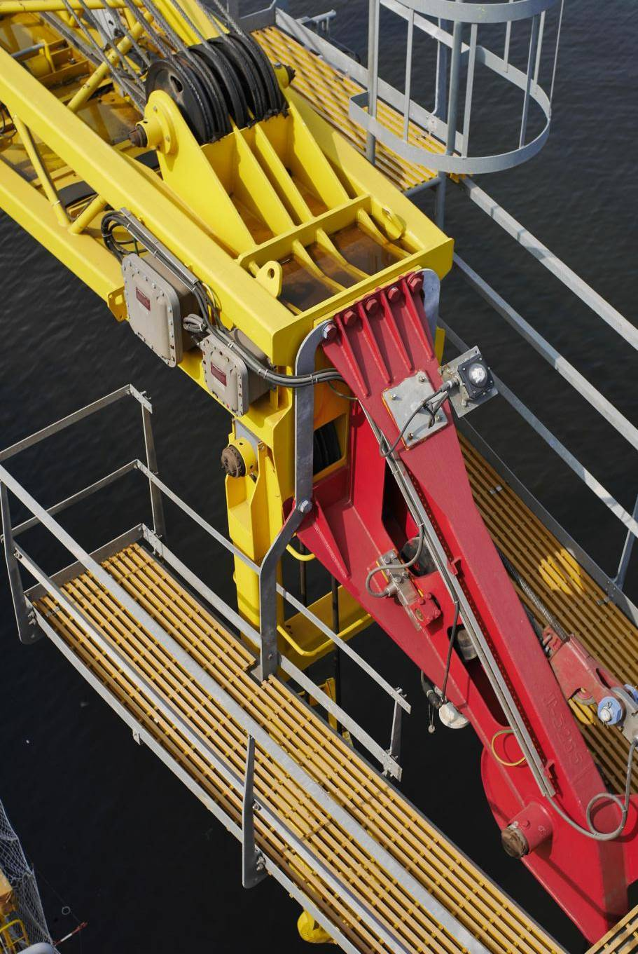
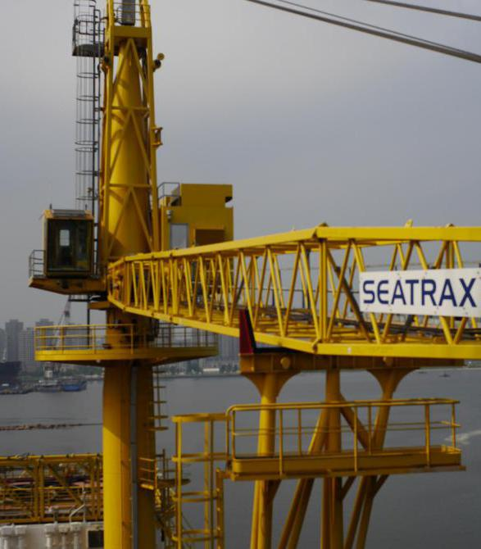
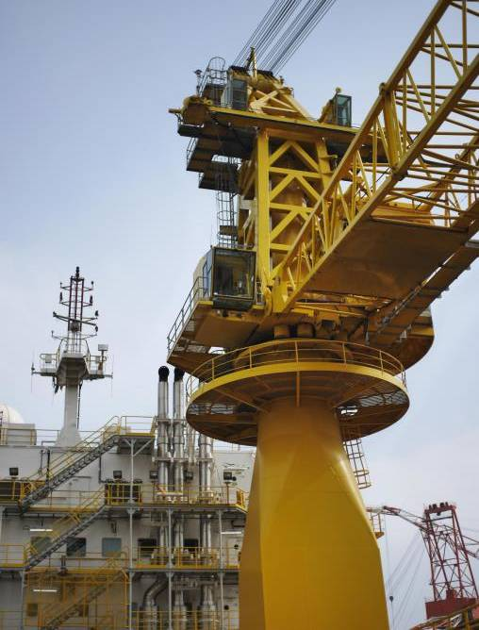
1.4 Technical Specification - Cranes & PAR etc
Main crane: | Seatrax S126 Port Mid Aft
Capacity: | 178 MT
Aux crane: | Seatrax S92 Starboard Mid Ship
Capacity: | 36 MT
Platform access: | Forum personnel access ramp
Tubular handling: | Highline Transfer System 3.3MT

Slide 11
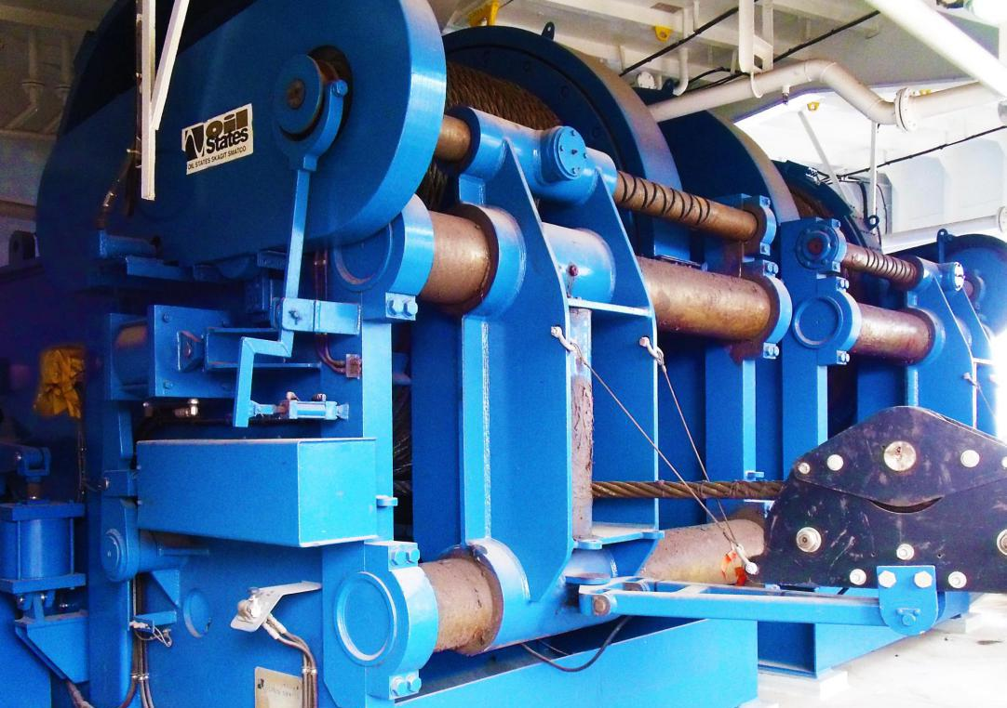
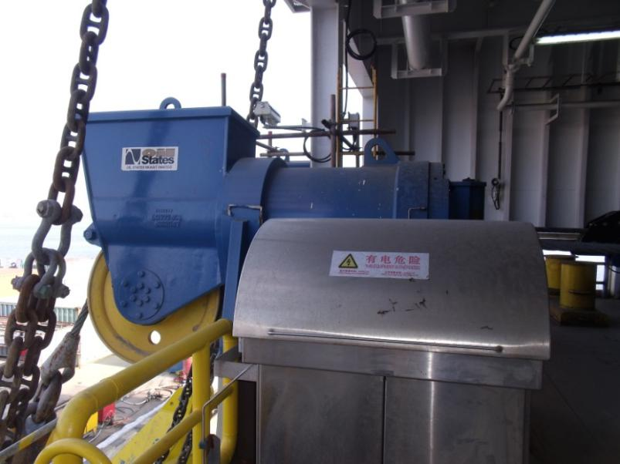
1.5 Technical Specification - Mooring Winches & Control System
The 8-Point Mooring System consists of the total system that is employed to position and hold the vessel on location while in operation. Generally, the system comprised of anchors, mooring lines, winches, sheaves, fairleads, pendant lines, buoys, shackles and other connecting equipment.
The mooring system is designed for water depth rating: Maximum: 200m (656feet). Note: 1,000m or 3280 feet with pre-laid mooring Minimum: 20m(65 feet)
Mooring winch: Four (4) Oil States DMW-250-108 , 300 HP (224kW)

Slide 12
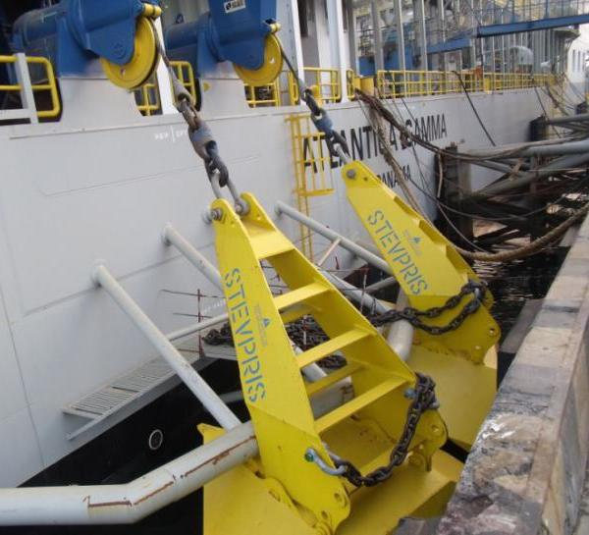
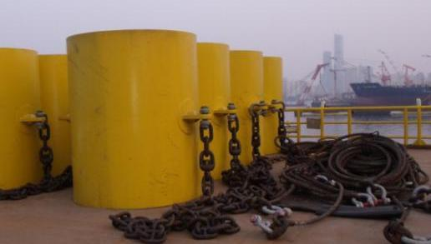
1.6 Technical Specification - Anchors & Pendant Bouys & Lines
Anchor | 8×6 t (VRYHOF MK6)
Anchor wire | 8 each, 2-1/2" (64mm) diameter x 4,593 feet(1,400m) long, 6 x 49 SW IWRC with min brk strength 3629kn, compacted strands drawn galvanized steel wire ropes insert zinc anode and both ends fitted with „sea-fit closed socket ABS certification
Anchor buoys | 8 each, Steel Anchor Buoy, with crucifix at the top and padeye at the bottom c/w high visibility coating, reflective tapes, numbered and identification marking. The bottom padeye is designed to fit SWL 55 Ton 'crosby' shackle
Pennat wires | Eight anchor pennants connected to the anchors back pad-eye for deployment and retrieval of the anchors shall be supplied. The pennants shall be usable for water depths up to 120 m.

Slide 13
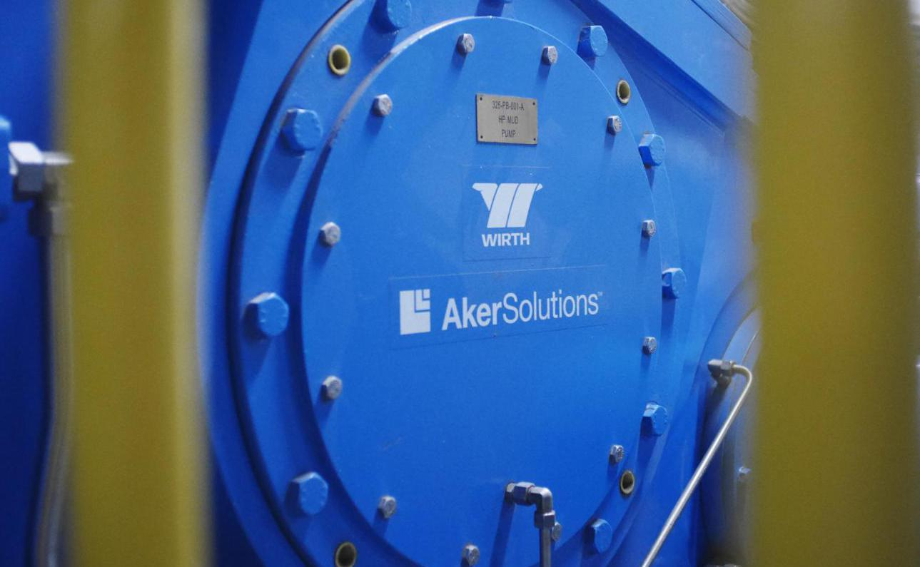
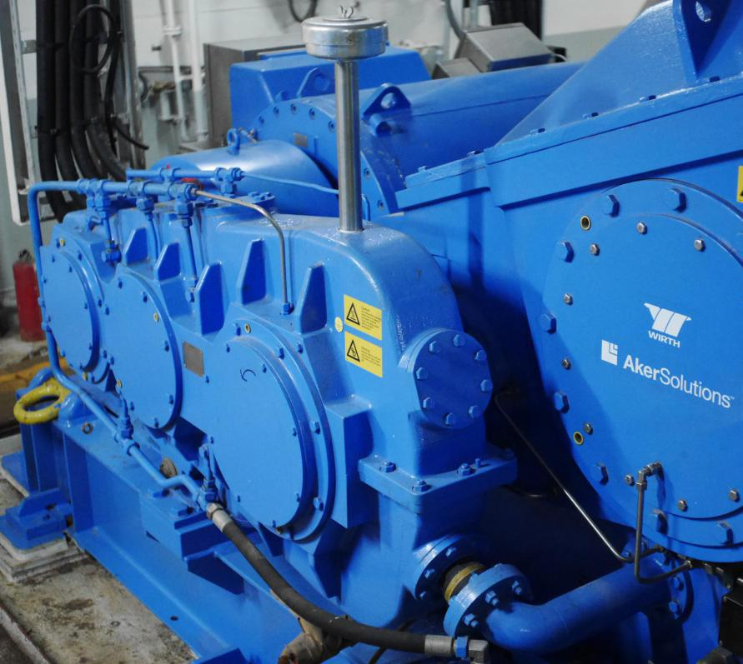
1.7 Technical Specification - Mud System
Mud pumps: | 3 x Aker Wirth TPK 1,600 AC-RG-WJ 7500psi
Shale shakers: | 3 x MI Swaco MD 3
Mud cleaner: | MI Swaco D3 HYDROCYCLONES
Degasser: | MI Swaco CD-1400 D-GASSER

Slide 14
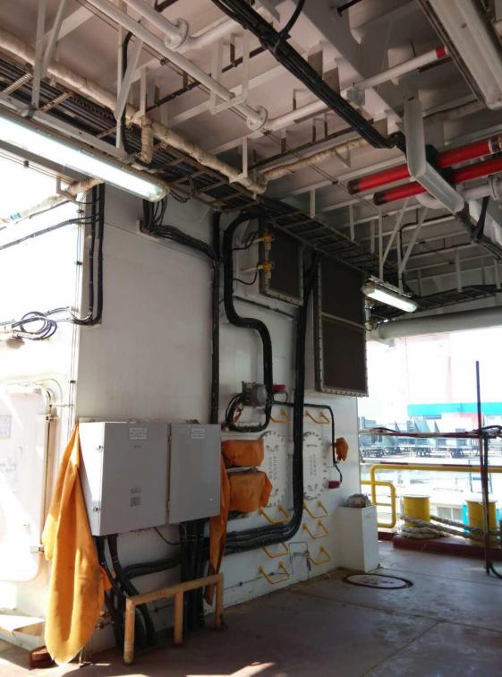
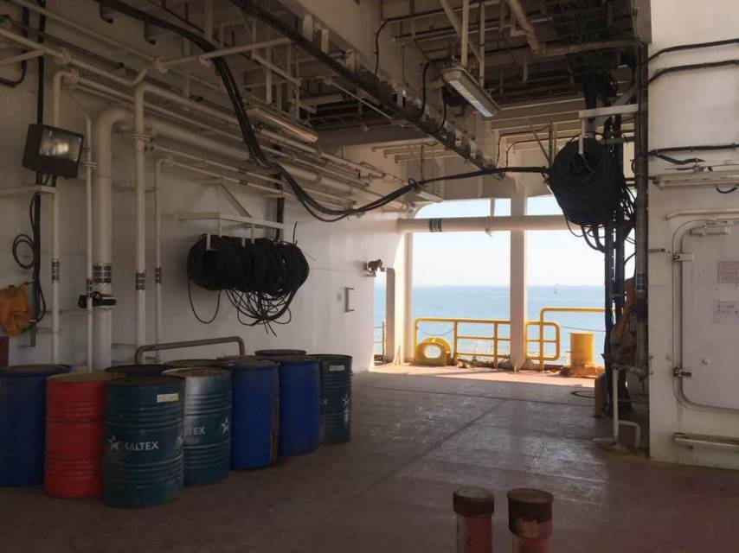
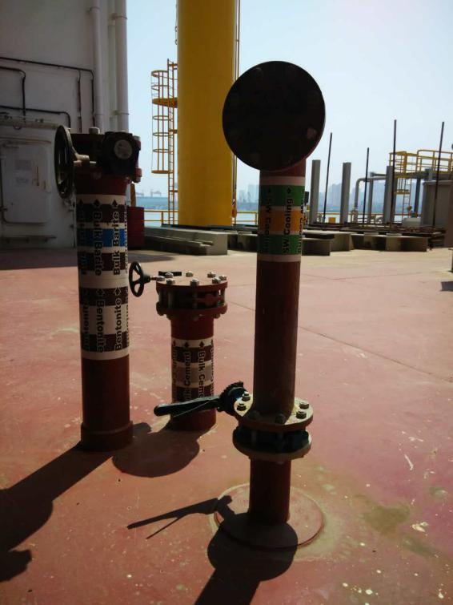
1.8 Technical Specification - Cement Unit System (on barge)
Vendor: | OCFE
Working pressure: | The cementing unit and support systems were located in the forecastle. Two 3” ID x 10,000 psi cement lines were routed to the MEP hose transfer station.

Slide 15
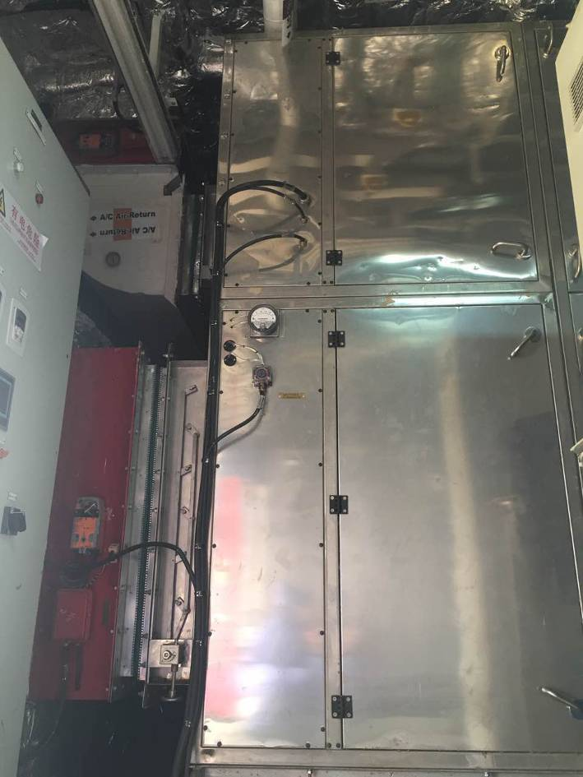
1.9 Technical Specification - HVAC System
Chiller units | 3 PCS YORK/CSH9573-240Y fresh water cooled Chillers at 3x50% configuration. Each cooling capacity 700kW,
Chilled water circulation pumps | 2 PCS chilled water circulation pumps, GRUNDFOS TP 125-430/4
Air handling units for accommodation area | 2 PCS YORK/MAHK2630 AIR HANDLING UNITS serve for Accommodation area. Two units are at 2x50% configuration. Supply: 27,700 m3/h Cooling Load: 250 kW Heating Load: 53 kW
Air handling unit for galley | 1 PCS YORK/MAHK1409 AIR HANDLING UNIT serves for GALLEY Supply: 5,350 m3/h Cooling Load: 119 kW Heating Load: 30 kW
Air handling unit for AFT utility area | 1 PCS YORK/MAHK2031 AIR HANDLING UNIT serves for AFT Utility area Supply: 23000 m3/h
Air handling unit for FWD utility area | 1 PCS YORK/MAHK1409 AIR HANDLING UNIT serves for AFT Utility area Supply: 7600 m3/h

Slide 16
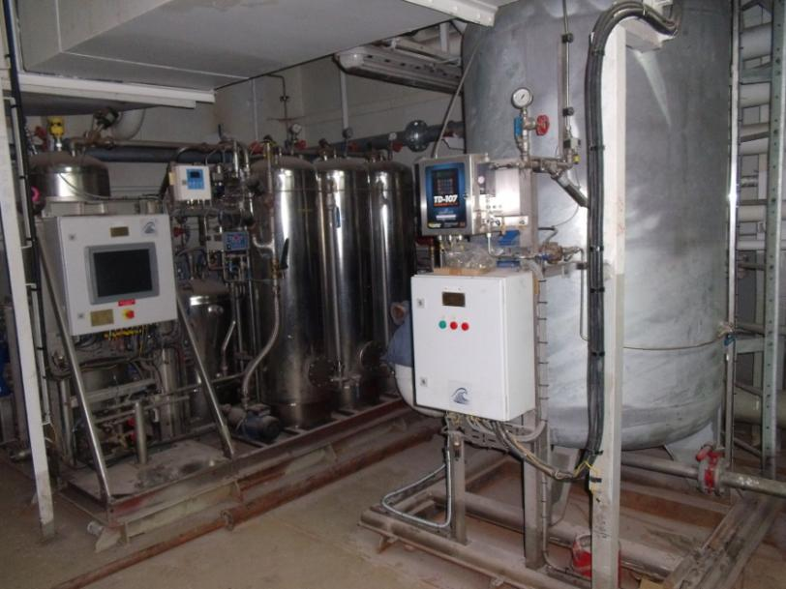
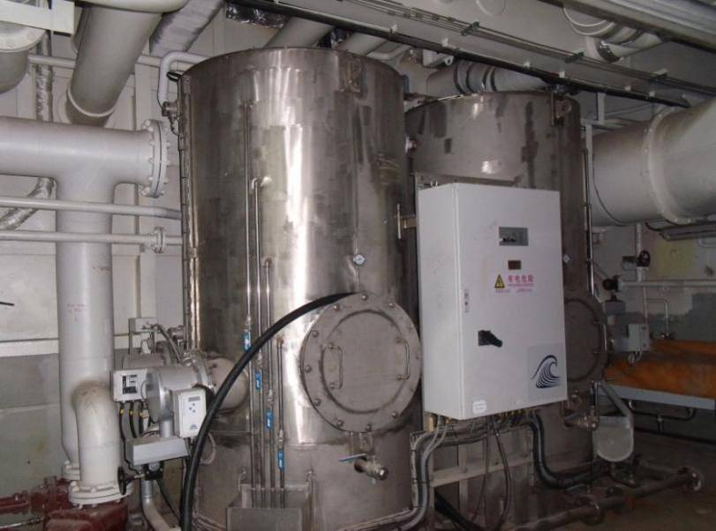
1.10 Technical Specification - Pollution Control
Non hazardous contaminated drain system | Vendor: Marinfloc, Sweden The contaminated drain system is to collect clean drains that can be monitored to discharge overboard, also can be treated the non-hazardous drain to meet that required purification by related rules then discharge to sea. Drain Separator: 1 set 5m3/h Settling Tanks: 2 sets 3m3 Sampling Tank Unit: 1 set 2m3 Control Discharge Unit: 1 set 15m3/h
Hazardous contaminated drain system | Vendor: Marinfloc, Sweden Contaminated drain from drill area (hazardous areas) include solids and will be separated by the decanter. The Liquid will be returned to the hazardous drain tank and be degassed then to be transferred to non-hazardous contaminated drain system to treat. Decanter: 1 set 5m3/h Degasser: 1 set 6m3/h
Bilge water system | Drains form other machinery spaces will be collected and treated by bilge water system.
Ballast water treatment sys. | Vendor: Optimarine, Norway Type: Filter + UV

Slide 17
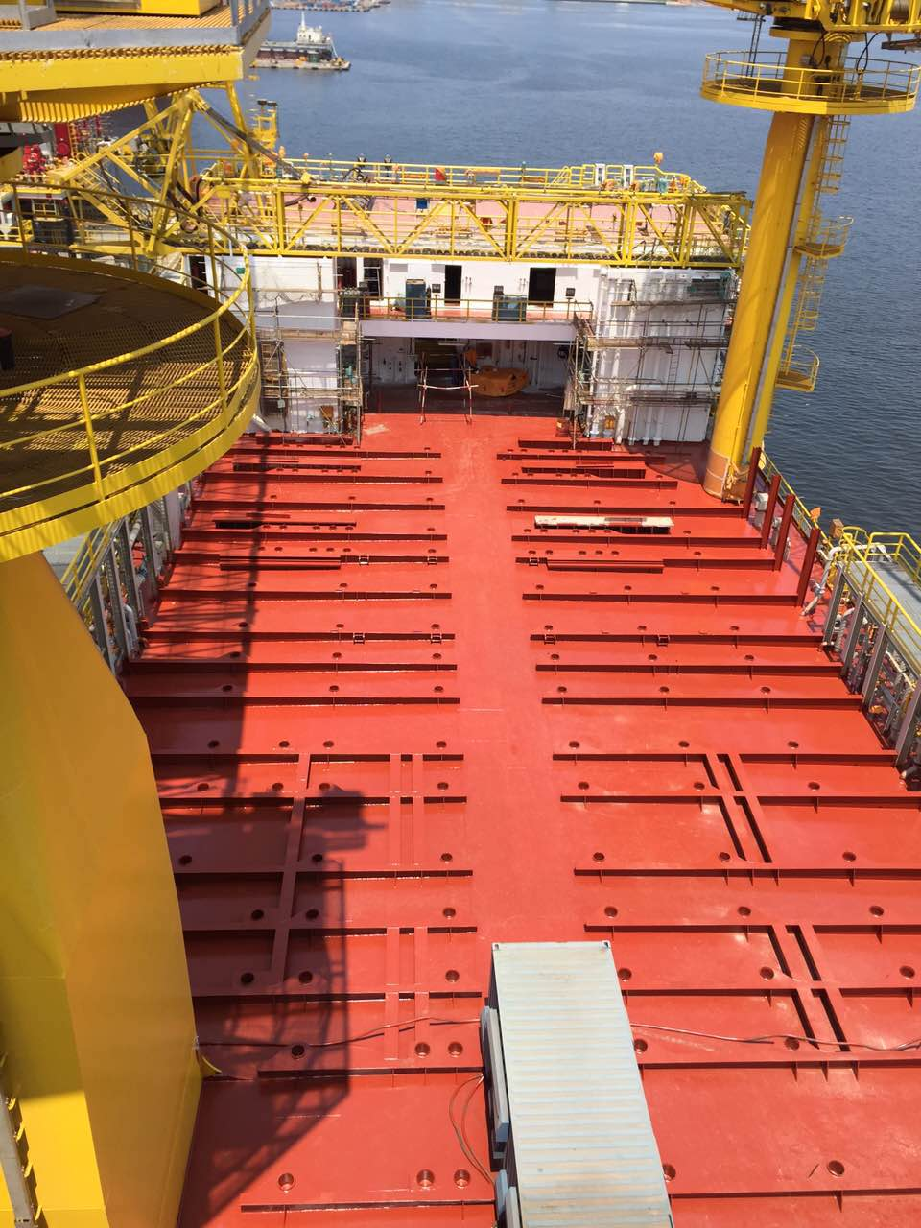
1.11 Technical Specification - Storage Capacity
Liquid mud system: | 7,890 bbls on Barge
Brine: | 4,190 bbls
Base oil: | 2,560 bbls
Drill water: | 8,950 bbls
Potable water: | 4,500 bbls
Diesel fuel: | 4,120 bbls
Bulk volume: | 4 x 8,000 cu ft
Sack storage: | 3,400 sacks

Slide 18
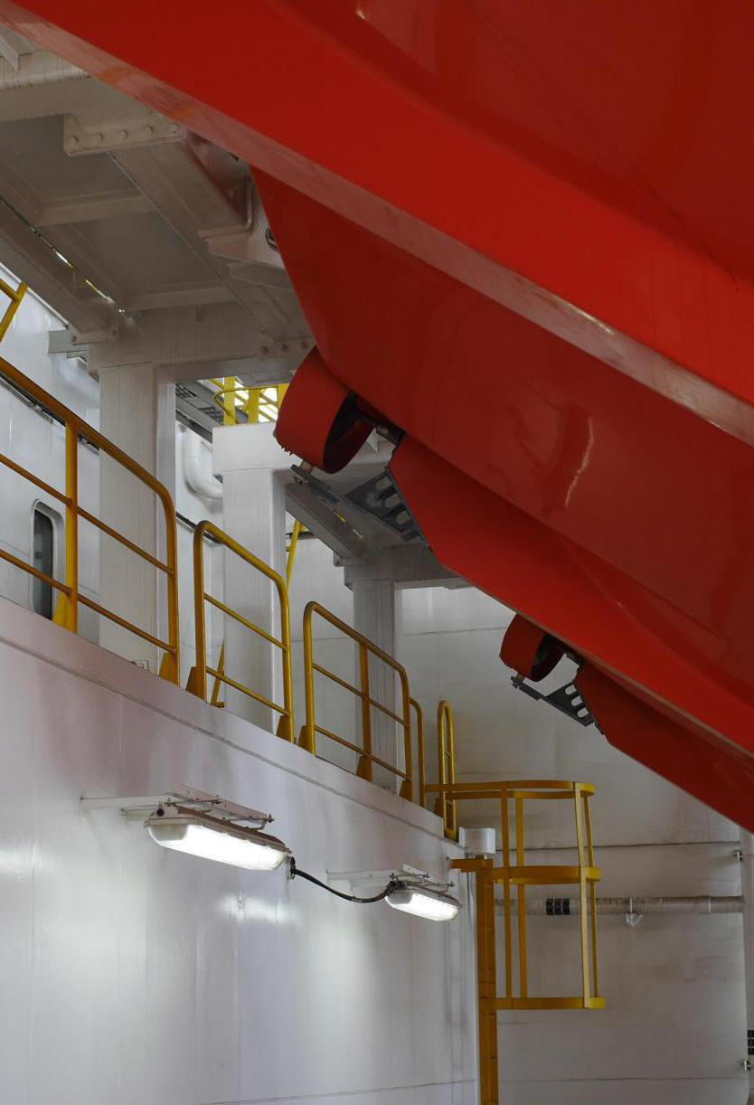
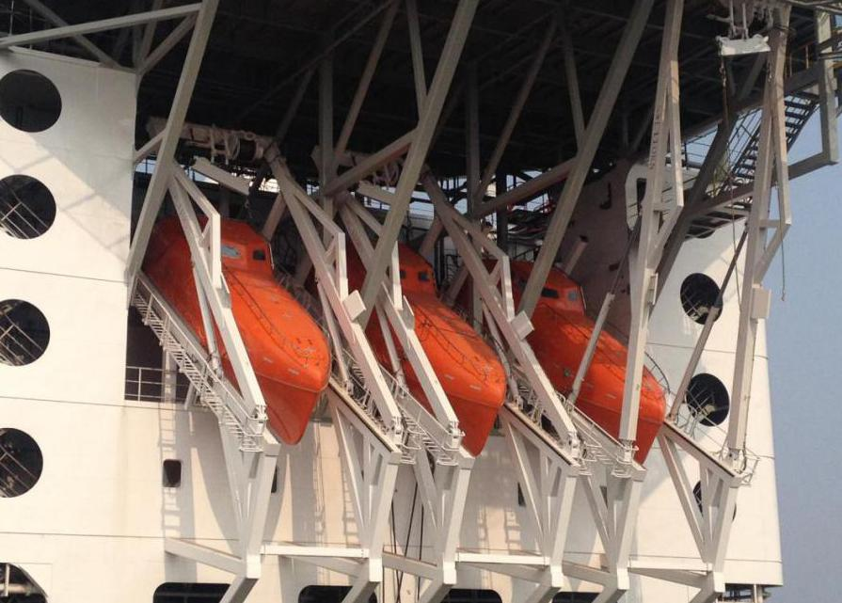
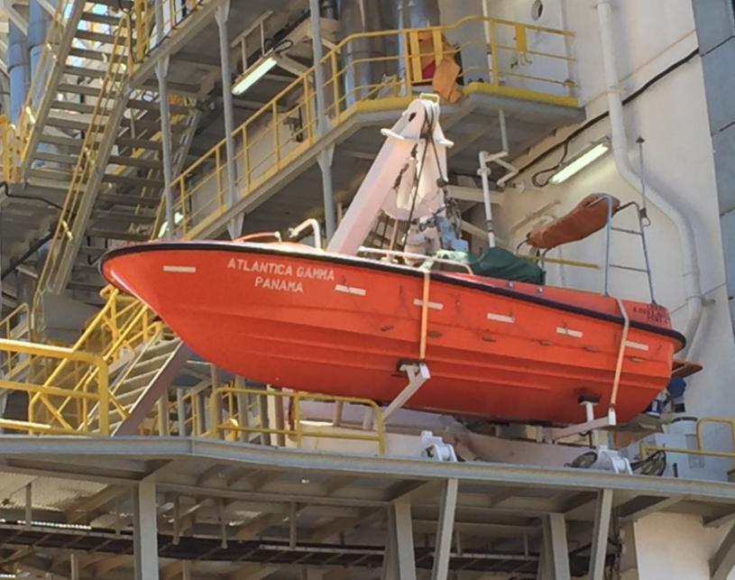
1.12 Technical Specification - Safety & Life Saving
Life saving primary: | 3 x 50 man freefall Launch Life Boats
Life saving secondary: | 8 x 35 man Inflatable Life Rafts
Life saving secondary: | 1 x 6 man Fast Rescue boat
Fire & gas detection: | In accordance w/ABS class
Fire suppression: | In accordance w/ABS class
Medical clinic: | Furnished for 140 POB

Slide 19
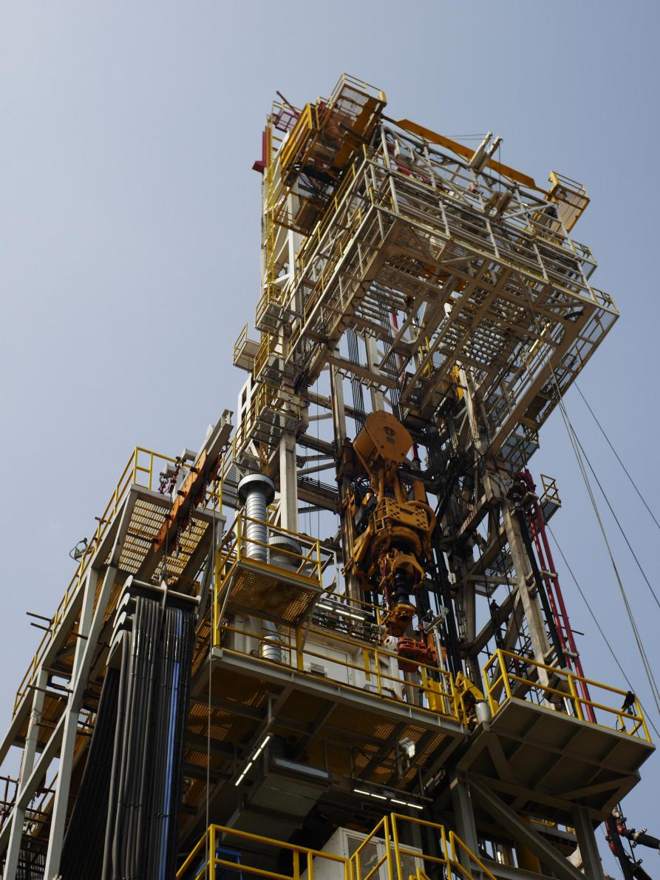
1.13 Technical Specification - Drilling Equipment
Mast rating: | 454MT (1,000 kip) Hook Load
Mast capacity: | 340 stands of 5-7/8” drill pipe (incl. HWDP) + 10 stands of 8-1/4” drill collars, (or) 170 stands of 5-7/8” drill pipe + (incl. HWDP) +10 stands 8-1/4” drill collars + 90 stands 9-5/8” casing
Mast make: | Loadmaster, Self Erecting
Mast height: | 152 ft+/-2 ft Clear Height
Substructure: | Woolslayer Box-on_box type
Substructure capacity: | 460MT （1,015 kip） setback
Skidding system: | Lift & Roll Systems, X-Y
Drawworks: | LDW 1,000k 2 x1500 hp, AC
Rotary table: | Cameron LH375
Top drive: | NOV TDS-8SA 750 mt
Top drive rating: | 62,250 ft lbs continuous
Traveling block: | Cameron TB500, 6X60”Sheave
Drillers cabin: | Enclosed, Climate Controlled
Power slips: | B & V PS500 Slips f/ DP & CSG
Casing stabbing: | OTG CSA

Slide 20
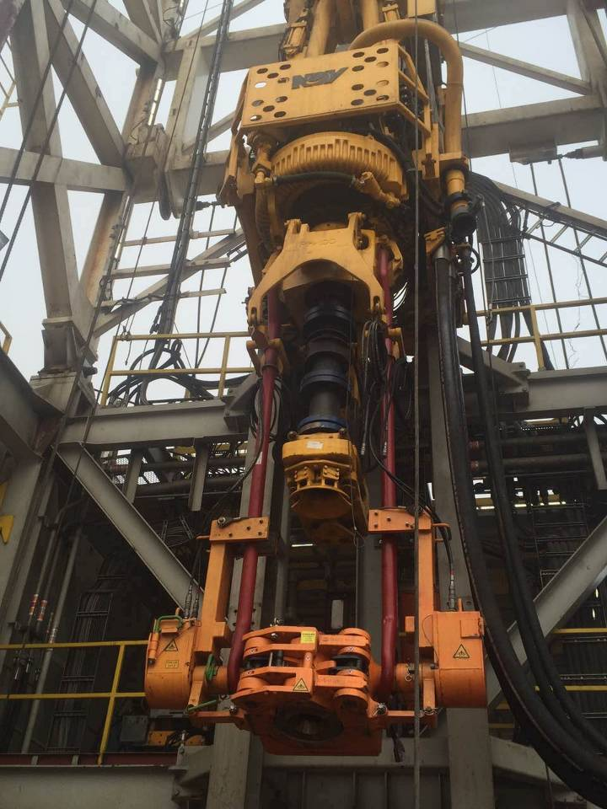
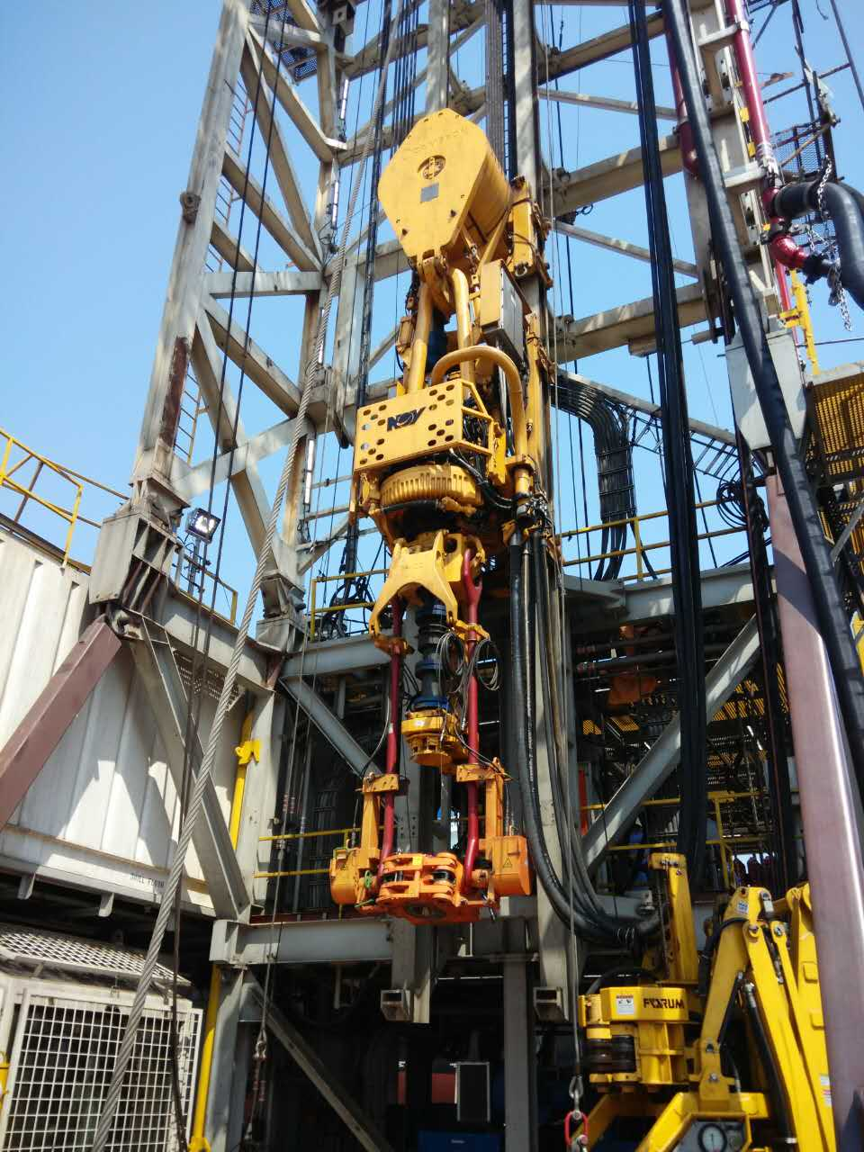
1.14 Technical Specification - Top Drive
Vender: | National Oil Varco
Type: | TDS-8SA

Slide 21
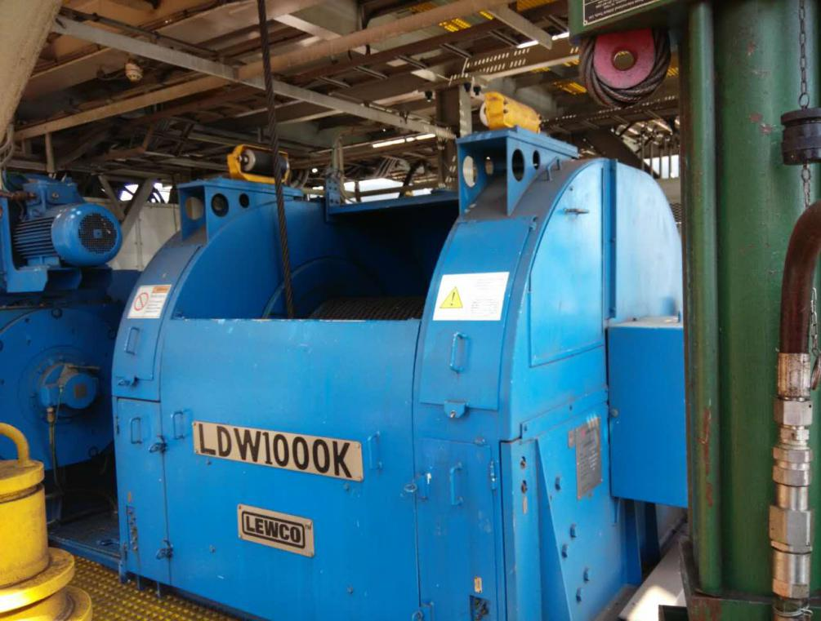
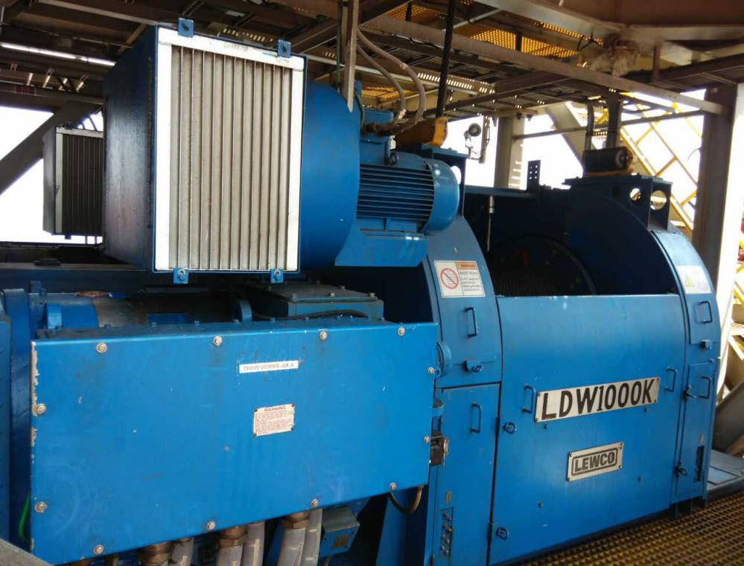
1.15 Technical Specification - Drawworks
Vender: | Cameron, USA
Type: | LDW1000K

Slide 22
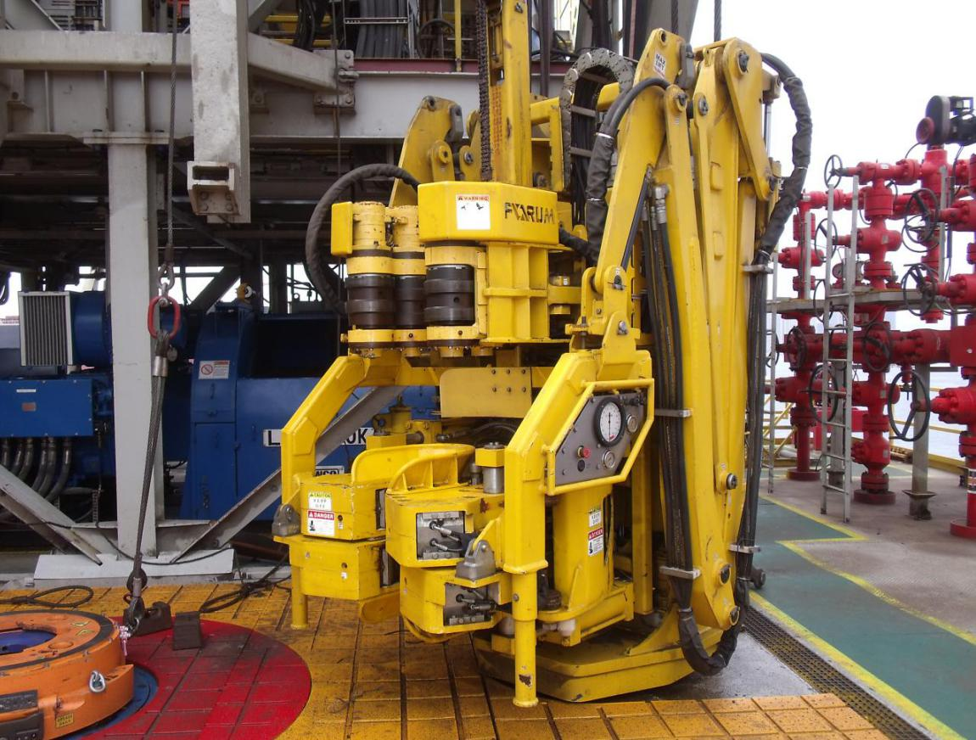
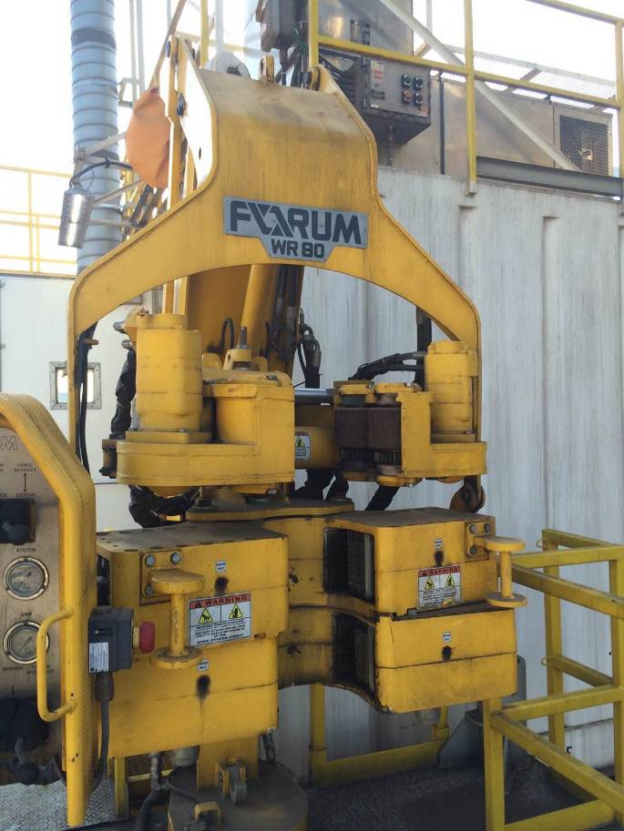
1.16 Technical Specification - Roughneck
Vender: | Forum, USA
Type: | WR-120&WR-80

Slide 23
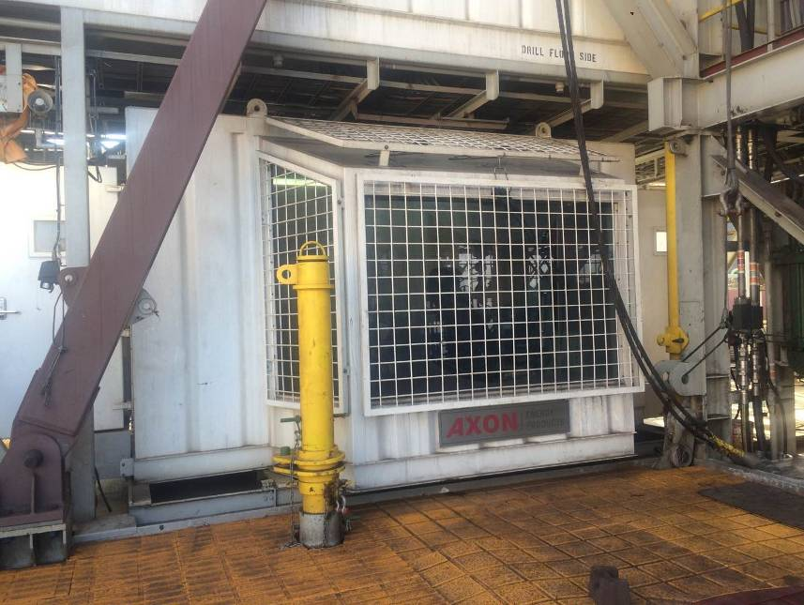
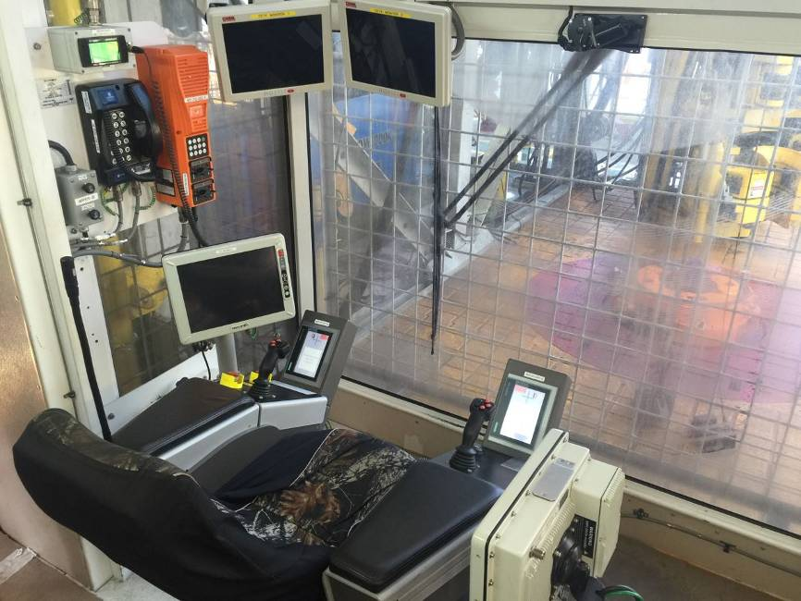
1.17 Technical Specification - Driller’s Cabin
Vender:

Slide 24
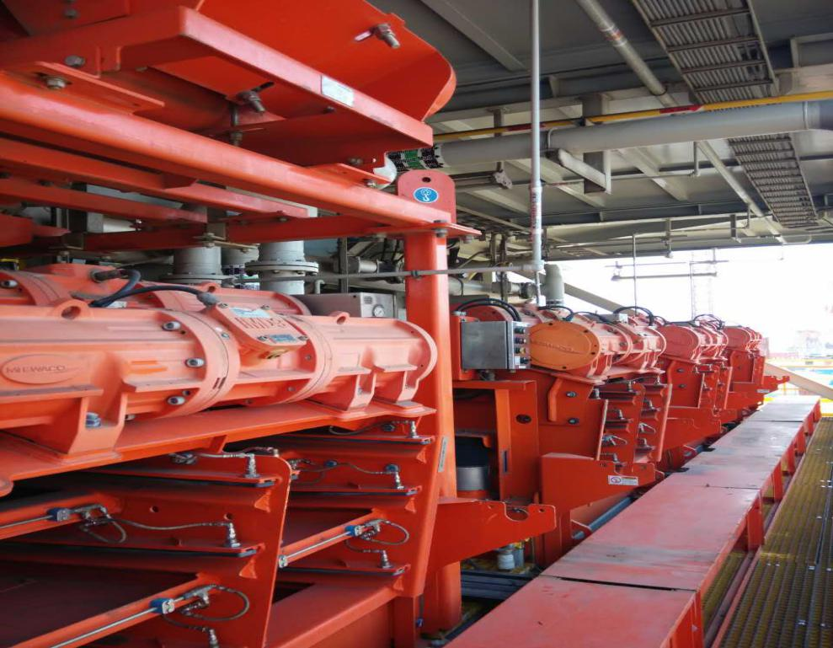
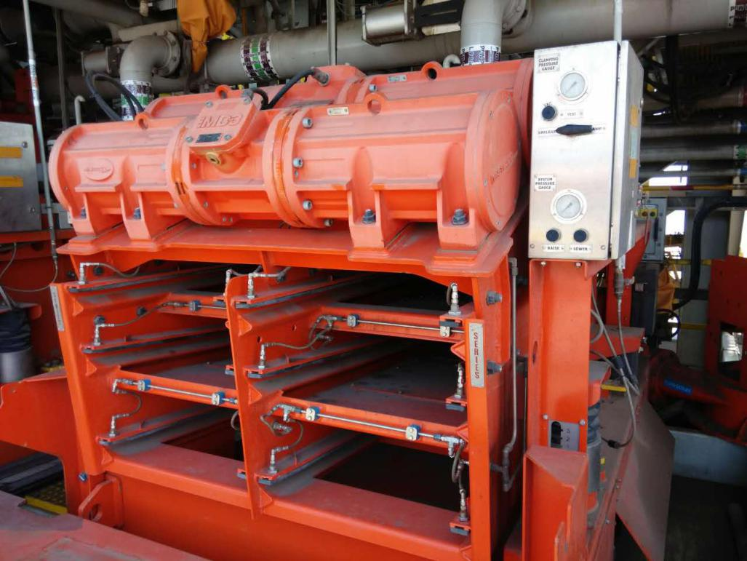
1.18 Technical Specification - Shale Shaker & Mud Cleaner
Vender: | MI-Swaco, USA
Type: | MD-3

Slide 25
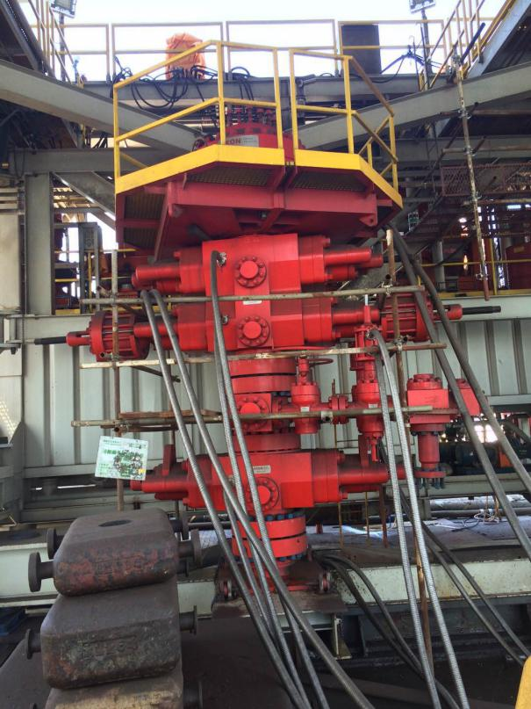
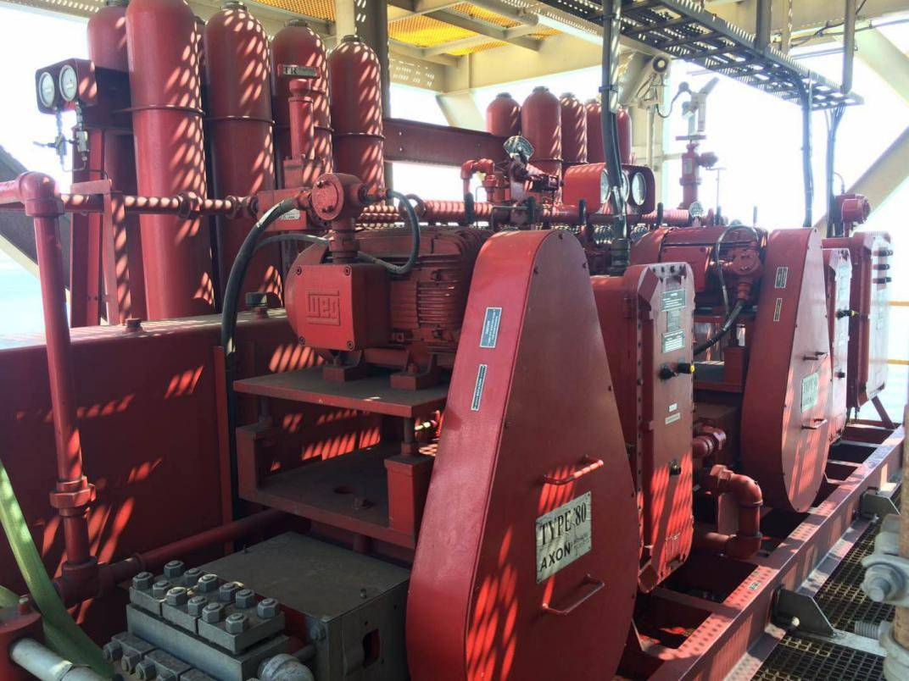
1.19 Technical Specification - BOP Equipment
Diverter assy: | Axon Pressure Product/Type 52 BOP, USA
BOP handling: | Ingersoll Rand/BHS 80 (4 x 20t)

Slide 26
2. Completion Status

Slide 27
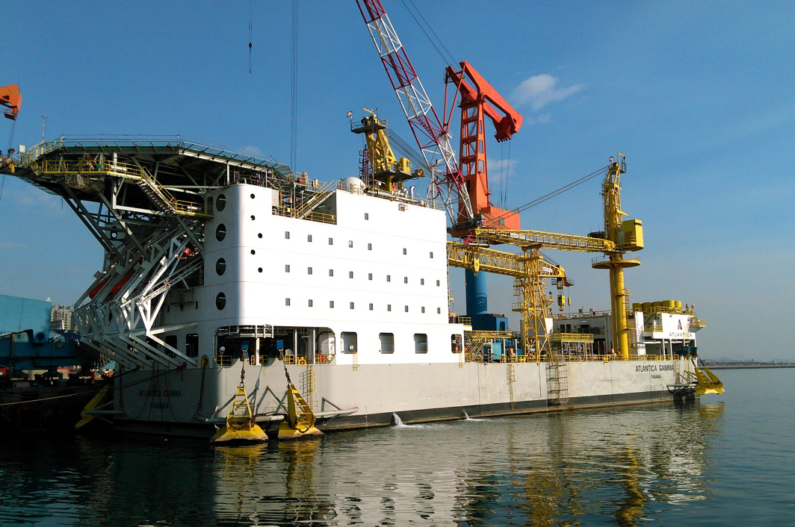
2.1 Completion status - Overview

Slide 28
2.2 Completion status - Statement of survey and certification status

Slide 29
2.2 Completion status - Statement of survey and certification status
“ Upon Completion of the remaining survey work as identified above(on last page) , the following certificates/reports may be issued” – cited from the same letter from ABS Class
Interim Class Certificate Load Line Certificate Survey of Load Lines Form LL-11-D International Tonnage Certificate Panama Tonnage Certificate Suez Cannel Tonnage Certificate Cargo Gear Certificate Register of Lifting Appliances MOU Safety Certificate ABS Record of Approved GMDSS Radio Installation International Oil Pollution Prevention Certificate | Supplement to International Oil Pollution Prevention Certificate, Form A. International Sewage Pollution Prevention Certificate SOF, Prevention of Pollution Prevention Certificate International Air Pollution Prevention Certificate Supplement to International Air Pollution Prevention Certificate SOVC, Ballast Water Management SOF, Verification of Onboard Loading Instrument SOF, CAP437 Exemption Certificate

Slide 30
3. Property Right Status

Slide 31
3.1 Property right status
Background sputes Due to the delay of the delivery of the project, however, the reason for the delay is due to the delay in the delivery of MEP equipment provided by Vendor AXON which is specified by the shipowner , the owner's lease has lapsed, if the owner receives the HTB-1, not only can not bring profits, but also spend large docking and maintenance costs, therefore, the owner has no intention to receive the HTB-1, put forward a large number of punches, and for various reasons to delay the closure of punches, and even proposed to terminate the contract. In early 2016, Seller received the notice "Termination of contract" from shipowner, and several rounds of negotiations were fruitless. In response to the shipowner's breach of contract cancellation, Seller initiated arbitration proceedings. Arbitration result After a long period of effort, on May 22, 2018, the arbitral tribunal made a final arbitration and Seller has won. Shipowner's supplies installed on board are the property of the shipyard; HTB-1 and all equipment and machinery on board shall be at the sole disposal of the Shipyard in accordance with Article 27.9(c) of the construction Contract; Obviously, the property rights of HTB-1 is not disputed and it is fully owned by Seller.

Slide 32
4. Maintenance Condition

Slide 33
4.1 Maintenance condition - Overview
Initial preservation, which including preparation / cleaning / rust /inspect, lubrication /oil, gear boxes, drain & breather, cylinder, motor / pump, valves, drum, air system, control boxes, space heater, cable /gland, battery, insulation, parts protection / seal etc; Daily preservation; Winter anti-freeze preservation.

Slide 34
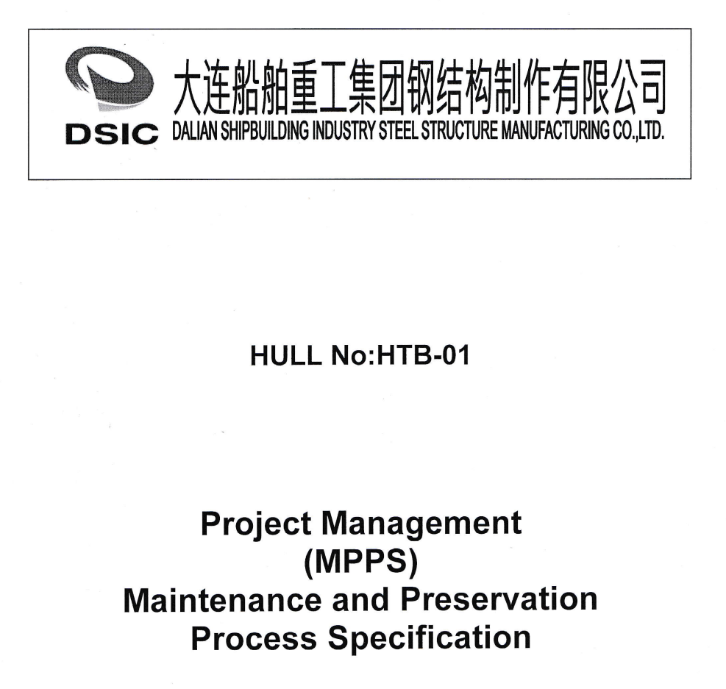
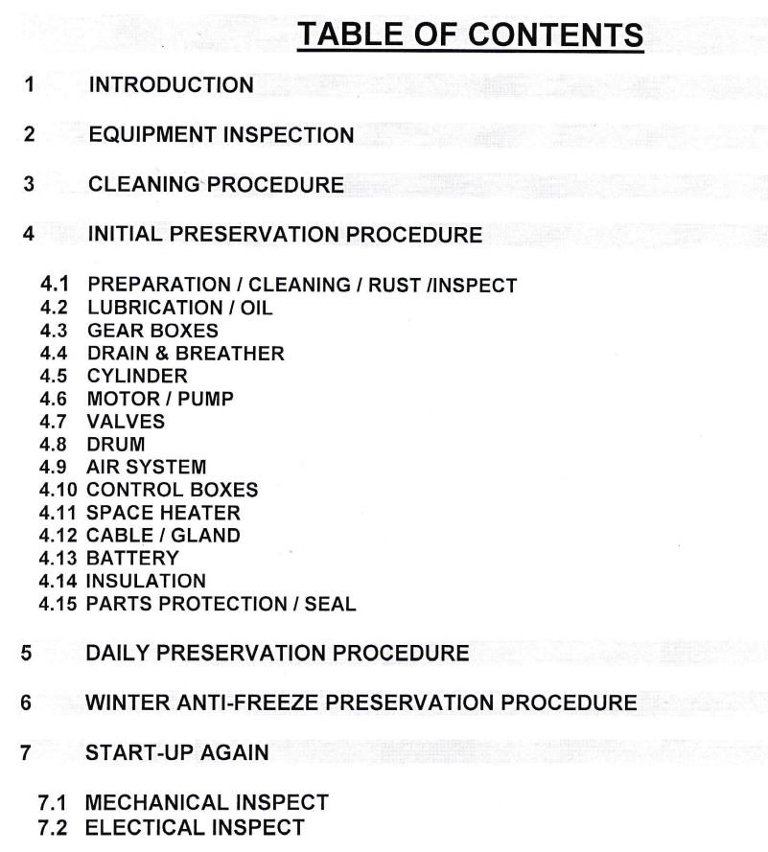
4.2 Maintenance condition - Maintenance team and Specification
Scope of Maintenance: As shown on the contents, maintenance work include: equipment inspection, cleaning, initial preservation, daily preservation, winter anti-freeze preservation, start-up again.

Slide 35
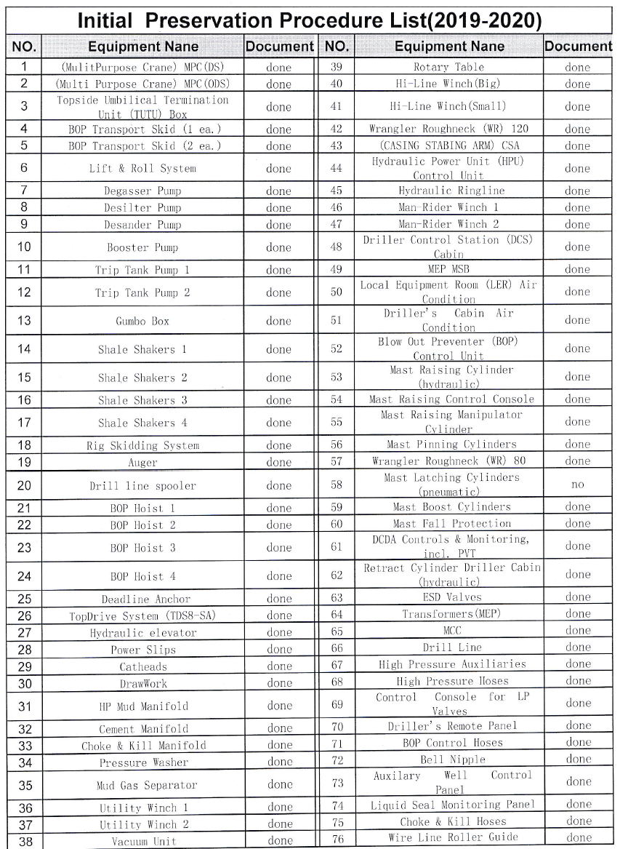
4.3 Maintenance condition - Initial Preservation
Preparation/Cleaning/Rusting/Inspection Lubrication/Oil Gear Boxes Drains & Breather Cylinder Motor/Pump Valves Drum Air System Control Boxes Space Heater Cable/Gland Battery Insulation Parts Protecion/Seal

Slide 36
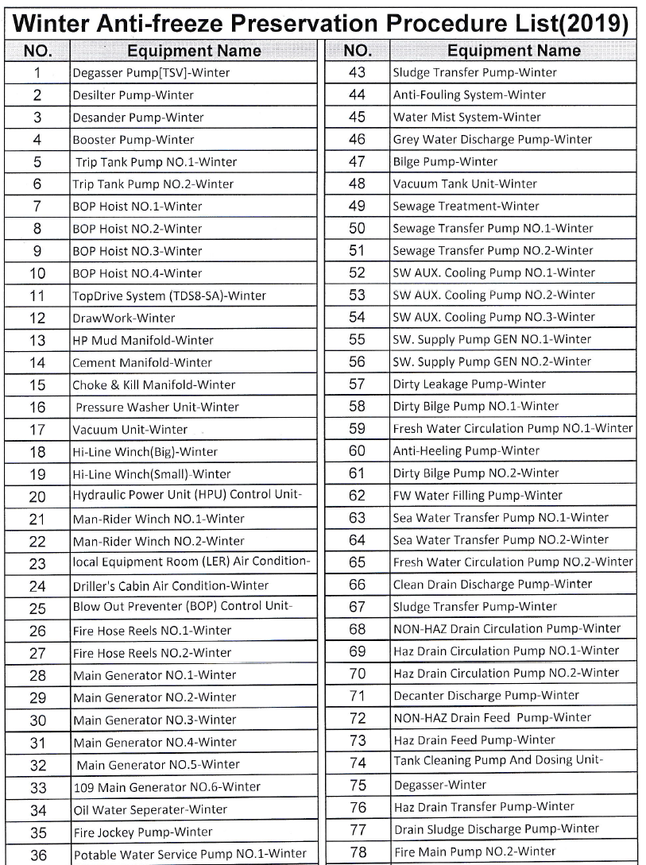
4.4 Maintenance condition - Winter Anti-Freeze Preservation
Winter preservation of water lines should be performed, water to be drained completely from plate coolers, pumps, recirculating cooling system, washer, valve bodies, piping system completely. Drain existing air from air filters resevoir and filters Drain attachent of the equipment tanks, valves, pipe etc. Leave valves/plugs in open position to allow condensation to drain from system If the equipment will be exposed for temperature below 0℃ by flushing with suitable water/glycol mixture or anti freeze. Motor heaters/space heaters energized in electrical motors, to prevent condensation from freezing inside electrical motor windings. If extra large system or equipment, it is supply the air heater or heater cable on machine surface, keep up the temperture over 0 ℃ in the room.

Slide 37
5. Current Situation

Slide 38
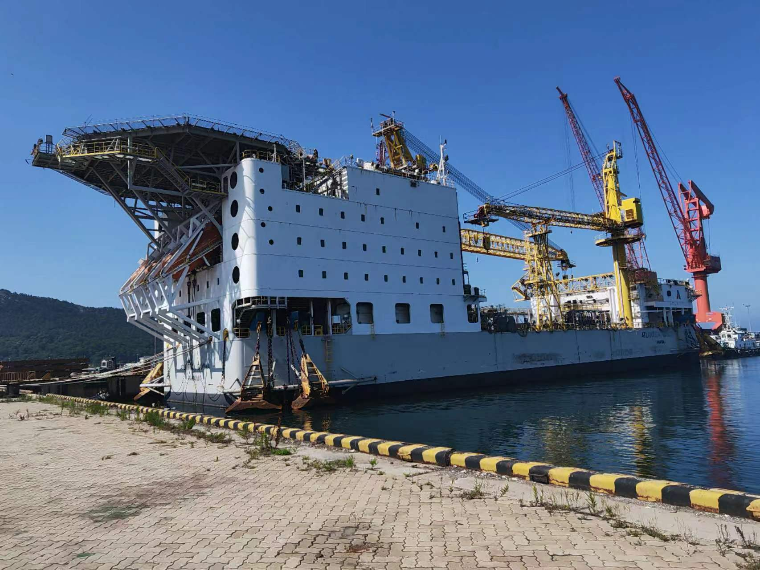

5.1 Current situation
We warmly welcome buyers interested in this project to come to Seller’s shipyard to have a visit on HTB-1. Inspection requires LOI , POF, 5% deposit into escrow 100% refundable if not as presented/ We must accompany any inspection this requires $10,000 travel expenses

Slide 39



5.1 Current situation

